Slide 1
Introduction to Advertising Assignment 1 (Individual): News of the Week By Patrick Obispo

Slide 2
“John Lewis Christmas advert breaks records after premiere weekend”
http://www.youtube.com/watch?v=XqWig2WARb0

Slide 3
The advertisement is an animated tale which was inspired by Disney.
It has proven to be more successful than the last year’s Christmas ad.
This Christmas Ad has garnered 4.7 million views on You Tube which was a big difference from last year of 3.7 million views since 2012.
The ad also had a massive 86,300 mentions on Twitter in its opening weekend which was an increase of 29% on last year’s advert according to We Are Social.
The other thing is that John Lewis garnered 7,ooo new followers on Twitter and 12,000 new fans on Facebook.
According to Ed Kitchingman, John Lewis should be proud with the response and reactions of the public. The reputation, the marketing and clever use of social media has helped to create hype which in return made the advert a National event.

Slide 4
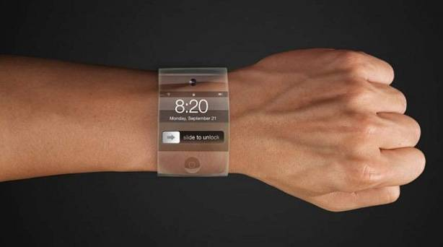
“Apple TV on hold as focus shifts to iWatch”

Slide 5
The Apple TV, which will cost between $1,500 to $2,500, is now being put back its release until 2015 as the company focuses more on the iWatch and other wearable devices. Apple has postponed the release date due to the fact that consumers do not change their television sets often and they want to make sure the Apple TV is beyond expectation. They are also trying to capture its target market. They want to make this particular smart TV to be unique and have contents that no smart TV have such as a la carte pay-tv channel. Therefore Apple is doing something new which is the iWatch. As of this year more than 50 employees are now working on the iWatch and tackling the technical problems that the watch have or will have.

Slide 6
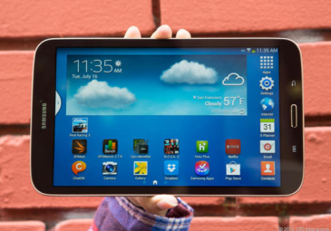
“Samsung takes aim at Apple's tablet top spot”

Slide 7
According to JK Shin, the Samsung head of mobile, they are planning on selling 40 million tablets this year more than what they sold last year. JK Shin said that they are planning on to take Apple’s crown as the top tablet manufacturer in the world. Samsung is planning to be the “most beloved” mobile company. Apple has already sold 48.2 million iPads and it is predicted that they will have solid sales because of the 2 new iPads. It was also predicted that the number of units that will be sold at the end of the year is 72 million. Samsung is still on the rise. According to a research firm IHS, Samsung’s shares increased from 19.9% to 22.2% while Apple decreased from 33.5% last year to 29.7% of the tablet market this year.

Slide 8
SOURCES
ARTICLE 1: http://metro.co.uk/2013/11/12/has-it-already-won-the-festive-ad-war-john-lewis-christmas-advert-breaks-records-after-premiere-weekend-4183948/
ARTICLE 2: http://www.cnet.com.au/samsung-takes-aim-at-apples-tablet-top-spot-339345896.htm
ARTICLE 3: http://www.independent.ie/business/apple-tv-on-hold-as-focus-shifts-to-iwatch-29751068.html

