Slide 1
FIS
Deryck Payne

Slide 2
Basic Concepts
UNDERSTANDING INFORMATION
Based on Chapter 1:
Business Information Systems
Bocij, Greasley, Chaffey, Hickie

Slide 3
Why study Information Systems and Information Technology?
Vital component of successful businesses
Helps businesses expand and compete
Businesses use IS and IT
To improve efficiency and effectiveness of business processes
For managerial decision making
For workgroup collaboration

Slide 4
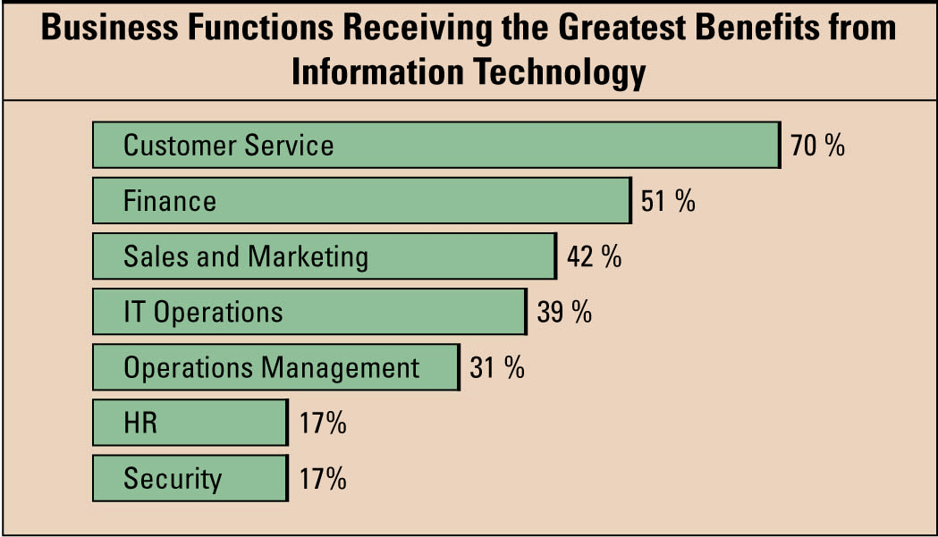
Information Technology’s Impact on Business Operations
Notes:
Describe a few of the types of IT services each business function might be receiving from IT
Customer service: click-to-talk, call scripting, auto answering, call centers
Finance: accounting packages, Sarbanes Oxley
Sales and marketing: campaign management, customer relationship management
Operations: supply chain management
Human resources: software to track employees at risk of leaving
CLASSROOM EXERCISE
Metrics on Business Magazines
Running metrics on current business magazines is an excellent way to demonstrate how much technology is everywhere in business. There are so many articles where you can run metrics to see how relevant IT is in the working world from Fortune 100 companies, to Top 100 Companies to Launch a Career, to Hot Growth Markets. Just pick a current article and run the metrics comparing IT to marketing, HR, accounting, etc. and prove how hot IT is in the business environment.
BusinessWeek resource http://www.businessweek.com/search/06brows2.htm
Fortune resource - click on the Lists dropdown http://money.cnn.com/magazines/fortune/

Slide 5
Information Technology
Any hardware, software or communications technology that might be adopted by an organization to:
Support or control a business process
Enable management decisions
Provide a competitive advantage.
IT may be used to support enterprise systems and e-business applications.

Slide 6
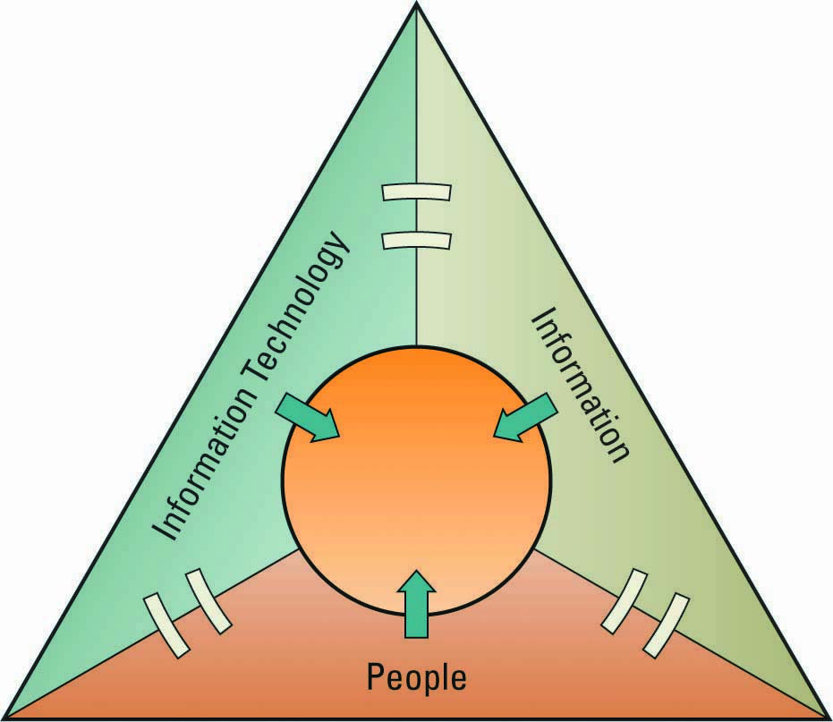
IT Resources
People use
Information technology to work with
Information
Notes:
IT in and of itself is not useful unless the right people know how to use and manage it efficiently and effectively
People, information, and information technology (in that order of priority) are inextricably linked
If one fails, they all fail
What is one of the most important assets in an organization?
Information is one of the most important assets in an organization, and the primary way that people get information is through information technology
Without databases and spreadsheets how would managers gather, correlate, and analyze information?
Manually
Performing these tasks manually, or by hand, is extremely time consuming

Slide 7
What does IS do for a business?
Notes:
Examples of business processes: record purchases, track inventory, pay employees, etc. Business would stop without such IS.
Examples of decision making: what lines of merchandise need to be added, what kind of investment required.
Examples of competitive advantage: put kiosk in store to connect to e-commerce website. Help gain advantage over competitor without such a kiosk.

Slide 8
Information System
A set of interrelated components that collect, manipulate & disseminate data & information & provide feedback to meet an objective.
Examples: ATMs; airline reservation systems; course reservation systems
Notes:
An information system is a collection of related things that work together to achieve a common goal. The components collect, process or transform, and distribute data and information.
Common examples of information systems include: ATMs, point of sale (POS) systems used by grocery checkout clerks; information systems used by airlines to make reservations or schedule flights; and the system you use at your university to register for classes.

Slide 9
Data vs. Information
Data: raw facts
Information: collection of facts organized in such a way that they have value beyond the facts themselves
Knowledge : information in action
Input(data) – Process – Output(information)
Notes:
The terms data & information are often used interchangeably. However, there is an important distinction: information is value-added data. Data is processed, organized or transformed to become information.
Data are raw facts. For example, if you write down your age & grade on an English test & hand it to me, I see 2 numbers – raw data. However, if you include the average age and average test score for your class, the data would have some meaning to me as a teacher… it would become information. Interestingly, your name and grade – data to me- could very well be information to you. In the context of your life or experiences, those 2 numbers alone would most likely have meaning.
Similarly, a grocery store manager would most likely find a list of every item sold today to be of little use – it is data. However, the amount that the store’s total sales are over or under planned sales would be information.

Slide 10
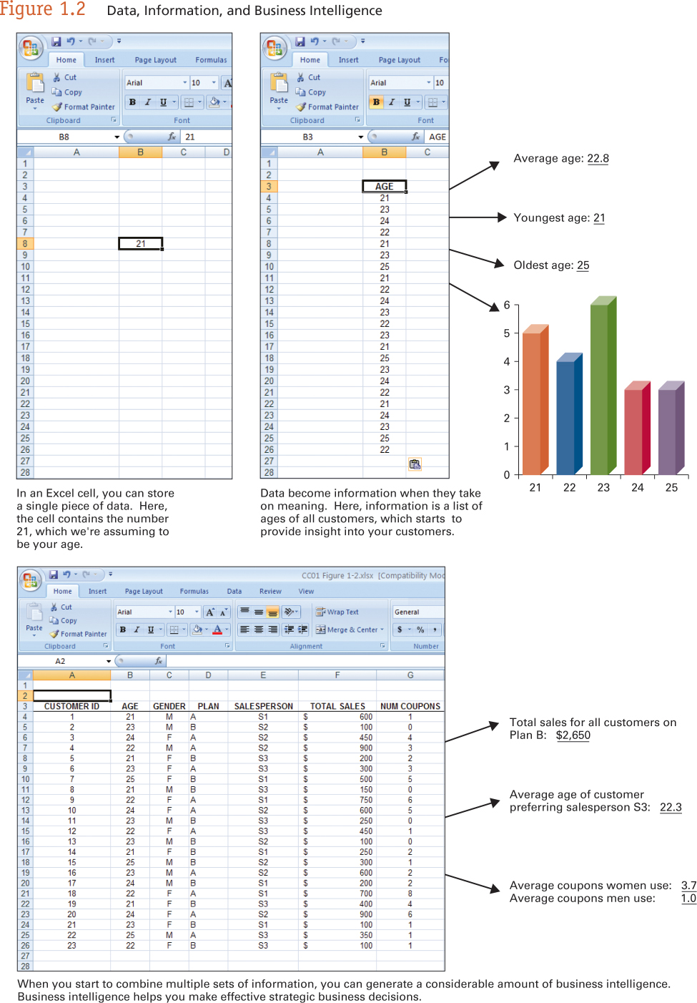
Data and Information

Slide 11
Creating Information
Processing Data is necessary to place them into a meaningful context so that they can be easily understood by the recipient.
Data
Transformation Process
Information
The basic function of an information system is to transform data into useful information.

Slide 12
Data becoming information
21/04/1944
The date an employee was born
How soon will this employee retire?
What do we do when they retire?
How will it impact us when she retires?
Do we want to convince her not to retire?
Do we want to offer early retirement?

Slide 13
Data Processes
Classification
Placing data into categories
Sorting/ Rearranging
Organising data into groups or order
Aggregating
Summarising
Performing Calculations
Selection
Choosing or discarding items based on criteria

Slide 14
Value of Information
TANGIBLE VALUE
The value of information is the benefit produced by the information minus the cost of producing it.
INTANGIBLE VALUE
Value is difficult or impossible to quantify its value
Example. Better decision making

Slide 15
Sources of Information
FORMAL COMMUNICATION
Structured, presented in a consistent manner
INFORMAL COMMUNICATION
Less well structured, presented by informal means
Word of Mouth

Slide 16
Qualities of Information
Qualities of good information
It should be relevant for its purpose.
It should be complete for its purpose.
It should be accurate for its purpose.
It should be clear to the user.
It should be prepared using consistent methods.
The user should be able to rely on it.
It should be communicated to the right person.
It should not be excessive – its volume should be manageable.
It should be timely – to be communicated at the right time.
It should be provided at a cost lesser than the value of benefits.

Slide 17
Qualities of Information
Time Dimension
Timeliness, Currency, Frequency, Time Period
Content Dimension
Accuracy, Relevance, Completeness, Conciseness, Scope
Form Dimension
Clarity, Detail, Order, Presentation, Media

Slide 18
Information Resource
Knowledge – broad term that can describe many things…
Contextual explanation for business intelligence
Actions to take to affect business intelligence
Intellectual assets such as patents and trademarks
Organizational know-how for things such as best practices

Slide 19
Week_2_Theory
Systems

Slide 20
What is a System
A set of interrelated components that work together for a collective goal. The Function of a system is to receive inputs and transform these into outputs
Data is used as Input for a process that creates Information
Data
Transformation Process
Information

Slide 21
What is a System
This Model illustrates a system that is Static
Performance of the system cannot be adjusted
No checks to ensure that it works correctly
To Monitor a system some type of Feedback mechanism is required.
Control must be exerted to correct any problems that occur.
SYSTEM MUST FULFIL ITS PURPOSE

Slide 22
Information System Is A System

Slide 23
Information System
A set of interrelated components that collect, manipulate & disseminate data & information & provide feedback to meet an objective.
Examples: ATMs; airline reservation systems; course reservation systems
Notes:
An information system is a collection of related things that work together to achieve a common goal. The components collect, process or transform, and distribute data and information.
Common examples of information systems include: ATMs, point of sale (POS) systems used by grocery checkout clerks; information systems used by airlines to make reservations or schedule flights; and the system you use at your university to register for classes.

Slide 24
System Components
Input: Inputs can take many forms and are not necessarily purely physical in nature.
Process: Transformation process of Date into Information:
Output: The finished products of the system: Can take many forms.
Feedback Mechanism/Loop: Information on the performance is gathered.
Control: Ensures that the system is working to fulfil its objective. (Adjusts the process or input components)

