Slide 1
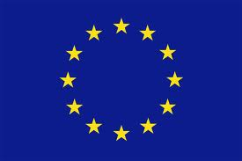
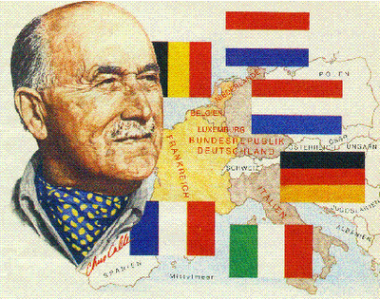
EU- Historical Perspective
Jean Monnet 1888 – 1979
Economist and diplomat
Deputy Secretary General of the League of Nations (1919-1923)
1945: Commissaire au Plan: headed first plan to modernize France’s economy post WWII
1949: Devised Schuman Plan for European Coal and Steel Community
1952: 1st President of ECSC
The ‘Father of United Europe’

Slide 2
From 1945 to 1973
Events in Europe are dominated by two contrasting themes:
The rise of two superpowers: US and USSR
The need for economic, political and cultural integration
New world order: the ‘Big Two’, US & Soviet Union, compete for world domination
Europe, devastated, impoverished, economically and politically dependent, no longer has a major role
A ‘third way’?

Slide 3
Cold War
USSR
Nikita Krutchev
USA
John F. Kennedy

Slide 4
Integration
Need for economic and political integration
European Integration: a unique experiment for the sake of achieving peace, freedom and the prosperity and well-being of its citizens
Resistance at first
Consensus rather than force of arms
End of colonial empires
Economic and social recovery achieved by mid-1960s
1973: Oil crisis highlights need of further integration

Slide 5
1945-1962: Europe Destroyed, Divided, Dominated
August 1945: Bombings of Hiroshima and Nagasaki – a turning point in world history
Europe left destroyed and traumatized
Decline of European countries on world stage
WWII: Over 50 million victims
USSR: 20 million ( 7 million civilians)
Poland: 6 million (20% of its population)
Yugoslavia: 1.7 million
Germany: 6 million
France: 600 000
Bombings, deportations, hunger, devastation
Holocaust: 6 million dead in the death camps

Slide 6
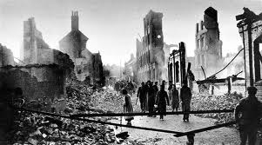
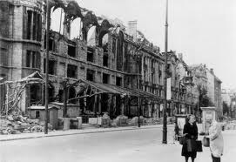
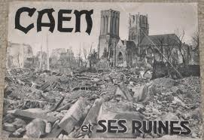
Destruction
Dresden
Coventry
Caen
Berlin

Slide 7
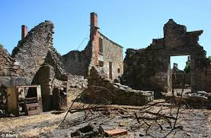
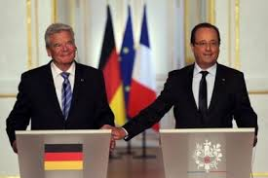
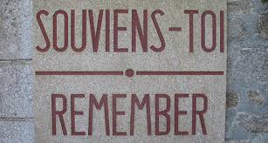
Oradour sur Glane
10 June 1944 4 September 2013
Joachim Gauck & François Hollande

Slide 8
A new world order
1946: Nuremberg Trials ‘Crimes against humanity’
1948: Foundation of State of Israel
Plight of ‘displaced persons’ : deportees, refugees, etc..
World divided in two Blocs
Roosevelt & Stalin – East v. West
1947: USSR sets up Cominform (Communist Information Bureau)
9 members: communist parties of the USSR, Bulgaria, Czechoslovakia, Hungary, Poland, Romania, Yugoslavia, France and Italy = a tool of propaganda for Soviet policy + obstructing implementation of the Marshall Plan
Dissolved in 1956

Slide 9
Marshall Plan 1948 - 1951
Official name: ERP, European Recovery Program
1947: George C. Marshall: US Secretary of State launches idea of European self-help program to financed by the US
1948: ERP is established: program of economic aid to 17 western and southern European countries
Austria, Belgium, Denmark, France, Greece, Iceland, Ireland, Italy, Luxembourg, the Netherlands, Norway, Portugal, Sweden, Switzerland, Turkey, the UK and West Germany.
Aims:
Create stable conditions in which democratic institutions could survive
Contain appeal of communist parties to voters in western Europe

Slide 10
A bipolar world
USSR rejected offer of Marshall plan aid
5 March 1946, Fulton, Missouri: Winston Churchill’s Iron Curtain speech
“From Stettin in the Baltic to Trieste in the Adriatic, an iron curtain has descended across the Continent” http://history1900s.about.com/od/churchillwinston/a/Iron-Curtain.htm
De facto partition of Europe:
April 1949: Washington Agreements create Federal Republic of Germany
7 October 1949: Creation of German Democratic Republic in former Soviet occupation zone

Slide 11
OEEC
1948: European countries set up the Organization for European Economic Co-operation to share out Marshall Plan aid
1948 –1952: $13 billion of American aid go to:
UK: 3.2 billion
France: 2.7 billion
Germany: 1.4 billion
Ireland: 133 million
Marshall Plan ends late 1951
European economic recovery is well under way

Slide 12
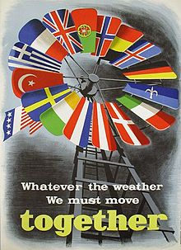
ERP
“It gave a new impetus to reconstruction in Western Europe and made a decisive contribution to the renewal of the transport system, the modernization of industrial and agricultural equipment, the resumption of normal production, the raising of productivity, and the facilitating of intra-European trade” (Herman Van der Wee, Prosperity and Upheaval: The World Economy, 1945-1980 (1984)

Slide 13
Marshall Plan Map

Slide 14
Political unity
Deeply scarred by war, Europe seeks political unity
Most political parties attracted by European project
Calls for a democratic European Union
Renunciation of old national rivalry
“United States of Europe”
1949: Creation of the Council of Europe = a forum for political and socio-cultural cooperation
Initially 10 democratic countries from Western and Northern Europe + Greece and Turkey + Germany in 1951: now 47 countries and 820 million citizens
Headquarters: Strasbourg
Not a European Union institution
November 1950: European Convention on Human Rights = beginnings of Europe-wide justice
European Court of Human Rights: Strasbourg

Slide 15
Council of Europe European Court of Human Rights
http://hub.coe.int/
www.echr.coe.int/
http://www.irishtimes.com/news/crime-and-law/call-on-irish-authorities-over-human-trafficking-1.1540212

Slide 16
Coal and steel
1948 – 1949: Saarland question (France v. Germany)
Collective action
9 May 1950: Monnet / Schuman Plan for pooling of coal and steel production and sales
Plan anchors Germany to the West
Co-operation leads to integration
18 April 1951: Treaty of Paris sets up European Coal and Steel Community
6 countries sign the Treaty: France, Germany, Belgium, the Netherlands, Italy and Luxembourg
Resistance and opposition (UK, Communists)

Slide 17
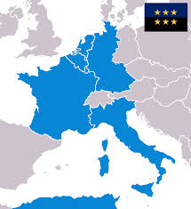
ECSC
The ECSC
Is based in Luxembourg
Headed by a 9-man High Authority
Independent of the member states
Presided by Jean Monnet

Slide 18
Difficult beginnings
Progress is initially slow – Monnet resigns
1955: Messina Conference
2 major European projects:
Common Market (European Economic Community or EEC) = customs union, abolition of tariff barriers, gradual opening of frontiers to movement of capital and labour
Euratom: access to nuclear energy
25 March 1957 : Treaties of Rome
UK proposes European Free Trade Association
EFTA: UK, Sweden, Denmark, Norway, Switzerland, Austria and Portugal sign EFTA Treaty in November 1959 – Finland joins in 1961

Slide 19
Common Market – EEC
1 Jan.1958: Common Market comes into force
Some opposition from France’s General de Gaulle
British government opens negotiations to join in 1960s (Conservatives under Harold McMillan)
French veto in 1963 and 1967
1965: ‘Empty Chair’ crisis
1969: De Gaulle resigns from French Presidency
UK re-applies and joins EEC in 1973, along with Ireland and Denmark.

Slide 20
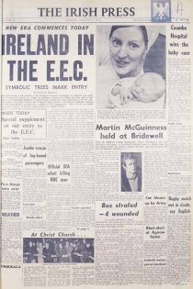
1973

