Slide 1
Group Dynamics

Slide 2
Personality

Slide 3
Personality
Personality... Those relatively and enduring aspects of individuals which distinguish them from other people, making them unique, but which at the same time permit comparison encourage comparisons between 2011.

Slide 4
Personality
Personality... Those relatively and enduring aspects of individuals which distinguish them from other people, making them unique, but which at the same time permit comparison encourage comparisons between 2011.

Slide 5
Personality
Personality influenced by
Genetic Inheritance (intelligence, creativity, aggression)
Family Experiences (socialisation, adaption to society)
Culture
Life Experiences
Birth order can impact on personality
(Adler, Leman 2001)

Slide 6
Birth Order
First Borns
Positive: Natural leaders, high achievers, high level of control, punctual, high attention to detail, punctual, organised
Negatives : Moody, insensitive, know-it-alls, poor at delegating, perfectionists

Slide 7
Birth Order
Middle child:
Positives: People pleasers, calm, down-to-earth, good listeners, good mediators and negotiators
Negatives: Try to please everyone, not good at handling conflict, poor decision-makers

Slide 8
Birth Order
Last-borns:
Positives: Strong people skills, make friends easily, extroverted, risk-takers
Negatives: Fear of being rejected, short attention span, self-centred

Slide 9
Birth Order
Only Children
Positives: Task-oriented, conscientious, dependable, like responsibility
Negatives: Very demanding, don’t accept criticism well, oversensitive

Slide 10
Personality Studies
Freud – psychoanalysis
Rogers & Maslow – Humanistic approach
Maslow – Hierarchy of needs
Rogers – person-centred approach
Kelly – Personal construct theory
Trait Theory
The Big Five

Slide 11
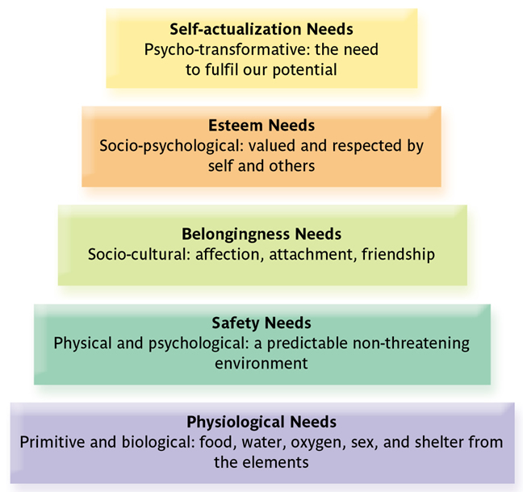
Maslow’s Hierarchy of Needs
Notes:
1
1

Slide 12
The Big Five
Emotional Stability
Responds in reasonable and consistent way to challenges
Continuum from emotional stability to neuroticism
Emotionally stable = self-confident, adjusted, easy going optimistic
Neurotic = Unstable, anxious, easily upset, emotional, low self esteem

Slide 13
The Big Five
Extroversion
Extroversion and introversion are descriptors used widely in psychology and personality profiling from Jung to Myers Brigg Type Indicators
Extroverts:
Are: Sociable, crave excitement, need to talk to people, optimistic and carefree, risk takers, impulsive, like change, display emotion, tough-minded, aggressive, quick-tempered
Find difficult: working alone, reflecting on key issues, undertaking preparation, thinking before acting, concentrating on a single act

Slide 14
The Big Five
Extroversion
Extroversion and introversion are descriptors used widely in psychology and personality profiling from Jung to Myers Brigg Type Indicators
Introverts:
Are: Quiet, introspective, retiring, reserved, tender-minded, suppress emotions, effective planners, pessimistic, reliable, distrust impulse, appreciate order, prefer books to people
Find difficult: Working in large groups, articulating thoughts, interacting with others

Slide 15
The Big Five
Openness to Experience
‘Fully functioning’ human beings are open to new experiences (Rogers)
Way of interacting with the world
Not a sign of mental health or level of adjustment
Open to experience: enhanced interaction with others, good communicators, adapt well to change
Closed to experience: conventional, traditional, prefer familiar routines, practical, down-to-earth

Slide 16
The Big Five
Agreeableness
Agreeable people are empathetic, considerate, friendly, generous, likeable
Believe most people are honest and trustworthy
Agreeableness enables effective relationship and network building and enhances performance
Low levels of agreeableness: Self-interested, less concerned with others’ well-being, can appear unfriendly and suspicious due to sceptical attitudes, compete rather than co-operate

Slide 17
The Big Five
Conscientiousness
Effective workers in a range of environments
High level of competence
Order, duty, achievement, self-discipline
At the extreme – perfectionists, compulsives, workaholics
Low in conscientiousness – laidback, less goal oriented, less driven by success

Slide 18
Other Personality Characteristics
Locus of control
Internal locus – believe that what happens to them is caused by them.
Believe they are masters of their own destiny
More likely to be politically or socially activated because they believe they can influence events
External locus – believe what happens is caused by external factors which they can’t control
Do not feel they have much influence on what happens around them
Prefer to take direction and have decisions made for them

Slide 19
Other Personality Characteristics
Self-esteem
Refers to a person’s evaluation of self-worth
Significant influence on behaviour
High self-esteem – independent, assertive, creative, risk takers
Develop effective relationships
Not easily influenced by others
Set challenging goals for themselves, not concerned about what others think
Low self esteem: Look for approval of others, lack confidence
Take fewer risks, set easier goals for themselves, are critical of themselves
Self esteem is related to an individual’s overall psychological wellbeing

Slide 20
Other Personality Characteristics
Authoritarianism
Describes sensitivity to status, formal authority and offical rules
Authoritarian personality submit to higher status and are aggressive to lower status
Driven by fear of failure, prefers highly structured organisations, clears lines of authority and responsibility
Do not like to be given new tasks and resist change

Slide 21
Group Dynamics

Slide 22
What are Group Dynamics?
Group Dynamics are
The study of people in groups
A general term for group processes
A psychological group is any number of people who (a) interact with each other, (b) are psychologically aware of each other, and (c) perceive themselves to be a group (Schein)

Slide 23
Why do Groups Form?
Groups form for a number of reasons:
Interpersonal attraction
People are attracted to those similar to themselves. Members will usually have one or more factors in common
Group’s activities and goals
Join group because enjoy activity of group – e.g. Sports, political, religious, professional activity
Social affiliation
People need people! They are social animals . Interest in group is impacted by levels of extroversion / introversion

Slide 24
Why do Groups Form?
Security
Safety in numbers – people feel more secure in a group
Esteem
Achieves need for esteem, enhances self-worth. Can be from belonging to a group perceived to be high status or from recognition within the group
Power
Groups provide a means to influence how others think, feel behave. Strength in numbers. Achieve both formal and informal positions of power within the group

Slide 25
Why do Groups Form?
Identity
People want to answer the question ‘Who am I?’ Groups give people an understanding of themselves. CVs – lists of groups people are proud to have belonged to!
Accomplishment
More than one person is normally required to accomplish a task – belonging to groups provides the support and environment to achieve

Slide 26
Types of Groups
Formal:
Deliberately created to achieve a set task
Command or Functional Groups – relatively permanent. E.g. Finance department
Task Groups – temporary, designed to achieve a specific task

Slide 27
Types of Groups
Informal:
Driven by social needs
Friendship (enduring) or hobbies (shorter term)
Employee behaviour is influenced by group behaviour
Groups have strong motivational influence on individual’s behaviour

Slide 28
Stages of Group Development
Forming
Storming
Norming
Performing
Adjourning
(Tuckman & Jensen)

Slide 29
Stages of Group Development
Forming – Stage of Mutal Acceptance
Desire to be accepted within group
Avoid controversy and conflict
Share personal information but avoid serious issues
Although may experience anxiety about joining group this is a comfortable non-threatening phase
Due to conflict avoidance not much is achieved
Storming
Norming
Performing
Adjourning (De-forming)

Slide 30
Stages of Group Development
Storming – Communication Stage
Members know each other and are more secure and self-assured
Begin to discuss feelings openly
Characterised by conflict as members begin to identify what they want from the group
Organisation structure will influence to what level hostility and conflict are expressed or repressed
To manage conflict, individuals seek out structural clarity and ongoing rules

Slide 31
Stages of Group Development
Norming – The Decision-Making Stage
Begin to develop ways of working together
A sense of identity and unity develops
Rules or Norms are established
People start to appreciate others’ skills/abilities
Members listen to each other, support each other, are prepared to change established view
An effective work group is formed
But some members may fear the decline of the group and therefore resist change

Slide 32
Stages of Group Development
Performing
Group structure is established
Members are achieving required goals
Know each other well enough to work together and trust each other
People undertake activities to benefit the group
Mature group evaluates and takes corrective action
Stage is characterised by spontaneity, flexibility and self-correction
Loyalty, morale and group identity are at high levels – focuses group on accomplishment

Slide 33
Stages of Group Development
Adjourning (De-forming and mourning)
Final stage
Completion of task and disengagement from group
Orientation moves away from group to individual
People feel proud of achievements and satisfied with being part of an effective group
Recognise what they have achieved and move on

Slide 34
Group Performance Factors
Size
Can be small or large
Small
Allows for frequent interaction and free exchange of information
Often arise out of larger groups
Advantage – increased support and involvement in decision-making
Disadvantage – Cliques may form

Slide 35
Group Performance Factors
Size
Can be small or large
Large
Wider range of resources
Capable of completing a number of different tasks
Satisfies needs of power, identity, security, accomplishment
Issues – Formal, bureaucratic, absenteeism

Slide 36
Group Performance Factors
Composition
Homogeneity
Group members from similar background
Achieve simple tasks
Commonalties reduce conflict
Good for tasks that need speed and co-operation
Heterogeneity
Diversity of experience and skills
Multi-functional
Good for complex tasks
Due to diversity / conflict, achievement of tasks takes longer

Slide 37
Group Performance Factors
Norms
Appropriate Behaviours
Help groups survive by rejecting deviant behaviour
Simplify – make group behaviour predictable
Help members fit in by understanding roles

Slide 38
Group Performance Factors
Cohesiveness
Forces that act on members to remain in group
Attraction
Motivation due to satisfaction
Resistance to leaving the group
Level of commitment to staying together
Influenced by maturity and homogeneity
Negative – groupthink
Group so similar no alternative views express
Members no longer realistic or critical
No disagreement

Slide 39
Teams
Small group of people with complementary skills
Achieving a common purpose
Effective and efficient teamwork goes beyond ability of 1 person
Good team
Informal, pleasant atmosphere
Lots of discussion
No resentment
Disagreements are confronted
No hidden agendas
Boss doesn’t dominate proceedings
Nobody hogs the stage
No one gets injured or ignored
People are assigned tasks on their capacity

