Slide 1
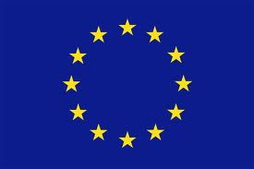
European Studies
1973: 1st enlargement: from 6 to 9
UK + Ireland + Denmark
Sovereignty
Definition: self-government either at the level of the individual or of the state; to say that a state is sovereign is to claim that it has a monopoly of force over the people and institutions in a given territorial area
Economic motives vs. political motives
ECSC: 1st step in economic and political unification of Europe

Slide 2
Main Institutions of the EU
1. The European Parliament
Only-directly-elected body of EU – President Martin Schultz
736 members (MEPs) elected every 5 years (June 2009)
Next elections: 22 – 25 May 2014
Strasbourg and Brussels
2. The European Council
Defines general political direction and priorities of EU
Institution of EU since January 2010 – President Herman Von Rompuy convenes meetings (twice per year – Brussels)
Heads of States or Government of 28 EU states
3. The Council (of Ministers) of the European Union
Main decision-making body of EU - Intergovernmental
Ministers from member states (foreign affairs, agriculture, transport, environment, etc.).
Rotating presidency every 6 months: Ireland January-June 2013 – Lithuania July – December 2013 – Greece January – June 2014 – Italy July – December 2014

Slide 3
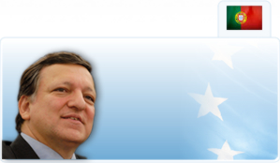
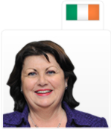
Institutions (2)
4. The European Commission
EU’s executive body
Supranational
Represents interests of EU as a whole
Drafts proposals for European laws
28 Commissioners
President: Jose-Manuel Barroso (Portugal)
Irish Commissioner: Maire Geoghegan-Quinn (Research, Innovation and Science)

Slide 4
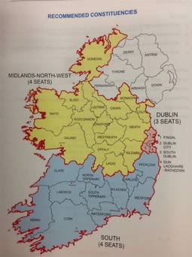
European Constituencies 2014
http://www.irishtimes.com/news/politics/changes-to-constituencies-herald-shake-up-in-european-election-1.1540263

Slide 5
The Treaties
The major Treaties
Rome 1958
Single European Act (SEA) 1987
Maastricht 1993
Amsterdam 1999
Nice 2002
Lisbon 2010
EC or EU?
EC = before Maastricht
EU = after Maastricht
Maastricht created the EU

Slide 6
EU Expansion, Enlargement, Accession
Enlargement : EU’s most successful foreign policy?
Enlargement:
when the external becomes internal
Non-member countries become member
Shapes the development of the EU itself
Accession:
The process whereby a country joins the EU and becomes a member state
Application – candidate status – membership
Candidate:
refers to a country whose application is confirmed by the EU but is not yet a member

Slide 7
Criteria for membership
Copenhagen Criteria (European Council Copenhagen 1993)
Membership requires:
That the candidate country has achieved stability of institutions guaranteeing democracy, the rule of law, human rights and respect for and protection of minorities
The existence of a functioning market economy as well as the capacity to cope with competitive pressure and market forces within the union
The presupposition of the candidate’s ability to take on the obligations of membership including adherence to the aims of political, economic and monetary union
Treaty Provisions (Amsterdam 1997)
Article 49 Any European state which respects the principles set out in Article 6 (1) may apply to become a member of the Union
Article 6 (1) The Union is founded on the principles of liberty, democracy, respect for human rights and fundamental freedoms, and the rule of law, principles which are common to the member states

Slide 8
28 Member States
Member States are the ‘building blocks’ of EU
EU = multinational and multicultural organisation
Size – Entry date – Wealth
‘Onion’ metaphor
6 ‘waves’ of enlargement: 1973 – 1981 – 1986 – (‘silent enlargement’ 1990) - 1995 – 2004 – 2007 - 2013

Slide 9
28 members states (2)
1958: France – Germany – Italy – Belgium – Luxembourg – Netherlands
1973: UK – Ireland – Denmark
1981: Greece
1986: Spain – Portugal
1995: Austria – Sweden – Finland
2004: Czech Republic – Slovakia – Slovenia – Hungary – Poland – Estonia – Latvia – Lithuania – Cyprus – Malta
2007: Bulgaria – Romania
2013: Croatia

Slide 10
28 member states (3)
Four clusters: Large – Medium – Small – Micro
Large: Germany , France, UK, Italy, Spain, Poland
Medium: Romania, Netherlands, Greece, Belgium, Portugal, Czech Republic, Hungary
Small: Sweden, Austria, Bulgaria, Croatia, Denmark, Finland, Slovakia, Ireland, Lithuania, Latvia, Slovenia, Estonia
Micro: Cyprus, Luxembourg, Malta
Recent enlargements: more small and medium states

Slide 11
Candidates
5 candidate countries
Macedonia
Iceland (negotiation)
Montenegro (in negotiation)
Serbia
Turkey (in negotiation)
Potential candidate countries
Albania
Bosnia & Herzegovina
Kosovo
See also: EU Enlargement : the next seven (BBC website) : http://www.bbc.co.uk/news/world-europe-11283616

Slide 12
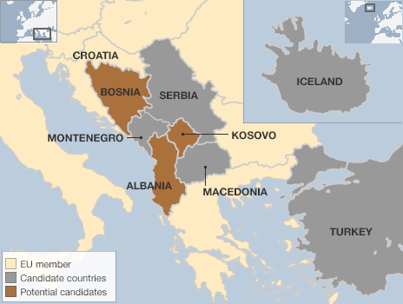
The next 7 – map

Slide 13
Languages
The European Union has 24 official and working languages. They are: Bulgarian, Croatian, Czech, Danish, Dutch, English, Estonian, Finnish, French, German, Greek, Hungarian, Irish, Italian, Latvian, Lithuanian, Maltese, Polish, Portuguese, Romanian, Slovak, Slovene, Spanish and Swedish.
Due to time and budgetary constraints, relatively few working documents are translated into all languages. The European Commission employs English, French and German in general as procedural (working) languages, whereas the European Parliament provides translation into different languages according to the needs of its Members.

Slide 14
Multilingualism and the EU
Multilingualism — working definitions
an individual's ability to communicate in several different languages
the co-existence of different language communities in one geographical/political area
an organisation's policy choice to operate in more than one language
Multilingualism is a fact of life in the European Union and one of the founding principles of the EU institutions. At DG Translation, our job is to turn that principle into reality.
Mother tongue +2
Promoting language learning is central to the EU’s language policy. The EU encourages everyone to learn and speak more languages, in the interests of mutual understanding and communication. Our goal is an EU in which every citizen knows at least two foreign languages in addition to their mother tongue.

Slide 15
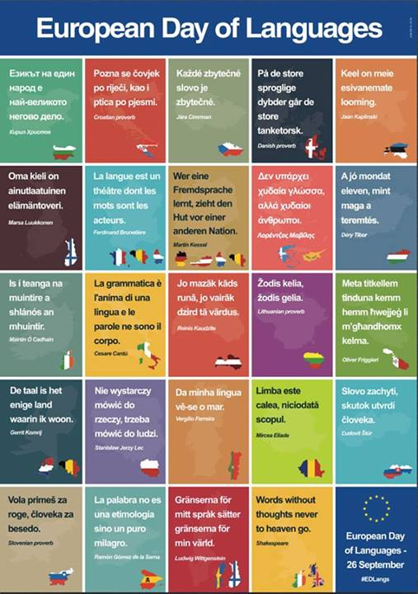
European Day of Languages

Slide 16
EU Translation budget & output
Output: 1.76 million pages (2012)
Workload steadily rising (new member states 2004, 2007, 2013)
Types of documents translated, in order of priority:
Proposed laws, policy papers, Commission consultation documents
Consultation documents to and from national parliaments, and correspondence with national authorities, companies and individuals
Websites and press releases
Cost: €330 m a year (estimated) – some €0.60 per EU citizen
Cost of all language services: less than 1% of all the general budget of the EU = divided by the EU population, it amounts to less than €2 per person per year

Slide 17
Translation and the EU
The EU policy of communicating in 24 official languages (multilingualism policy) is unique in the world. All official languages enjoy equal status. EU citizens in the 27 member countries can use any of them to communicate with the European institutions, which helps to make the Union more open and more effective.
A multilingual organisation like the EU needs high quality translation and relies on professional linguists to keep it running smoothly. The role of the language services in the various EU institutions and bodies is to support and strengthen multilingual communication in Europe and to help Europeans understand EU policies.

Slide 18
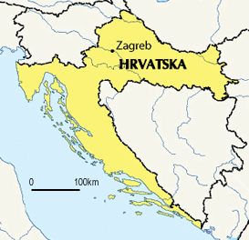
Croatia 2013
Year of entry : 2013
Capital city: Zagreb
Population: 4 398 150
System of government : parliamentary democracy
Currency: kuna
Schengen area: expected to join in 2015
http://www.bbc.co.uk/news/world-europe-17212572

Slide 19
Schengen
The Schengen area and cooperation are founded on the Schengen Agreement of 1985. The Schengen area represents a territory where the free movement of persons is guaranteed. The signatory states to the agreement have abolished all internal borders in lieu of a single external border. Here common rules and procedures are applied with regard to visas for short stays, asylum requests and border controls. Simultaneously, to guarantee security within the Schengen area, cooperation and coordination between police services and judicial authorities have been stepped up. Schengen cooperation has been incorporated into the European Union (EU) legal framework by the Treaty of Amsterdam of 1997. However, all countries cooperating in Schengen are not parties to the Schengen area. This is either because they do not wish to eliminate border controls or because they do not yet fulfil the required conditions for the application of the Schengen acquis.
http://europa.eu/legislation_summaries/justice_freedom_security/free_movement_of_persons_asylum_immigration/l33020_en.htm

Slide 20
Ireland and UK re Schengen
Partial participation = “cooperating countries”
Police and judicial cooperation in criminal matters
Fight against drugs, trafficking, etc.
SIS (Schengen Information System) : database to exchange data on certain categories of people and goods
But:
Border controls remain (airports, ferry ports, etc.)
Islands v. countries with “extensive and permeable land borders”
Common land frontier (NI)

Slide 21
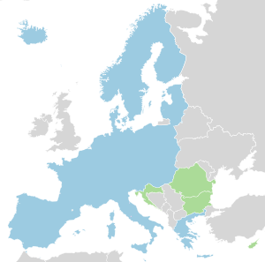
Schengen area
26 countries
22 EU Member States
Bulgaria, Romania, Cyprus,
Croatia (in green) = legally obliged to join
Ireland and UK maintain opt-outs
4 EFTA* states
Iceland, Lichtenstein, Norway
Switzerland
2 microstates
Monaco, San Marino
*EFTA: European Free Trade
Association

Slide 22
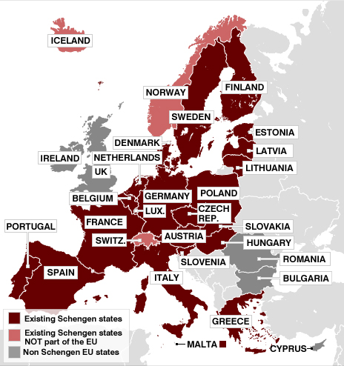
Schengen Area Q&A
http://www.bbc.co.uk/news/world-europe-13194723

Slide 23
Migration and the EU
Humanitarian crisis in Syria
2.2 million refugees at start of 2013
3.2 million by end of year (between 3,000 and 5,000 leave Syria everyday)
5.2 million by end of 2014
Most settle in neighbouring countries: Turkey – Lebanon – Jordan – Iraq – Egypt
A comprehensive European migration policy
“The Commission presents a set of measures aimed at establishing a comprehensive European migration policy, founded on greater solidarity between Member States and enabling the European Union (EU) to respond better to the challenges presented by migration”
http://europa.eu/legislation_summaries/justice_freedom_security/free_movement_of_persons_asylum_immigration/jl0059_en.htm
Yet:
No common EU position - double standards?
More solidarity and flexibility needed (UN)

Slide 24
Migration and the EU
Free movement, Asylum and Immigration
http://europa.eu/legislation_summaries/justice_freedom_security/free_movement_of_persons_asylum_immigration/index_en.htm
Humanitarian assistance
1.7 billion euros of EU funds to help with Syrian humanitarian crisis between 2011 and 2013
UK: 203 million – Germany: 117 million – Sweden: 39 million
Netherlands: 29 million – France: 25 million – Italy: 17 million
Is it enough?

Slide 25
Migration
Frontex: EU Agency for the Management of the Operational Cooperation at the external borders of the Member States
Frontex promotes, coordinates and develops European border management. See: www.frontex.europa.eu
Migratory routes to the EU: http://www.frontex.europa.eu/trends-and-routes/migratory-routes-map
Approx. 31,000 migrants have crossed the Mediterranean towards Italy and Malta since beginning of 2013 (2012: 16,000)
From Somalia, Eritrea and Syria

Slide 26
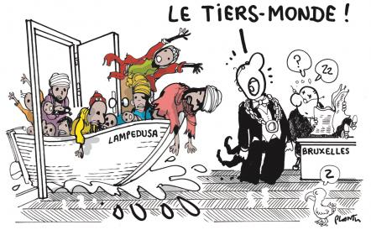
Lampedusa
« Lampedusa doit être candidate au prix Nobel de la paix 2014 » (transl: Lampedusa should be awarded the Nobel Peace Prize in 2014 » according to Fabrizio Gatti, an Italian journalist
From French Newspaper
Le Monde, 9-10-2013

Slide 27
Lampedusa (2)
http://www.rte.ie/news/2013/1009/479277-lampedusa-shipwreck/
http://www.irishtimes.com/news/world/europe/barroso-and-letta-heckled-on-visit-to-sicilian-boat-people-island-of-lampedusa-1.1555406
https://maps.google.ie/maps?hl=en&q=Lampedusa&safe=strict&um=1&ie=UTF-8&sa=N&tab=wl

Slide 28
Turkey
https://maps.google.ie/maps?hl=en&safe=strict&q=turkey&ie=UTF-8&hq=&hnear=0x14b0155c964f2671:0x40d9dbd42a625f2a,Turkey&gl=ie&ei=O3JWUoWDBIXE7Aal6YGgAQ&ved=0CIABELYD
A hub for people smugglers
Rackets: huge sums demanded by smugglers
By plane: up to 10,000 per person
By sea: to Italy and Greece: up to 5,000 per person
By land, on bus or by foot though Bulgaria : up to 500 per person
Turkey: the main gateway to the EU for Afghans, Iraqis, Somalis, Syrians
Up to 800,000 Syrians live in Turkey
in camps near the border or in cities like Istanbul (between 120,000 and 250,000)
Up to 100,000 Syrians have arrived in Istanbul over the last 2 months

Slide 29
Case Study: the Roms
A European people of Indian origin
Roma or ‘Gypsies’?
‘Rom’ or ‘Roma’ = an endogenous term used since the 1970s
Romani: language spoken by about 5-6 million Roma people throughout Europe and the USA – closely related to the languages of northern India, particularly Punjabi
10 – 12 million of Roma live in Europe (half in in EU)
One of Europe’s most deprived communities
Discrimination, racial insults, extreme poverty and exclusion
Accusations of living off criminal activities
Failure to integrate in Western society
Largest concentration:
Romania: 1.85 m Bulgaria: 750 000 Slovakia: 490 000
Italy : 150 000

Slide 30
Current situation of Roma populations in EU
Bulgarian and Romanian nationals enjoy full rights to free movement pursuant to EU law in 14 (of 25) Member States
Denmark, Estonia, Cyprus, Latvia, Lithuania, Poland, Slovenia, Slovakia, Finland, Sweden, Hungary, Greece, Spain, Portugal
Free access to labour market in Czech Republic
Restrictions apply in 10 Member States until 31 December 2013
Belgium, Germany, Ireland, France, Italy, Luxembourg, Netherlands, Austria, UK, Malta
Romanian and Bulgarian citizens require a work permit
Conditions are generally being eased

Slide 31
Freedom of movement
Complete freedom of movement for workers form Bulgaria and Romania from January 2014
Free movement of persons = one of the fundamental freedoms guaranteed by EU law = one of the pillars of the EU
Includes the right to work in an other Member State without a work permit
Essential part of the Single market and European citizenship
At least 12 million EU citizens reside in a Member State other than the one of origin
Roma population living in the EU are EU citizens = have the same rights as any other citizen
But: the right to move and reside freely within the territory of the Member States is not unconditional
Restrictions can be based on grounds of public policy, public security or public health

Slide 32
Expulsions
Decision to ‘remove’ an EU citizen should not be taken lightly
Decision must be proportionate to threat to public policy or burden on public funds that EU citizen(s) concerned represent(s)
EU Member State must take account of considerations such as:
Length of residence in country, age, state of health, family and economic situation, social and cultural integration into host Member State and extent of links with country of origin
Decision of expulsion must be notified and notice to leave of one month to be given
Right of appeal

Slide 33
France
15 000 – 20 000 Roma live in France
Mostly in 400 illegal camps (half in greater Paris area)
Forced evictions and repatriation : over 10 000 per year
Arbitrariness and discrimination
Ineffective: most will come back (right to free movement)
Why?
‘Failure to integrate’ into French society (?)
Allegations of illegal and criminal activities, harassment of local populations, begging, etc.
France rebuked by EU Commission over its treatment of Roma people and by Amnesty International
Viviane Reding: Commissioner for Justice and Fundamental Rights
http://www.amnesty.ie/news/french-authorities-forcibly-evict-150-people-including-60-children

Slide 34
A Political Issue
Presence of Roma people exploited for political gain (2014 elections)
Viviane Reding:
“If I’m not mistaken, there is an election round the corner. Every time people don’t want to talk about important things like the budget or debts, they discover the Roms”
On the ground: ‘Médecins du Monde’ say
Roma people want to integrate but cannot find work
Roma people have very poor living conditions (limited access to water and hygiene, little or no provision for waste and refuse collection, etc.
Roma people are settled people not travellers
Different customs and culture should not jeopardize their ability to integrate into European society
Unfairly scapegoated
Forced evictions and expulsions have serious consequences on health, well-being of Roma population

Slide 35
A political issue
France have called for renegotiating the Schengen agreement which allows Roma to travel to France
Viviane Reding:
“We have European rules that have been signed by France, rules about the free circulation of European citizens. And they are not Roma, but individuals”.
Is it about race?
The EU has attempted to remove the notion of ‘race’ from the statute books since the 1950s yet
It is making a return with reference to Schengen
EU content to open its borders to Bulgarian or Romanian businessmen but not to Roma on the basis of their ethnic origin

