Slide 1
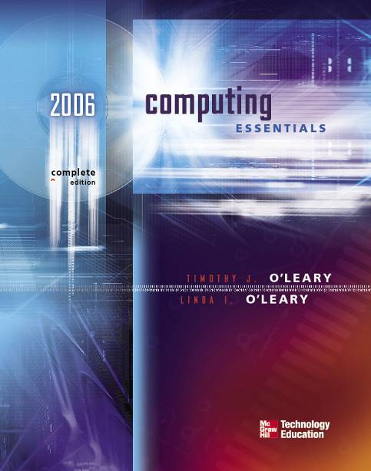

7
CHAPTER
INPUT AND OUTPUT
Page 150
Notes:
Most of the electronic devices used in daily life involve input or output.
Connecting to the information in a computer always involves input or output.
Input devices translate our knowledge into computer language.
Output devices present computer language in a format we can understand.

Slide 2
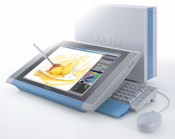
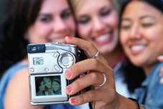
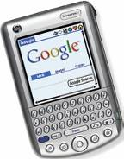
Competencies (Page 1 of 2)
Define input
Describe keyboard entry, pointing devices, & scanning devices
Discuss image capturing devices, digitizing devices, & audio input devices
Page 178

Slide 3
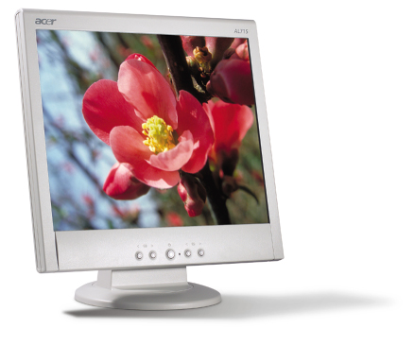
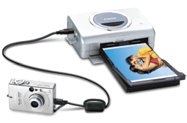
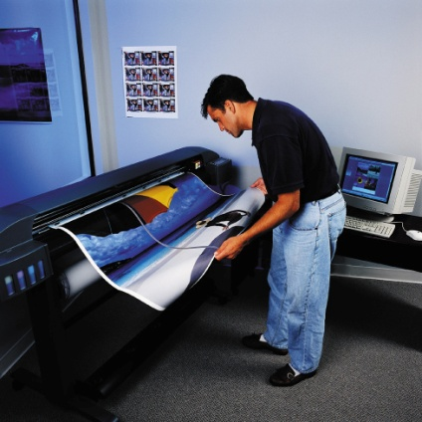
Competencies (Page 2 of 2)
Define output
Describe monitors, printers, and audio output devices
Discuss combination input & output devices
Page 178

Slide 4

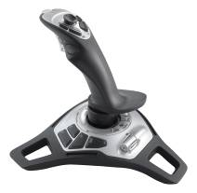
What is Input?
Any data or instructions used by a computer
Input devices
  Hardware
    Keyboards
    Pointing devices
    Scanners
    Other devices
  Translates data into a form that the system unit can process
Page 180
Notes:
Input devices are hardware used to translate words, sounds, images, and actions that people understand into a form that the computer can understand
Input allows user to put their information into computer language
Most common are keyboard, mouse, “light” pens, and increasingly voice!

Slide 5
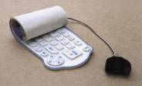
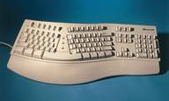
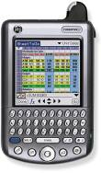
Keyboard Entry (Page 1 of 2)
Keyboards
  Traditional keyboards
  Flexible keyboards
  Ergonomic keyboards
  Wireless keyboards
  PDA keyboards
  Features
    Typewriter keyboard with numeric keypad
    Special purpose keys
      Toggle and combination keys
Page 180
Notes:
Keyboards come in a variety of designs
Range from full-sized to miniature and from rigid to flexible
Common types
Traditional
Flexible – fold or roll up fore easy packing or storage
Ergonomic keyboards – similar to traditional
Keyboard arrangement is not rectangular and a palm rest is provided
Wireless
PDA - miniature keyboards

Slide 6
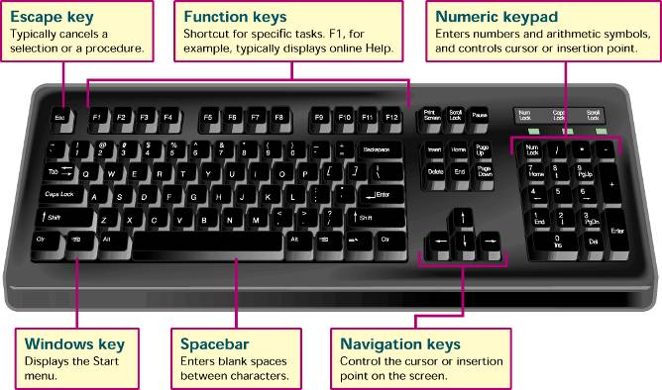
Traditional Keyboard (Page 2 of 2)
Return
Page 181
Notes:
Features
Numeric key pad – used to enter numbers and arithmetic symbols
Toggle keys
Cap Locks
Combination keys – perform an action when used with other keys
CTRL key

Slide 7
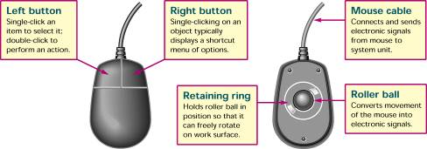
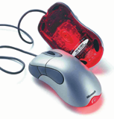
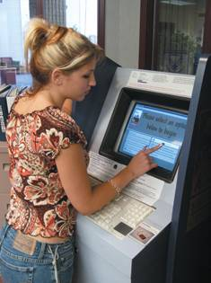
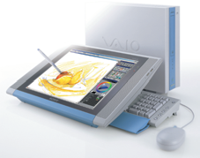
Pointing Devices (Page 1 of 2)
Mouse
  Mechanical
  Optical
  Cordless or wireless
Joystick
Touch Screen
Light Pen
Page 182
Notes:
Direct entry creates machine-readable data that can go directly to the CPU.
Pointing devices mouse, joystick, touch screen, light pen, and stylus
Mouse
Mechanical – traditional type; left/right button and mouse ball
Optical – has no moving parts
Emits and senses light to detect mouse movement
Can be used on any surface
Cordless – battery powered
Uses radio waves or infrared light waves
Joystick – input for computer games
Touch Screen – a kind of monitor with a clear plastic outer layer
Easy to use
Commonly used at restaurants, ATMs, and information centers
Light pen – a light sensitive pen-like device

Slide 8
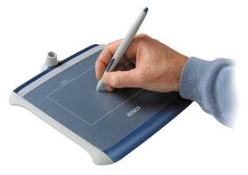
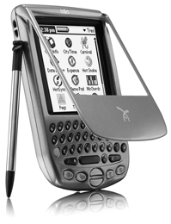
Digitizing Devices (Page 2 of 2)
Graphics Tablets
Stylus
Return
Page 184
Notes:
Graphics tablets – use a special graphics surface or tablet and a stylus; record sketches and tracings of maps and other drawings
Used by artist, mapmakers, and engineers
Stylus – uses pressure to draw images on a screen; interacts with a computer through handwriting recognition software

Slide 9
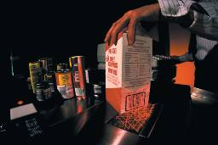
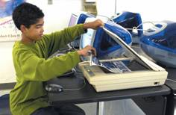

Scanning Devices (Page 1 of 2)
Optical scanners
  Flatbed
  Portable
Bar code readers
  Handheld wand readers or platform scanners
  Contain photoelectric cells that read bar codes
Page 184
Notes:
Scanners move across text and images
Devices convert scanned data into a form the system unit can process
Types
Optical – known as a scanner
Recognizes light, dark, and colored areas that make up individual letters or images
Types
Flatbed – much like a copy machine
Portable – typically a handheld device that slides across the image making direct contact
Bar Code Readers
You see these devices at the grocery store
Wand scanner or platform scanner
Reads bar codes or vertical zebra striped marks printed on product containers
Products have a UPC (Universal Product Code)

Slide 10
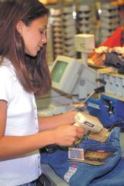
Scanning Devices (Page 2 of 2)
Character and mark recognition devices
  Scanners that recognize special characters & marks
  Magnetic ink character recognition (MICR)
  Optical-character recognition (OCR)
  Optical-mark recognition (OMR)
Return
Page 185
Notes:
Character and mark recognition devices
MICR – used by banks to read magnetically encoded characters
OCR – specially preprinted characters are read by OCR devices such as wand scanners
OMR (also called mark sensing) – devices sense the presence or absence of marks, common for test scoring

Slide 11

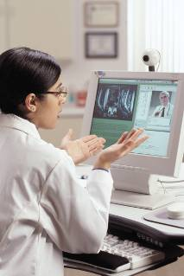
Image Capturing Devices (Page 1 of 3)
Digital camera
  Images recorded digitally on a disk
  Images can be downloaded to a computer
Digital video camera
  Records motion digitally
  Can take still images as well
  WebCams
    Specialized digital video cameras
    Broadcast images over the Internet
Page 186
Notes:
These devices create or capture original images
Digital camera – similar to traditional cameras except images are recorded digitally on disk or camera’s memory
Digital video camera – records motion digitally on a disk or camera’s memory
Can take still photos as well
Web-cams – specialized digital video cameras that capture images and send them to a computer to broadcast over the Internet

Slide 12
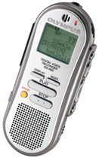
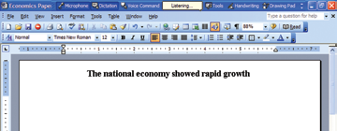
Audio-Input Devices (Page 2 of 3)
Voice
  Voice recognition systems
    Using the language bar in Microsoft Word you can switch between voice command mode and dictation mode to enter text and commands into documents
Portable Digital Voice
Recorder
Page 187
Notes:
Convert speech into digital code; most common device is the microphone; gaining in popularity are the portable digital voice recorders used with voice recognition systems
Voice recognition systems
Microphone, bundled with sound card and software
Some voice recognition systems must be trained for user’s voice
Some can translate from one language to another
Language bar in Microsoft Word
Voice command mode – allows the user to select menu items, toolbars, and dialog box options
Dictation mode – allows the user to dictate text directly into a Word document

Slide 13
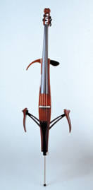
Audio-Input Devices (Page 3 of 3)
MIDI - Musical Instrument Digital Interface is a standard that allows musical instruments to connect to the system unit in the form of encoded digital signals representing musical sounds
Yamaha MIDI Silent Cello
Yamaha MIDI Silent Cello
Return
Page 190
Notes:
MIDI – a standard that allows musical instruments to connect to the system unit using MIDI ports

Slide 14
What is Output?
Processed data or information
Types of output
  Text
  Graphics
  Audio & video
Output devices
  Monitors
  Printers
  Other Devices
Page 190
Notes:
Converts machine-readable information into people-readable form
Four most common output types – text, graphics, audio, and video
Monitors are commonly called display screens and the output is referred to as soft copy

Slide 15
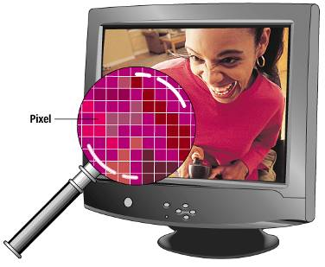
Monitors (Page 1 of 2)
Known as screens or display screens
Output referred to as soft copy
Features
  Resolution-pixels
  Dot pitch
  Refresh rate
  Size
Page 191
Notes:
Standards indicate screen quality (resolution). Some monitors are used on the desktop, others are portable.
Features
Resolution – one of the most important features; images are formed on a monitor by a series of dots or pixels (picture elements)
Dot pitch – the distance between each pixel; most newer monitors have a dot pitch of .31 mm (31/100th of a millimeter) or less
Refresh rate – indicates how often a displayed image is updated or redrawn on the monitor; most monitors operate at a rate of 75 hertz which means that the monitor is redrawn 75 times each second; flickering indicates that the monitor rates are lower than 75 hertz
Size – or viewable size is measured by the diagonal length of a monitor’s viewing area
Common sizes are 15, 17, 19, and 21 inches

Slide 16
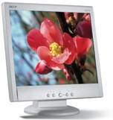
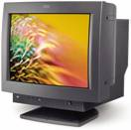
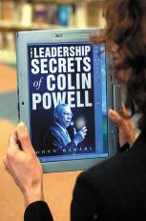
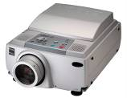
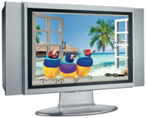
Monitors (Page 2 of 2)
Cathode-ray tube or CRTs
Flat-panel
  Require less power to operate
  Portable and thinner than CRTs
Other monitors
  E-books
  Data projectors
  High-definition television (HDTV)
Return
Page 191
Notes:
Cathode-Ray Tubes – similar to television technology; are bulky
Flat-Panel Monitors – or liquid display (LCD) monitors
Passive-matrix or dual-scan – images created by scanning the entire screen
Active-matrix or thin film transistor (TFT) – each pixel is individually activated
eBook – also called e-book readers; handheld, book sized; cost less than publishing and delivery of printed matter
Data projectors – similar to slide projectors; extension of monitor
HDTV – merger of microcomputer and TV called PC/TV; output is digital so can freeze video sequences to create high-quality still images

Slide 17

Printers (Page 1 of 2)
Translates information that has been processed by the system unit
Output referred to as hard copy
Features
  Resolution
  Color capability
  Speed
  Memory
Page 193
Notes:
Printers translate information that has been processed by the system unit and present the information on paper
Output is called hard copy
Features
Resolution – measures the clarity of images produced
Measured in dpi (dots per inch)
Most printers use an average of 1200 dpi; the higher the dpi, the better the quality of image produced
Color capability – more expensive to print in color; usually have the option to print in either color or b/w
Speed – measured in the number of pages printed per minute
10-15 pages per minute is the average for a single color page (black); 5 to 10 pages per minute for color
Memory – used to store printing instructions and documents waiting to be printed

Slide 18

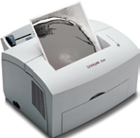
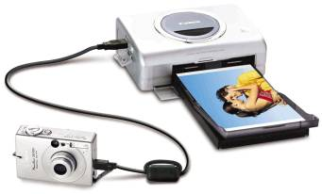
Printers (Page 2 of 2)
Ink-jet printer
Laser printer
  Personal laser printers
  Shared laser printers
Thermal printer
Other printers
  Dot-matrix
  Plotters
  Photo printers
  Portable printers
Return
Page 194
Notes:
Three major types of printers: ink-jet, laser, and thermal; most people are familiar with these
Inkjet printers spray ink at high speed onto the surface of paper
Laser printers uses a laser light beam to produce images
More expensive than ink jet printers
Thermal printers – uses heat elements to produce images on heat sensitive paper
Used to produce high quality art work
Other Printers
Dot-matrix – slow and not used much any more; poor quality but faster than some of newer printers
Very noisy
Inexpensive
Plotters – special purpose for maps, images, architectural & engineering drawings
Photo printers – designed to print photographs from digital cameras
Portable printers – usually small/lightweight and designed to work with a notebook computers; may be ink-jet or laser printer that prints in either b/w or color

Slide 19

Audio-Output Devices
Translates audio information from the computer into sounds that people can understand
Common devices
  Speakers
  Headphones
Return
Page 196
Notes:
These devices produce sounds for people
Connected to a sound card in the system unit
Voice output is quite common; creating voice output is not as difficult as recognizing and interpreting voice input

Slide 20
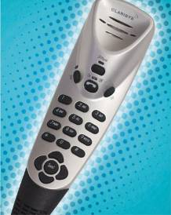
Combination Input and Output Devices
Many devices combine input and output capabilities
Fax machines
Multifunction devices
Internet telephones
  known as Telephony
  and Voice-over IP (VoIP)
  Three approaches
Terminals
Page 196
Notes:
Combination devices include fax machines, multifunction devices, Internet telephones, and terminals
Internet telephone – specialized input and output devices for receiving and sending voice communication
Connect to the system unit through a USB port
Telephony – the transmission of telephone calls over computer networks
Known as Voice over IP
Uses Internet rather than traditional
Requires
Internet telephone
Internet
Special service provider
Sound card
Special software
Terminal is an input and output device that connects to a mainframe or a host computer

Slide 21
Internet Telephone
Computer-to computer
  Place free phone calls when using a computer to send and also to receive via the Internet
  Software is available for free or very low cost
Computer-to traditional telephone
  Place the call from a computer to a phone using an Internet phone service provider that supplies the software for a small monthly fee and/or airtime fee
Traditional telephone-to-traditional telephone
  Subscription to an Internet phone service provider that supplies a special hardware adapter to connect a traditional phone to the Internet with a fee connected to service
Return
Page 197

Slide 22

Terminals
An input and output device
Connects to a mainframe or server
Types of terminals
  Dumb terminal
  Intelligent terminal
  Network terminal
  Internet terminal
Return
Page 197
Notes:
Terminals – input and output device connecting users to mainframe computers
Dumb terminal – no processor or local storage
Intelligent terminal – CPU, memory and storage; Net PC, or Net Personal Computer
Network terminal – low cost alternative to intelligent terminal
Internet terminal – or Web terminal or Web appliance, accesses and displays Web pages on a television set

Slide 23

A Look to the Future
Electronic Translators May Be in Your Future
Electronic Interpretation may soon exist to provide personal interpretation for foreign languages and images
Prototype portable handheld electronic interpreters are currently in a testing phase at the U.S. Office of Naval Research
Creating is labor intensive using both linguists and programmers
Page 199
Notes:
Researchers have begun human trials that allow humans to control machines with their thoughts
Brain machine interface is currently pursued as a way to allow those with certain disabilities to become functional

Slide 24
Discussion Questions (Page 1 of 2)
Define input and output devices.
Describe the different types of pointing, scanning, image capturing, and audio-input devices.
Describe the three categories of output devices.
Page 206
Notes:
Have students turn to the end of Chapter 7 in their textbooks to view the same “Open-Ended” questions/statements

Slide 25
Discussion Questions (Page 2 of 2)
Define input and output devices.
What are combination input and output devices? Describe four such devices.
Page 206
Notes:
Have students turn to the end of Chapter 7 in their textbooks to view the same “Open-Ended” questions/statements

