Slide 1
How the Internet Works

Slide 2
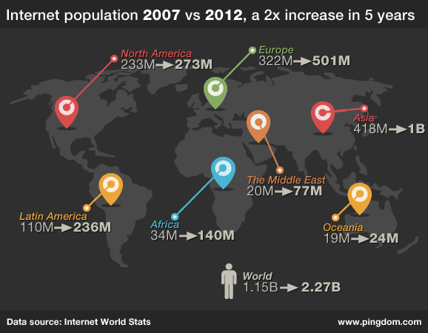
Internet
Notes:
What makes the Internet work at all, is something called the Internet Protocol (IP). You may have heard of the term IP Address. A protocol is a set method for a way of doing things.
We use protocols in the ‘real’ world all the time.
Phone calls: etc

Slide 3
INTERNET TECHNOLOGY
Network architecture used is TCP/IP (transmission control protocol/internet protocol)
Client/server technology is the key to the net
Connection to internet
Computer - TCP/IP is not hardware specific
Telephone line - Transmits information
Modem - Converts digital signals to analogue signals and vice versa
Communications software - Controls exchange of information
Service provider - Allows user to share it’s direct leased line internet connection

Slide 4
THE INTERNET
Internet Addresses
Internet addresses (IP addresses) comprise four numbers, separated by full stops, each one less than 256 e.g. 122.234.34.8
Sometimes called dotted quad
No two computers can have the same address
These numbers are assigned names by the Online Domain System
Each Domain is given responsibility for creating names within its own group
Domains include:
.com, .org, .edu, .ie, .uk etc.
Notes:
That’s basically how the Internet works. You tell your computer to connect to a resource, let’s say MakeUseOf.com. Just pulled that out of my hat. MakeUseOf.com is a human readable form for the IP address 216.92.56.91. Who’s going to remember that? Exactly.
So we have something called a Universal Resource Locator (URL) like MakeUseOf.com. Something called a Domain Name Server (DNS) which looks up that URL and then figures out the IP address associated with it. Think of a REALLY big phone book. You look up your plumber’s name and then you figure out what his phone number is.

Slide 5
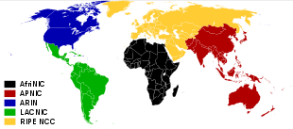
Notes:
What the above image shows is the available IP version 4 (IPv4) space. MakeUseOf.com is located in the 216 block. Remember that from the first 3 digits of the IP address? That block belongs to ARIN - American Registry for Internet Numbers. Kind of like how the country code 353 belongs to Ireland
RIPE : Réseaux IP Européens Network Coordination Centre

Slide 6
Data Packets
Notes:
.Each piece of data you send out is broken down into packets. Imagine mailing your friend a book, page by page. Each page will have to carry your friend’s address and the page number to let him know what order it goes in. It should also let him know how many pages there are, so he knows when he has it all. They should also have your address, so if the mail person can’t deliver it, they know where it came from.
So, each packet carries the intended IP address, a number to determine where the packet fits back into the data sent, how many packets to expect, as well as your IP address

Slide 7
INTERNET TECHNOLOGY
WORLD-WIDE WEB (WWW)
A system and set of standards for storing, retrieving, formatting, and displaying information in a networked environment using graphical user interfaces and dynamic links to other documents
Hypertext
Text or images which contain a link to where further information about the phrase or picture is stored
Computer supported non-linear viewing of information
Ideal hypertext
no structure
No beginning or end
Hypermedia
A combination of Hypertext and other Multimedia

Slide 8
World Wide Web
HTTP
Hypertext transfer protocol
The communications standard used to transfer pages on the web
Primarily used as an internet protocol
Also used in supporting enterprise wide distributed information systems within a single business
HTTP documents are edited to a special format called Hypertext Markup Language (HTML)
HTML
Used for publishing documents
Codes for document title, headings and paragraphs etc.
Encodes hypermedia anchors containing URL links
Include elements of multimedia or pointers to multimedia files

Slide 9
Gateways to the Web
Search engines sift through the text on the web and try to find things that match. Different search engines bring different results back!
Two commonly used search engines
www.yahoo.com (Now owned by BING)
www.bing.com (Microsoft)
www.google.com (Google)
.

Slide 10
What a Search Engine Isn’t
It doesn’t check content for you
There are also filters that are sometimes in place that reduce your content!
It doesn’t guarantee authenticity
Just like a book or a newspaper, a webpage can be wrong, or very biased
It doesn’t filter out rubbish for you
In fact it may be set to filter out good stuff
It can’t figure out what you really meant ☺
It only knows the letters you type and the order

Slide 11
Googling
Google has been such a popular search engine that people use the term as a verb
Google it!
Since it is so popular, and unlike Yahoo!, isn’t categorized I’ll show you some tips and tricks

Slide 12
www.google.com
But wait, there's more!
There are a lot more things to Google than the basic search. The first thing to notice is the labels at the top. These change your search type.
You can add www.google.com/advanced_search to the URL bar and get a more specific search.

Slide 13
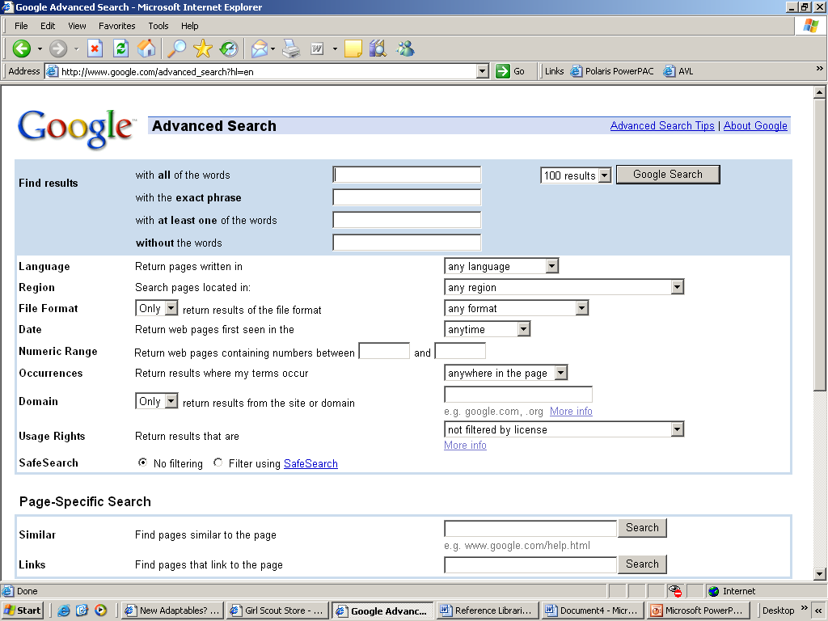

Slide 14
Search Box Tricks
“Monkey time” : would search for monkey time, in that order exactly
Monkey time : would search for any page with monkey AND time on the same page
Monkey OR time : would search for any page with monkey on it, or any page with time on it
Monkey –time would search for any page with monkey but without time (- = not)

Slide 15
Search Box Tips
( ) can be used to enclose a search
(Monkey OR banana) time : would search for any page with monkey or banana that ALSO has time on it.
Searches can be very exacting!
(“monkey with a banana” OR “monkey in a tree”) AND (time lunch spotted (lost OR found)) : the AND is not needed but won’t mess the search up either, and helps make it more clear ☺ ( ( stuff) ) is called “Nesting”

Slide 16
Truncating
Sometimes you can search using special symbols like * and ?
These take the place of letters when you don’t know them.
? Says “I’m not sure” within a word. For example: wom?n would get results for womAn or womEn while wom* might get womb, women, woman, women’s etc. * is harder to use on Google search. Just be aware of the option ☺

