Slide 1
Learning To Learn: Group Presentation
By Colin Gaughan
Patrick Obispo
Notes:
To view this presentation, first, turn up your volume and second, launch the self-running slide show.

Slide 2
“HIGELLA”
The TV chef, Nigella Lawson, allegedly took drugs such as cocaine as well as class B and prescribed drugs a court has heard. She did it for ten years and during her marriage with her ex-husband Charles Saatchi. Charles Saatchi blames her for trashing their daughter's life and the family’s life. He also stated that she was so “off her head” she gave permission to her two PA’s, Elisabetta and Francesca Grillo, to use the divorced couple’s company credit card and spend it on anything they want.

Slide 3
Tabloids
VS
Broadsheets
Notes:
Half of the people in your audience are verbal thinkers and the other half are visual.

Slide 4
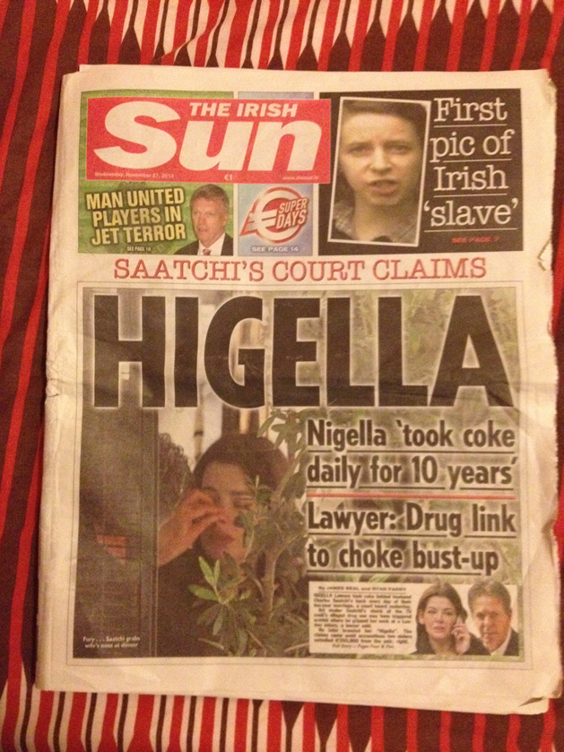
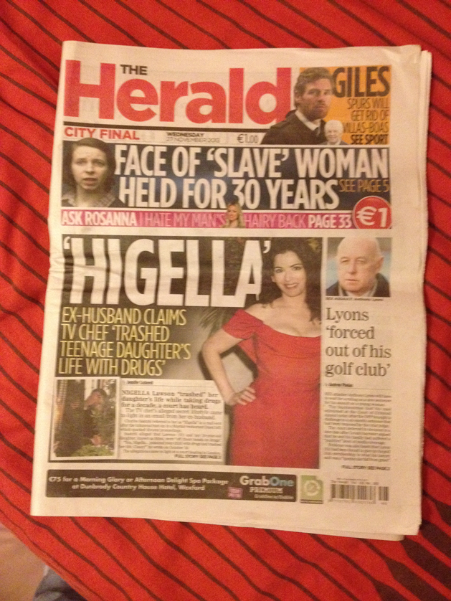
TABLOIDS

Slide 5
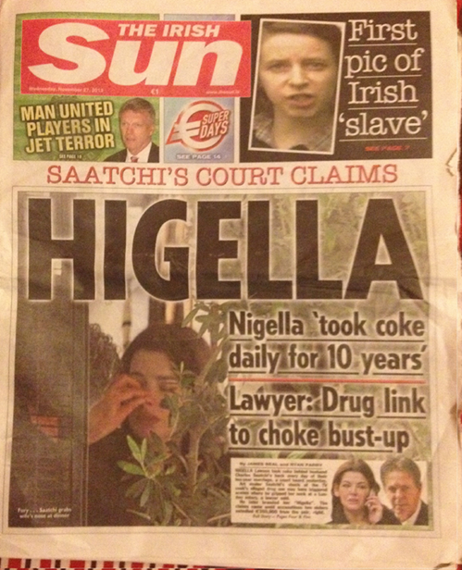
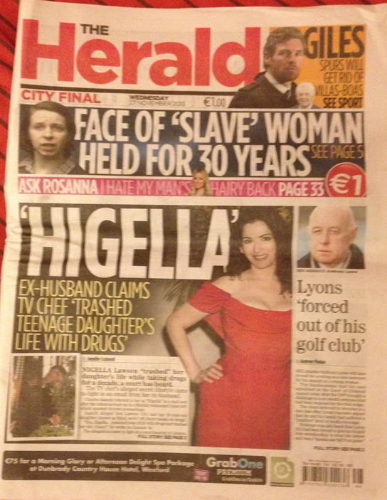
The newspapers provide us pictures relating to the story which is the alleged drug use of Nigella Lawson (the holding of the nose).
Even though there are a few sub stories surrounding the news item, the sub stories doesn’t take the attention off the news item chosen.
The headline, which is “HIGELLA”, is in bold and this catches the attention of the readers.
The framework that the news item is in, takes up half of the front covers which indicates that it is important news.
As we can see there is limited information of the story in the front page. This allows readers to be more intrigued to read the article and this is also a characteristic of a tabloid.

Slide 6
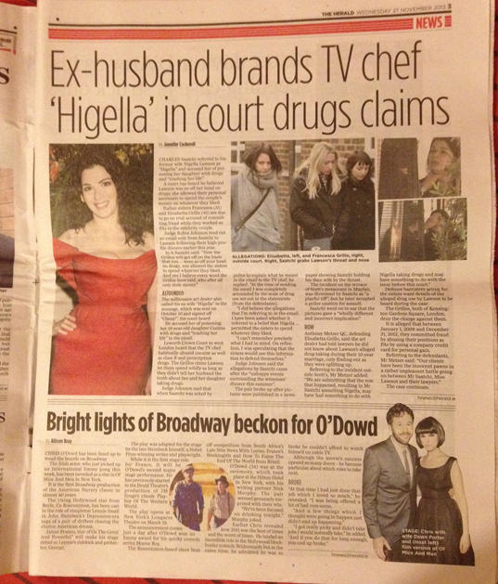
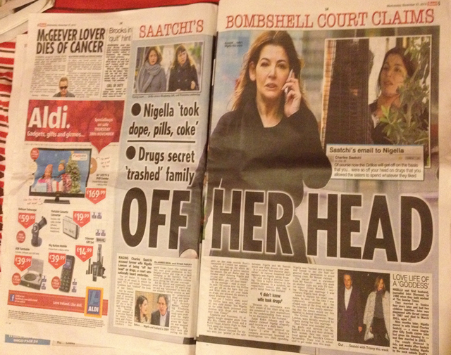
The pictures provided illustrate the news item which adds an interest to the readers. The pages almost look like a poster and this is an extreme effort to grab the attention of the readers. Nigella is portrayed “wrecked” in The Irish Sun while in The Herald it doesn’t.
The framework that the news item is in, takes up almost all of the page in both newspapers. The news item took up two pages (pg. 4 & 5) in The Irish Sun and one page (pg. 3) in The Herald. This shows us that the news item has an importance to both newspapers.
The articles are very short compare to a broadsheet which has a very long article.

Slide 7
TABLOIDS: NEWS ITEM ANALYSIS
THE IRISH SUN & THE HERALD
Simple and easy to understand.
Mixed facts and emotions together.
Mixed different stories in the articles.
Bias.
Some information could be untrue.
Uses heightened language (over the top language).
Focuses more on famous people and their private lives and scandals.
Articles written very “slangy”/informal.
Focuses more on gossip instead of major stories.

Slide 8
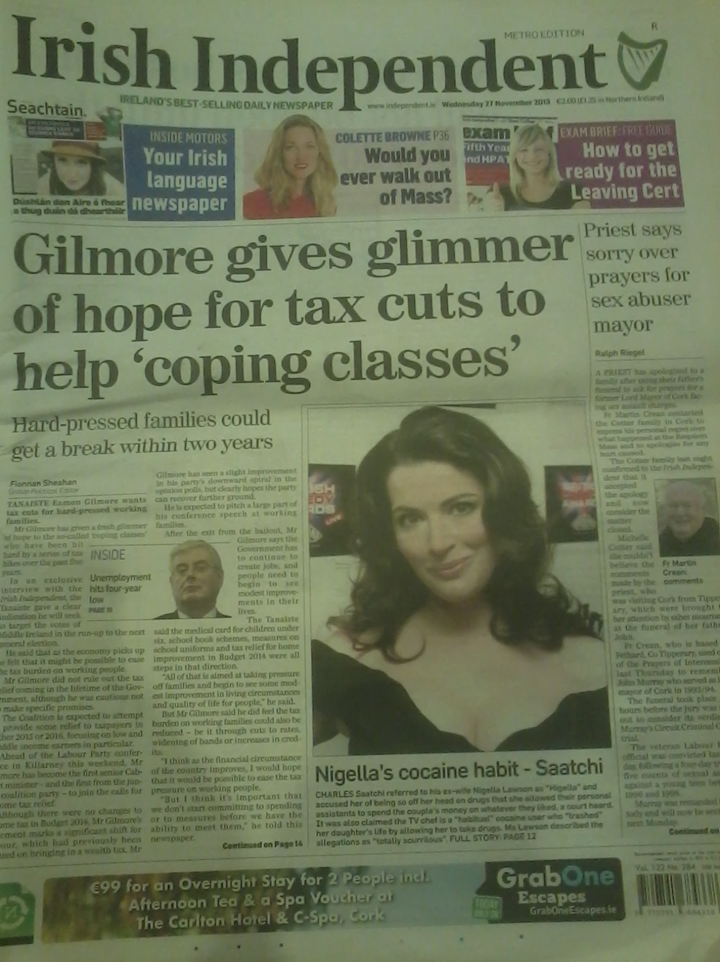
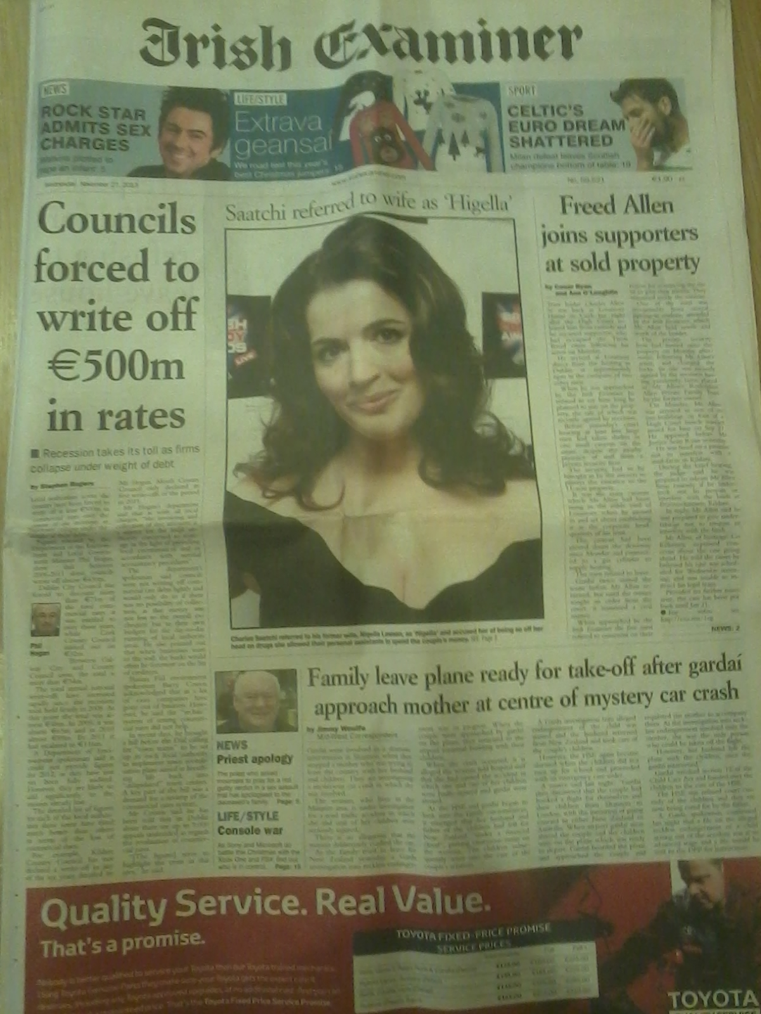
BROADSHEETS

Slide 9
The story is not the main headline on the newspapers. It only has a picture of Nigella and a brief summary of the story.
There is limited information on the story on the front pages as broadsheets aim to be provide information on more important issues.
The story is in the centre of both paper and the big image of Nigella draws the reader’s attention.
As with all broadsheets, more serious matters take preference over “celeb scandals”.

Slide 10
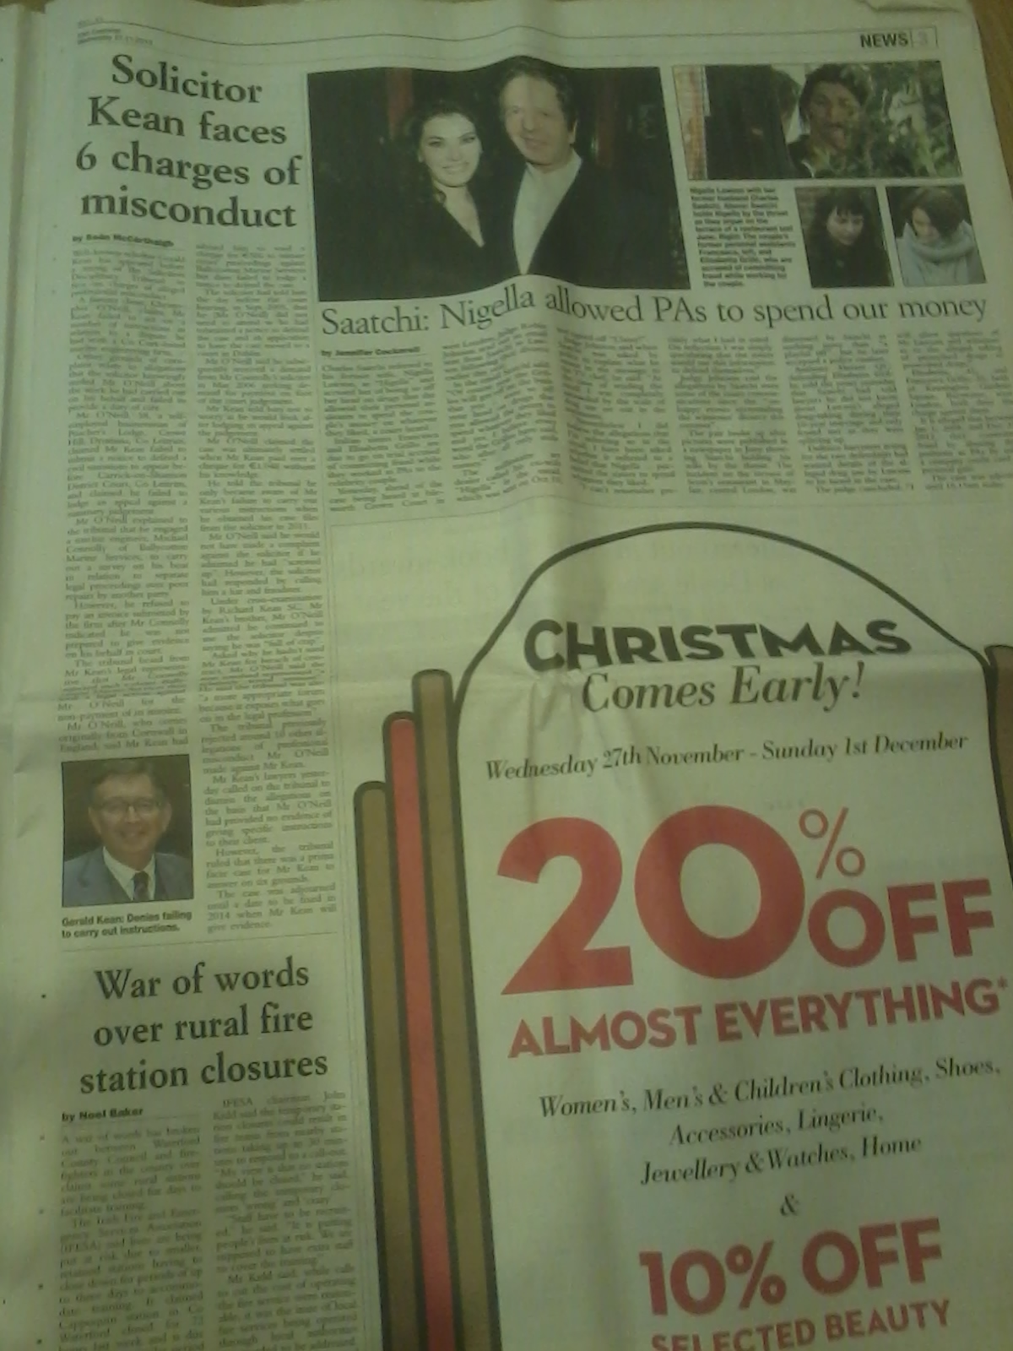
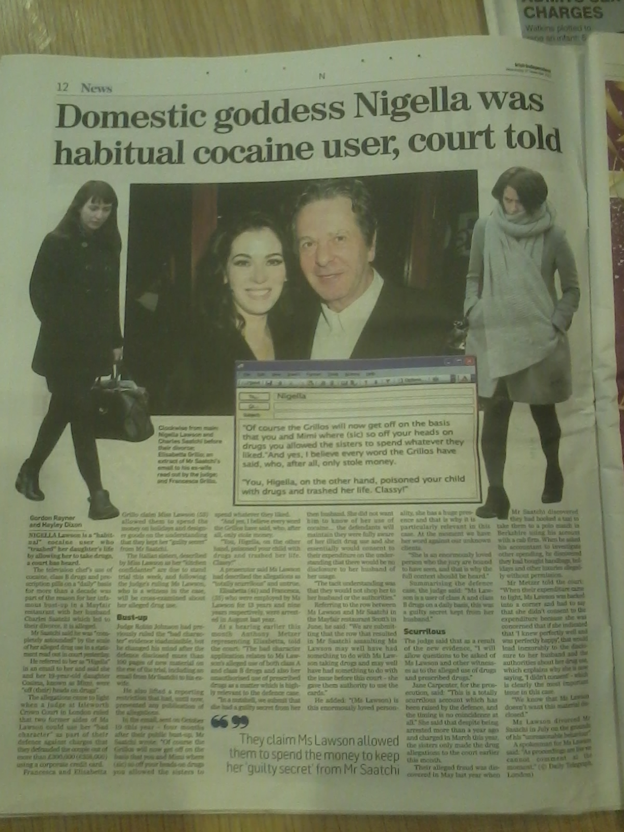
Both papers have the same image of Saatchi and Lawson together in happier times.
They have images of all the parties in the court case which helps them to be unbiased by not focusing solely on the drug use claims.
The articles are very long in order for the newspapers to provide an unbiased and factual source of information for readers. They look at both sides of the story.
The two papers have used a longer, more informative title than the two tabloids we have looked at. This is a common feature of broadsheets.

Slide 11
BROADSHEETS:NEWS ITEM ANALYSIS
THE IRISH EXAMINER & THE IRISH INDEPENDENT
Front page of both. On the broadsheets a much more serious matter is dealt with in the main story.
‘Irish Examiner’ has placed the story page 3. About 1/3 of page.
Page 12 of the ‘Irish Independent’. Full page.
The language is formal and serious.
Factual and unbiased.
Terms such as “alleged” and “claimed.
Irish Independent: a claim is made, however, at then end of the sentence they say “a court has heard”.
Quote from Grillo sisters’ defence lawyer.

Slide 12
Conclusions

Slide 13
SOURCES
ARTICLES: The Irish Sun, The Herald, Irish Examiner, Irish Independent.
http://leavingcertenglish.net/2011/05/broadsheets-vs-tabloids/
http://journalism.about.com/od/trends/a/tabloidsbroadsheets.htm

Slide 14
THANK YOU!

