Slide 1
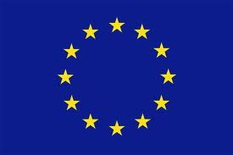
EU institutions
EU = a politically unique system
More than just a confederation of states but not a federal state
Federalism: the principle of sharing power and sovereignty between levels of governance, usually between central government and sub-state level (state – USA; province – Belgium or canton – Switzerland; Lander – Germany)
In constant evolution for 58 years
Institutional triangle
Council of the European Union
European Parliament
Commission

Slide 2
EU Institutions (2)
In brief:
Council of Ministers `(Council of the European Union)
represents the member states
Is EU’s main decision-making body
EP= European Parliament
Represents the people - the citizens of Europe
Shares legislative and budgetary power with Council (co-decision)
Commission
Represents the common interest of the EU
Is the main executive body
Has the right to propose legislation and ensures that EU policies are implemented

Slide 3
The Commission
A unique organisation – no counterpart
A hybrid organisation between executive (government) and bureaucracy (administration)
A ‘supranational’ institution
Dates back to ECSC / 1952 (High Authority)
A political executive wing of 28 Commissioners (the College) and their staff (the Cabinets)
An administrative wing: the ‘services’
A president: Jose-Manuel barroso

Slide 4
The Commission (2)
Functions:
Initiates policy and represents general interest of EU
Acts as guardian of the Treaties
Monitors policy implementation; ensures application of EU legislation
Manages and negotiates international trade and cooperation agreements
As a ‘supranational’ institution, it acts independently of EU Member States – does not take political instruction from national governments

Slide 5
Commissioners
College of 28 meet once a week
Decisions are made by majority voting – consensus is preferred
28 portfolios allocated by president
Own private staff: “Cabinet” of 7 officials
Take oath of independence
Responsible for over 30 DGs (Directorates General = Commission departments)
A difficult balancing act
Neven Mimica: Commissioner from Croatia, with Consumer Policy portfolio = 28th Commissioner

Slide 6
Administrative Commission
A bureaucracy of 25,000 civil servants
Over 30 DGs
Policy-making posts (approx.6,000)
Research and development
Translating and interpreting (24 official languages)
Is based in Brussels (Belgium)

Slide 7
The Commission President
Jose-Manuel Barroso
Born Lisbon (Portugal) 23 March 1956
Agreed by national governments
Selects other Commissioners
Can reject nominee of member state
Has final say in allocation of portfolios
Has right to shuffle team and redistribute portfolios
Has gone from ‘primus inter pares’ to ‘primus super pares’ (from ‘one among equals’ to ‘one above equals’)
Has political leadership

Slide 8
The European Parliament
Relatively low profile
Only directly-elected institution of EU
Develops and shapes policies and laws
Acts as ‘voice of the people’
Has 736 members (2009-2014)
Elected every five years
Direct universal suffrage
Ground rules: gender equality and secret ballot
Voting age: 18 (Austria: 16)
Independent legislators

Slide 9
736 MEPs
Number of MEPs per country dependent on size of population
Germany: 99 - Malta: 5
One third of MEPs are women
Ireland: 12 MEPs in 4 Constituencies
From 2014: 11 MEPs in 3 Constituencies
Over one third of Irish MEPs are women (5 out of 12)
Brussels, Strasbourg, home constituencies
Do not sit in national delegations but according to political affinities

Slide 10
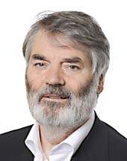
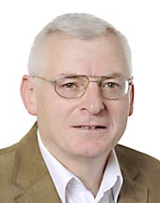
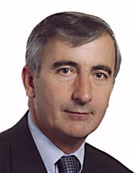
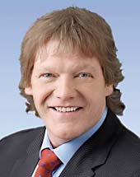
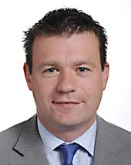
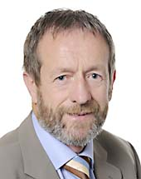
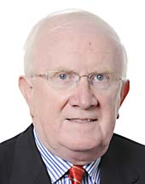
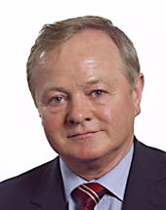
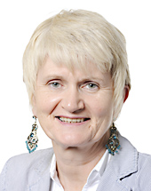
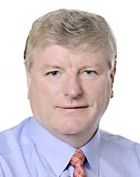
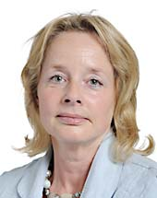
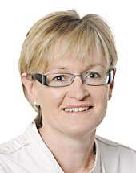
Irish MEPs 2009
Dublin
De Rossa, Prionsias (Labour)
Higgins, Joe (Socialist Party)
Mitchell, Gay (Fine Gael)
South
Crowley, Brian (Fianna Fail)
Kelly, Alan (Labour)
Kelly, Sean (Fine Gael)
North-West
Gallagher, Pat the Cope (Fianna Fail)
Harkin, Marian (Independent)
Higgins, Jim (Fine Gael)
East
Aylward, Liam (Fianna Fail)
Childers, Nessa (Labour)
McGuiness, Mairead (Fine Gael)

Slide 11
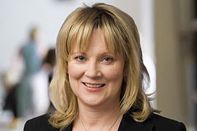
Irish MEPs 2013
Dublin
Costello, Emer (Labour)
Murphy, Paul (Socialist Party)
Mitchell, Gay (Fine Gael)
South
Crowley, Brian (Fianna Fail)
Prendergast, Phil (Labour)
Kelly, Sean (Fine Gael)
North-West
Gallagher, Pat the Cope (Fianna Fail)
Harkin, Marian (Independent)
Higgins, Jim (Fine Gael)
East
Aylward, Liam (Fianna Fail)
Childers, Nessa (Independent)
McGuiness, Mairead (Fine Gael)

Slide 12
7 political groups
European People’s Party (EPP – Fine Gael)
Progressive Alliance of Socialists and Democrats (S&D – Labour)
Alliance of Liberals and Democrats for Europe (ALDE - Fianna Fail)
Greens / European Free Alliance (Greens)
European Conservatives and Reformists Group
Confederal Group of the European United Left – Nordic Green Alliance (Socialist Party)
Europe of Freedom and Democracy Group

Slide 13
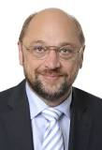
The EP
Largest political group: EPP
MEPs elect a President
Martin Schulz (Germany)
Multilingualism: 24 official languages
EP = world’s largest employer of translators and interpreters (1/3 of all staff)
Secretariat (4,600 staff) in Luxembourg and Brussels
Secretary-General

Slide 14
3 main Functions of EP
Supervisory
Control over Commission and Council
Approval of major international decisions (assent procedure e.g. enlargement)
Approval of Council’s nominee for Commission President
Appoints whole Commission
Right of censure
Legislative
Right of co-decision
Budgetary
Approval of EU budget
Final say in some areas (spending on regions, education, culture, social policy)
Not on agriculture

Slide 15
Report from the EP 23/10/13
March 2012: The EP set up a Special Committee on Organized crime, Corruption and Money laundering to assess the impact of mafia-type activities on the EU’s economy
In October 2013 it has approved a number of measures such as:
Anti-corruption and anti-money laundering proposals
Proposals to abolish banking secrecy and eliminate tax havens as well as impose greater penalties on those involved in human trafficking
According to figures published by the European Commission:
Trafficking in human beings generates criminal profits estimated at €25 billion across the world
The total number of forced labourers in the EU is said to be about 800,000, of whom 270,000 are victims of sexual exploitation
The cost of corruption in the EU is calculated at some €120 billion a year (1.1 per cent of the EU’s GDP)

Slide 16
The Council of the EU
Primary decision-making body of EU
Represents interests of national governments
‘Voice of Member States’
Configuration of Council varies according to issue / portfolio
Presidency held for six months on rotational basis (pre-established rota)
Ireland: 1 Jan – 30 June 2013
Lithuania: 1 July – 31 December 2013

Slide 17
Council (2)
Passes laws, usually jointly with EP (Co-decision)
Co-ordinates economic policies of Member States
Defines and implements EU CFSP (Common Foreign and Security Policy)
Concludes international agreements
Adopts measures in area of police and judicial cooperation
With EP, has authority over EU budget
Produces regulations, directives, decisions, common positions, recommendations

Slide 18
Voting Systems
3 forms of voting
Simple majority for questions of procedure
Unanimity for constitutional questions (e.g. Accession of new Member States)
QMV: Qualified Majority Voting for the bulk of decisions (3/4 of all EU Legislation) 2 conditions for QMV:
As of 1 July 2013, QMV is set at 260 out of total of 352
Cast by at least 15 member states out of 28
Must represent at least 62% o the population of EU (315 million out total of 508 million)

Slide 19
QMV 2013
Distribution of votes for each Member State
Germany, France, Italy, UK 29 votes
Spain, Poland 27 votes
Romania 14 votes
Netherlands 13 votes
Belgium, Czech Republic, Greece, Hungary,
Portugal 12 votes
Austria, Sweden, Bulgaria 10 votes
Denmark, Croatia, Ireland, Lithuania,
Slovakia, Finland 7 votes
Cyprus, Estonia, Latvia, Luxembourg,
Slovenia 4 votes
Malta 3 votes
Total 352 votes

Slide 20
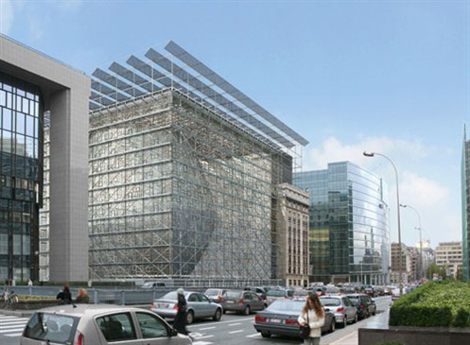
The European Council
A new institution, created by the Treaty of Lisbon (2009)
Meetings: 4 times a year (or more in periods of crisis) as ‘Summits’
Full-time President: Herman Van Rompuy
Located: Brussels – the Europa building
http://www.european-council.europa.eu/the-institution/europa-building?lang=en

Slide 21
The European Council (2)
A glance at the history of the European Council
The European Council was created in 1974 with the intention of establishing an informal forum for discussion between Heads of State or Government. It rapidly developed into the body which fixed goals for the Union and set the course for achieving them, in all fields of EU activity. It acquired a formal status in the 1992 Treaty of Maastricht, which defined its function as providing the impetus and general political guidelines for the Union's development. On 1 December 2009, with the entry into force of the Treaty of Lisbon, it became one of the seven institutions of the Union.
http://www.european-council.europa.eu/the-institution?lang=en

Slide 22
European Council (3)
What the EU Council does:
Provides impetus and political guidelines for the Union’s development
Does not have a legislative function
Who are its members?
Heads of State or Government of member states
How does it take its decisions?
Consensus is usual
How is President elected?
Usually by qualified majority but Van Rompuy elected unanimously in November 2009

Slide 23
European Council (4)
What does the Council President do?
“The President’s tasks include chairing the European Council meetings, driving forward its work and facilitating consensus. At this level and in this capacity, he also ensures the external representation of the Union on issues concerning the common foreign and security policy. The President’s term of office is two and a half years, renewable once.” (www.europa.eu)

Slide 24
The European Council (5)
Composition of EU Council meeting Brussels 24th-25th October 2013:
http://www.european-council.europa.eu/media/1001035/web_bce_24-25octobre.pdf
President of the European Council :Herman van Rompuy
28 Heads of State or Government
4 Presidents (France – Romania – Lithuania – Cyprus)
24 Prime Ministers or Chancellors
24 men and 4 women (Lithuania – Denmark – Germany – Slovenia)
President of the European Commission: Jose-Manuel Barroso
President of the European Parliament: Martin Schulz High Representative for Foreign Affairs and Security Policy: Catherine Ashton
Secretary-General: Uwe Corsepius

Slide 25
EU Institutions: in summary
The EU Institutions explained by their presidents
http://www.youtube.com/watch?v=Av2sI0dHXpQ
Question: Of the 4 main institutions of the EU, which, in your opinion, is the most powerful?
Other institutions:
The European Court of Justice (ECJ – Luxembourg)
The European Central Bank (ECB – Frankfurt)
The European Court of Auditors (ECA – Luxembourg)

Slide 26
Job in Europe for Kenny?
http://abonnes.lemonde.fr/idees/article/2013/10/30/la-vraie-fausse-bonne-idee-de-m-schulz_3505157_3232.html
http://www.irishtimes.com/news/politics/kenny-being-seriously-talked-about-for-european-roles-1.1582329#.UnZvK10VGuY.email
http://www.independent.ie/irish-news/politics/enda-is-talk-of-eu-as-he-is-linked-to-top-position-29721964.html

Slide 27
Etymology maps
http://imgur.com/a/iVK8a

