Slide 1
My Life
By: Patrick Obispo

Slide 2
About Me…
My name is Patrick Obispo.
I am 18 years old.
I live in James’s St. D8.
I went to CBS Secondary School where I completed my Leaving Certificate 2013.

Slide 3
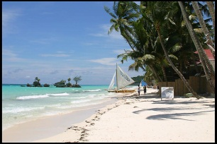
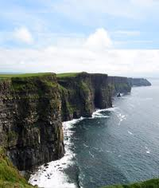
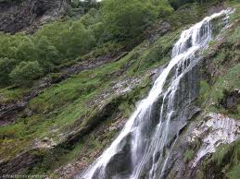
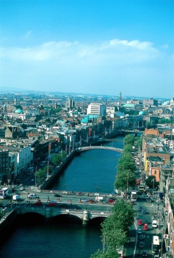
About Me…
The Philippines
I was born in Saudi Arabia but I am from the Philippines where I grew up. I went to school there but I continued my studies in Ireland.
I moved to Ireland, in 2003, with my sister when I was 7 years old. I’ve been living here for almost 11 years now.
Ireland

Slide 4
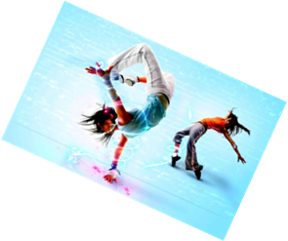
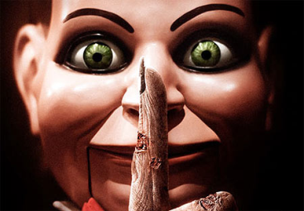
SINGING AND MUSIC One of my hobbies is to sing. For me singing is the best way to release stress. I inherited this talent from my father who also like singing. I also love to listen to music. I listen to all genres of music.
Hobbies and Interest
READING
I also like to read books. One of my favourite book is “The Fault in our Stars” by John Green.
MOVIES
I love watching movies especially horror movies.
DANCING
I also love to dance. I dance because it’s very enjoyable and fun.

Slide 5
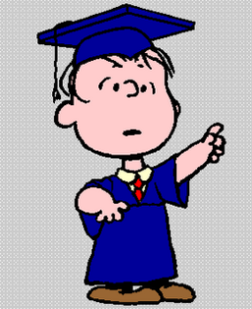
Experiences
Unfortunately, I do not have any experiences within this course but I am willing to learn and know more about this course.
Future Plans
I would like to get my degree for this course and hopefully work in an Advertising Agency or else go into Event Management. If not I would further my studies by getting a Master’s Degree and a PhD.
Why I chose this course?
I chose this course simply because I was interested on how influential an advertising can be. I was also curious on how advertisements are made and how they are introduce to the consumers. The other reason for choosing this course is it is a broad course and it has a lot of opportunities after it. I was also interested in the theories about advertising and marketing. What I Liked most about this course is that they offer a work experience in 4th year. This is a good opportunity to put all the theories into action.

Slide 6
THE END

