Slide 1
Software

Slide 2
Software
Application Software
Operating System Software
SCREEN BEAN INTRODUCTION — TEXT: How do we get data into the computer?
How do we get data and information out of the computer?

Slide 3
Software
Software describes the programs installed on computers.
Computers require two types of software:
- operating system software
- applications software

Slide 4
Figure 4.1 Categories of computer software

Slide 5
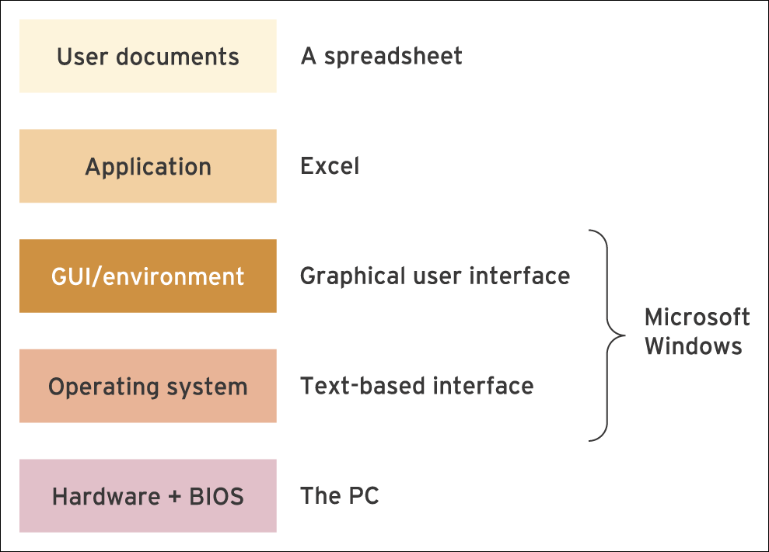
Figure 4.2 Diagram showing the relationships between the different types of software and hardware

Slide 6
Categories of software
Software: A series of detailed instructions that control the operation of a computer system. Software exists as programs that are developed by computer programmers.
Systems software: This form of software manages and controls the operation of the computer system as it performs tasks on behalf of the user.

Slide 7
Software Applications
System Software / Operating Systems
Application Software

Slide 8
Software Applications
System software has no other purpose than to run the computer; but without it, you couldn’t use application software. DOS, Linux and Windows NT are system software. System software is often referred to as an Operating System (OS); software that provides network services, like Windows NT and Novell NetWare, is referred to as a Network Operating System (NOS).

Slide 9
Software Applications
Application software is used for a purpose beyond merely operating the computer: for example, word-processors, spreadsheets, databases, e-mail, graphics and games programs - i.e. something useful! These programs are also referred to as software packages or software programs
General Purpose applications: This is also known as productivity software and describes a category of computer software that aims to support users in performing a variety of common tasks. (e.g. word processor, spreadsheet, database).
Application-specific software: This is intended to serve a specific purpose, for example software used in the marketing and accounting functions (see chapter 6 for more details).

Slide 10
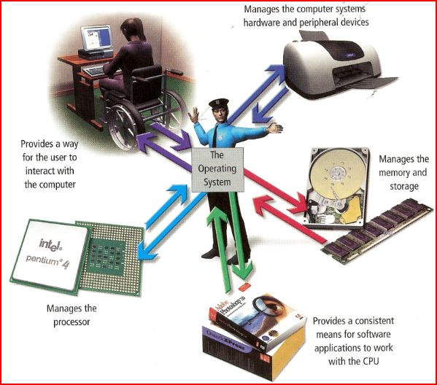
Operating System Software…
is busy behind the scenes, performing housekeeping tasks, enabling you to access programs, and managing files. It also ensures that everything is running properly.
Notes:
Explain how operating system software works in the background, keeping things running and making sure you can use the computer. Systems software is the interface between the user and the computer.

Slide 11
Operating Systems
Windows 7 (just released)
Windows Vista, XP, Me, 2000, 98 & 98 SE, NT, 95
DOS
UNIX
Linux
OSX (Lion, Leopard, Tiger etc)
DOS
Apple IOS
Nokia
RIM
Android

Slide 12
Software Applications
Word Processing
Word
WordPerfect
Ami Pro
Works

Slide 13
Software Applications
Database Management
Access
Paradox
FileMaker Pro

Slide 14
Data warehouses, data mining and analytics
Data warehouses are large database systems containing detailed company data on sales transactions which are analysed to assist in improving the marketing and financial performance of companies.
Data mining of data warehouses is an attempt to identify a relationship between variables in order to assist decision making. It will involve statistical techniques such as multiple linear regression where a number of variables are compared to identify patterns.
Analytics is a term that is used to describe various approaches to data-driven analysis.

Slide 15
Software Applications
Graphics
Photoshop
Paintshop Pro

Slide 16
Software Applications
Presentation Software
Microsoft PowerPoint
Lotus Freelance

Slide 17
Software Applications
Desktop Publishing
Microsoft Publisher
Pagemaker

Slide 18
Software Applications
Web Publishing
FrontPage
Dreamweaver

Slide 19
Software Applications
Email
Microsoft Outlook
Microsoft Outlook Express

Slide 20
Software Applications
Utilities
Anti-virus
Web popup blocker
Screen capture
PIM – Lotus, Contact Manager
Screen Savers

Slide 21
Internet concepts
Internet: A global network system made up of many smaller systems.
World Wide Web (WWW): Interlinked documents on the Internet made up of pages containing text, graphics and other elements.
Hypertext Markup Language (HTML): WWW pages are mainly created by producing documents containing HTML commands that are special tags (or codes) to control how the WWW page will appear when displayed in a web browser.
Web browser program: Enables users to navigate through the information available and display any pages of interest.
Hypertext: Hypertext is highlighted words or phrases that represent links to other documents activated by clicking the mouse.
Electronic mail (e-mail): The transmission of a message over a communications network.

Slide 22
Software distribution models
Alternative models of software distribution include open source and application service providers.
Open Source is a generic term used to describe software that is supplied to users completely free of charge and without restrictions limiting how it is used, modified or redistributed. In general, the source code for the program is freely available and users can modify it as they see fit.
An application service provider (ASP) supplies software and services to a client organisation over a network, usually the Internet. Users access software and data via a web browser. This type of approach is often described as on-demand software or software as a service.

