Slide 1
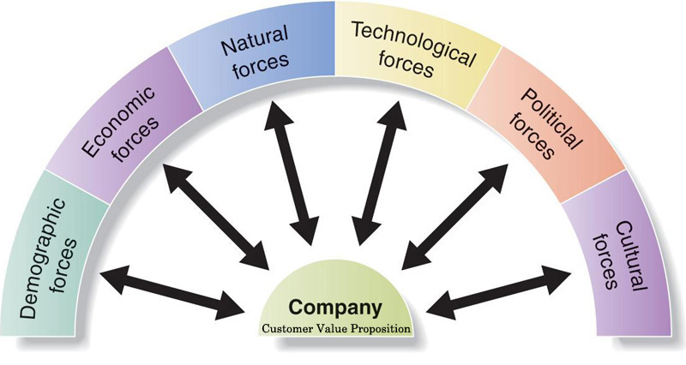
The Macro-Environment
By: Luke Bennett
Ciaron Hynes
Patrick Obispo
Padraig Mooney

Slide 2
What is the Macro-Environment?
The Macro-Environment is a broad range of factors which are external to a firm. The factors are uncontrollable and it influences decisions of a firm. The factors includes demographic, economic, technological, political and regulatory, socio-cultural, natural and consumerism.

Slide 3
Technological Factor By Luke Bennett

Slide 4
Definition
Technology can be defined as the purposeful application of information in the design, production, and utilization of goods and services, and in the organization of human activities.
Technology has a major influence nowadays on most peoples live. Businesses have had to adapt their approaches to fit in with the ever evolving world of technology. It has allowed marketers and advertisers to reach a wider audience with more of a impact with the ability to engage with the customer.
Sourced: http://www.businessdictionary.com/definiton/technology.html#ixzz2jyZNfMNU

Slide 5
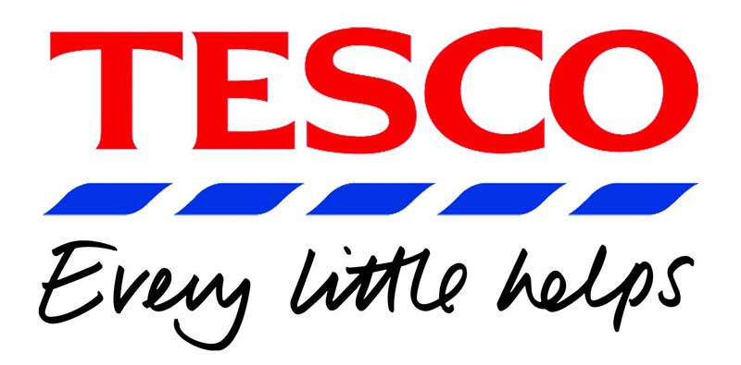
ARTICLE: Tesco’s new scanning machines
Retail giant Tesco is no new comer to technology but now it is about to change its whole system with new technology
Tesco wish install new scanning software which will allow them to scan a person and through this gain valuable marketing information.
It is based upon a persons physical features and shopping habits. By scanning a person they will be able to roughly estimate the persons age and gender.
Sourced from www.bloombergbusinessweek.com

Slide 6
Advantages of Technology in a Business
The technology will allow marketers to gain valuable information about current customer trends and shopping habits. Allowing them to best engage with the customers.
An example of how the new software will work is middle-aged woman buying gas in suburban London at 11 a.m. on a weekday might be in the mood for a coffee.
Marketers will have the necessary information to create new innovative ideas in which the best help the business.

Slide 7
Economy Factor By Ciaron Hynes

Slide 8
Definition of economy
The set of fundamental information that affects a business or an investment's value. Various economic factors need to be taken into account when determining the current and expected future value of a business or investment portfolio. For a business, key economic factors include labour costs, interest rates, government policy, taxes and management.

Slide 9
Effects of Economy on Marketers
High inflation causes people to be more cautious with their money.
Supply and Demand / Low demand + High supply = Low Prices.
Interest rates and taxes.
Prices stay the same.
Deflation is better for consumers and traders.

Slide 10
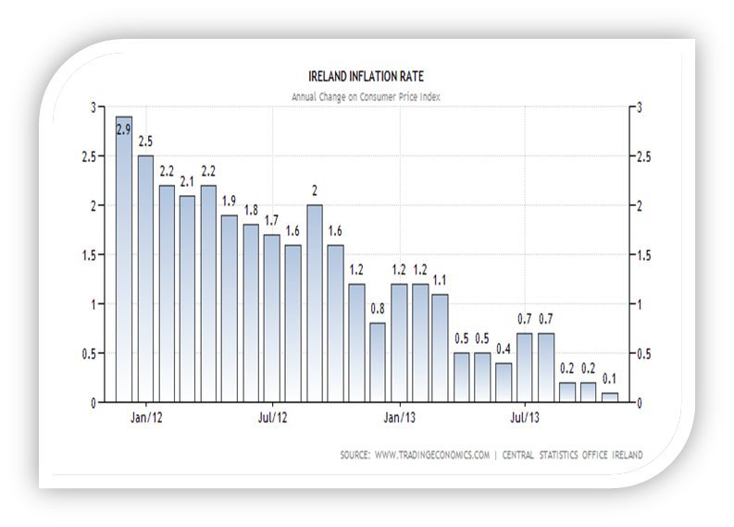
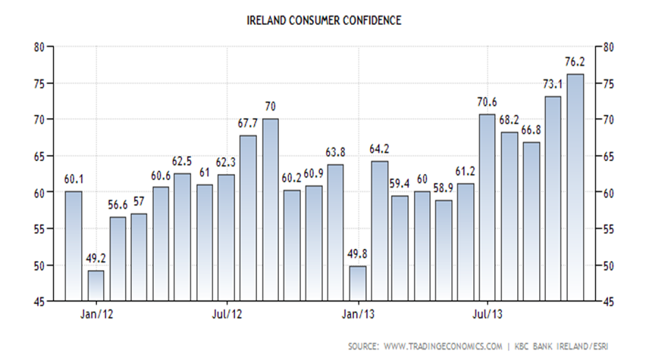

Slide 11
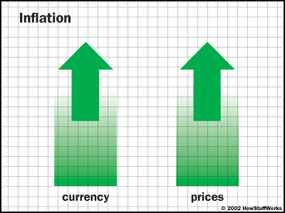
Inflation low but prices high
Ireland was the fifth most expensive EU state in 2011.
Prices were 17% above the EU average.
The GDP growth rate was 1.4 per cent in 2011.

Slide 12
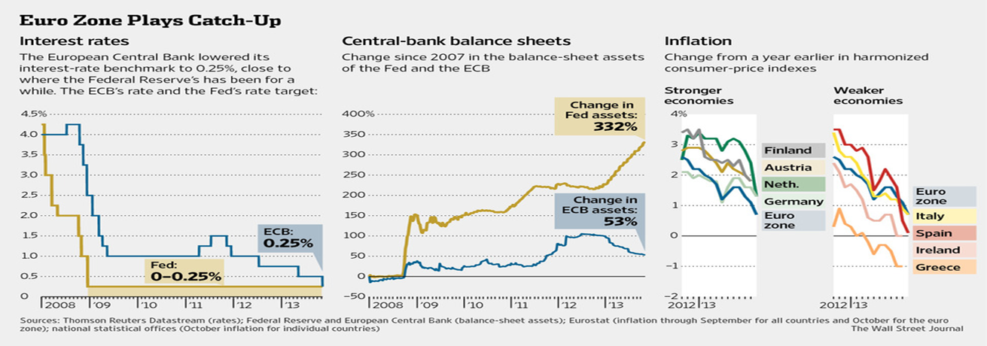
Government debt increased substantially to 108.2 per cent of GDP in 2011, the third highest debt/GDP ratio in the EU.
The employment rate (for those aged 15-64) in Ireland rose from 65.2 per cent in 2002 to 69.2 per cent in 2007, but fell to 59.1 per cent by 2012.

Slide 13
Sources
www.The Journal.ie
www.CSO.ie
www.Online.WSJ.com
www.businessdictionary.com

Slide 14
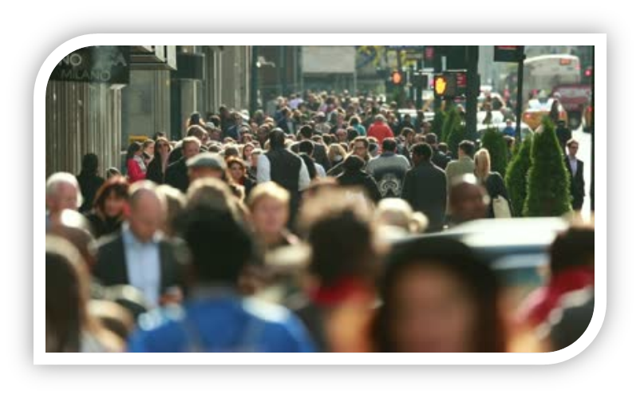
Socio-Cultural Factor By Patrick Obispo

Slide 15
What is Socio-Culture?
Socio-Culture is a mixture of social and culture factors. Socio-Culture is the evolution of an individual and it also involves the traditions, customs, beliefs and perceptions of a human being. Some of the socio-cultural changes includes decline birth rates, increased life expectancy etc.

Slide 16
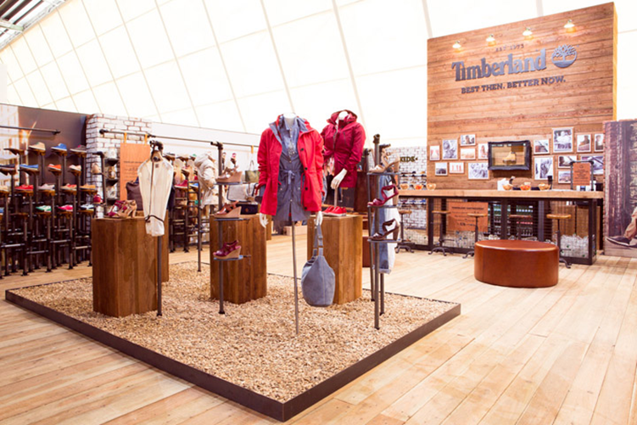
The New Timberland
Timberland has been planning to change its marketing approach and to re-launch the brand for the last two years. According to Jim Davey, the vp-global marketing at Timberland, the new campaign “Best then, Better now” is the first stepping stone in re-launching the brand. Jim Davey explained to Ad Age that they wanted to put a more stylish and modern brand and offer new styles to be more appropriate to the “millennial” customers but still keep the same reputation the brand offers before. He also stated that they have also changed their approach to creativity and media. They have now joined Twitter, Instagram, Tumblr etc. The target market has also changed. The main target for them is now 25 – 30 years old.

Slide 17
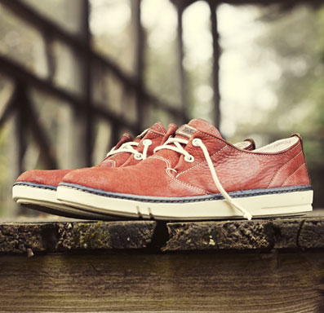
Implications for Marketers/Timberland
Marketing Timberland as a new and revamped product.

Slide 18
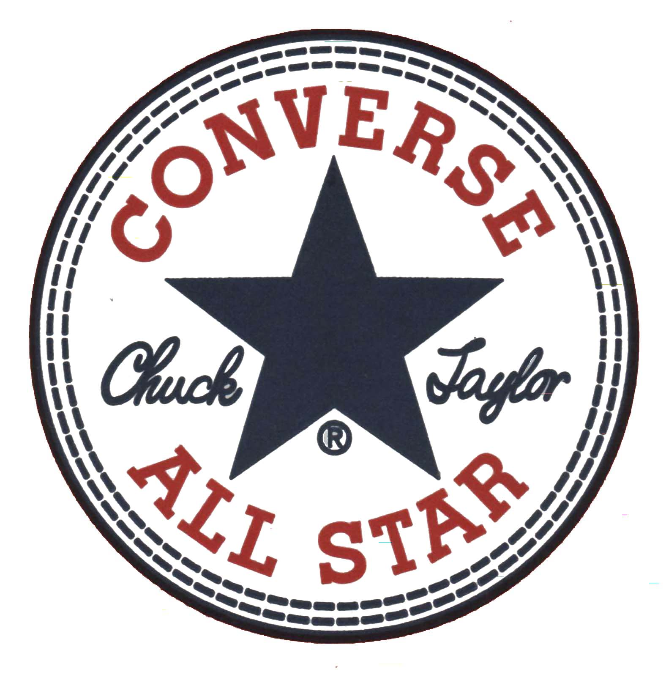
Competing against other shoe companies.

Slide 19
Sources
ARTICLE: http://adage.com/article/cmo-strategy/timberland-revamps-marketing-millennials/244492/
IMAGES: http://retaildesignblog.net/2013/07/31/bread-butter-berlin-2013-summer-timberland-by-green-room/
http://www.timberland.com/en/lookbook/

Slide 20
Demographic Factor By Padraig Mooney

Slide 21
What is Demographics?
Demographics are the statistical characteristics of human populations, such as age and income, that are used by businesses to identify markets for their goods and services.
Demographics are used to identify who your customers are (now and in the future), where they live, and how likely they are to purchase the product you are selling.
The first macro environmental force that marketers monitor is the population, because people make up the markets.
Marketers are keenly interested in the size and growth rate of population in different cities, regions and nations, age distribution and ethnic mix.
Read more:
http://www.answers.com/topic/demographics#ixzz2k95vyaYM

Slide 22
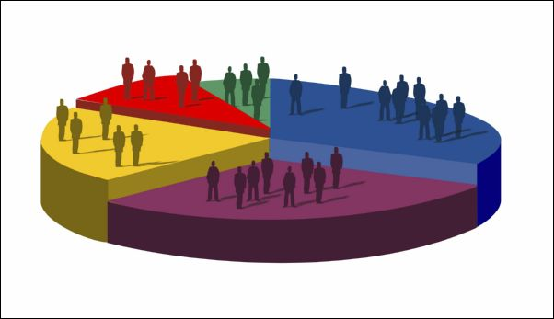
The Demographics of Health Care
For health-care marketers, knowing where people are sick is a useful data point. As part of the American Consumer Project, GfKMRI ran their 25,000 household survey data and found out the most common illnesses in different states.
But more important is what the residents there do when they get sick. This is critical for health-care marketers, clearly, but also for other sectors because the increasing dollars being spent on health-care aren't being spent on other products.

Slide 23
IMS Health recently reported that spending on medicine rose to $320 billion in 2011. According to the Bureau of Labour Statistics, health-related categories such as insurance, medications and supplies take up 6.6% of total spending, up from 5.4% in 2000. Consumers in their 20s are spending a whopping 78% more than the baby boomers did when they were in their 20s. Resource: http://adage.com/article/adagestat/demographics-health-care.

Slide 24
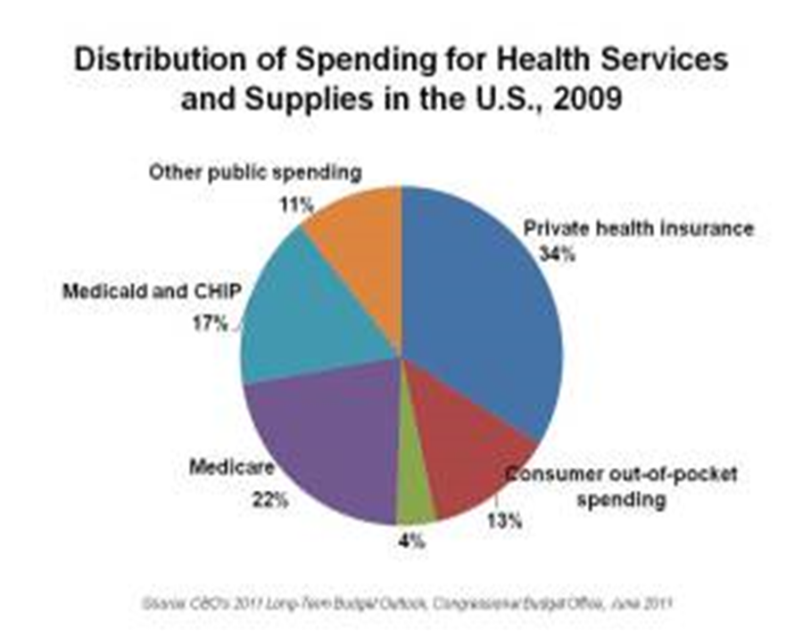

Slide 25
Thank you for listening Any questions?

