Slide 1
Web 2.0 and Social Media

Slide 2
What is Web 2.0 and Social Media?
Web 2.0 is a way of thinking about how knowledge is created, shared, managed, and leveraged using technology.
Web 2.0 is NOT a particular look, feel, or design – nor is it limited to just the Internet.
Social media are web and mobile tools used for sharing and discussing information.

Slide 3
What is Social Media?
Social Media is the umbrella term for web-based software and services that allow users to come together online and exchange, discuss, communicate, and participate in any form of social interaction.
This interaction can encompass text, audio, images, video, and other media, individually or in any combination.

Slide 4
What is Social Media?
It can involve:
The generation of new content
The recommendation of and sharing of existing content
Reviewing and rating products, services and brands
Discussing current issues
Pursuing hobbies, interests and passions.
Sharing of experience and expertise.

Slide 5
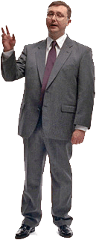
Web 1.0 vs. Web 2.0
Web 1.0 was about reading
Web 2.0 is about writing
Web 1.0 was about owning
Web 2.0 is about sharing
Web 1.0 was about companies
Web 2.0 is about communities
Web 1.0 was about home pages
Web 2.0 is about blogs
Web 1.0 was about portals
Web 2.0 is about RSS and syndication
Web 1.0 was about taxonomy
Web 2.0 is about “tags” and folksonomy
Web 1.0 was about Netscape
Web 2.0 is about Google
Web 1.0 was about wires
Web 2.0 is about wireless
Web 1.0 was about dialup
Web 2.0 is about broadband
Adapted from www.joedrumgoole.com

Slide 6
Social media is a conversation between people…
Supporters Participants Audiences
Donors Thought Leaders
And guess what?
The conversation is NOT controlled…
Not organized…
Not on message…

Slide 7
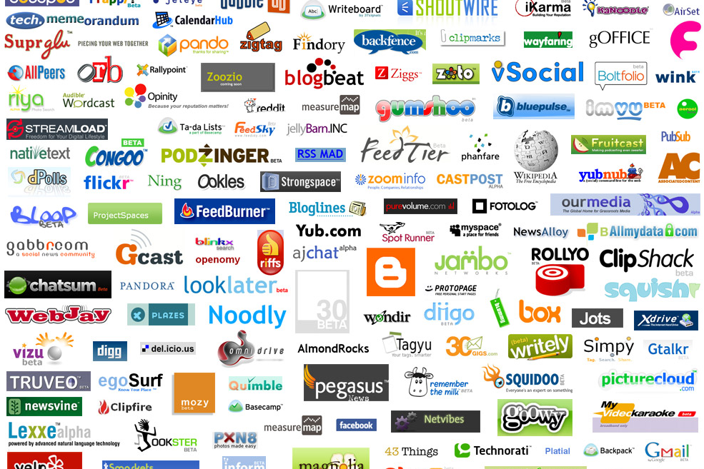

Slide 9
SOCIAL MEDIA USE IS GROWING
184 million bloggers
73% of active online users have read a blog
45% have started their own blog
57% have joined a social network
55% have uploaded photos
83% have watched video clips
39% subscribe to an RSS feed
Source: Universal

Slide 10
Why Now?
Better access to technology for the average user – higher speed Internet connections, faster computers, better cell phones, etc
Millennials are known as “digital natives,” having lived with the internet all of their lives.
Young people are beginning to expect and demand their employers and others to use online media to recruit, communicate, engage, and manage knowledge.

Slide 11
Why does it matter?
Web 2.0 and social media technologies are about connecting people information and each other so they can better create and collaborate.
This user-driven form of community development is becoming an essential driver of civic engagement.
We need to be in touch with how our constituents interact and communicate both with us and each other.
Web 2.0 and social media technologies will help strengthen and enhance traditional communication and recruitment strategies.

Slide 12
Web 2.0 major breakthroughs
The three major breakthroughs of Web 2.0 are:
Blurring the distinction between content consumers and content providers.
Moving from media for individuals towards media for communities.
Blurring the distinction between service consumers and service providers

Slide 13
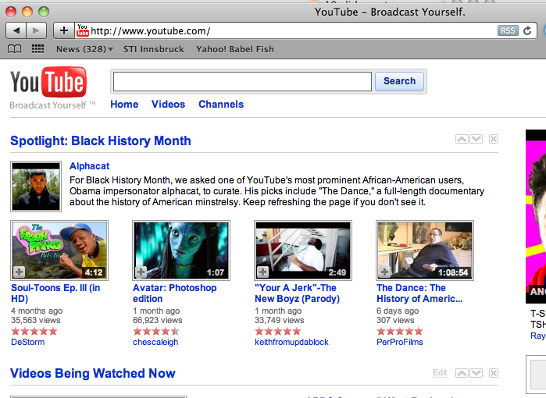
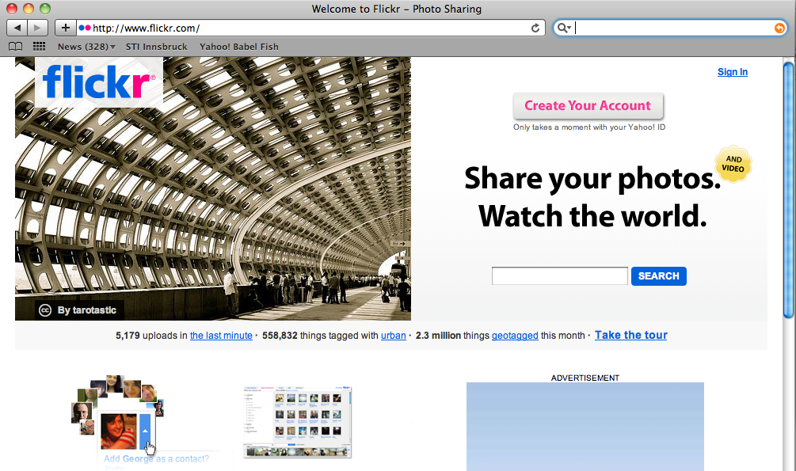
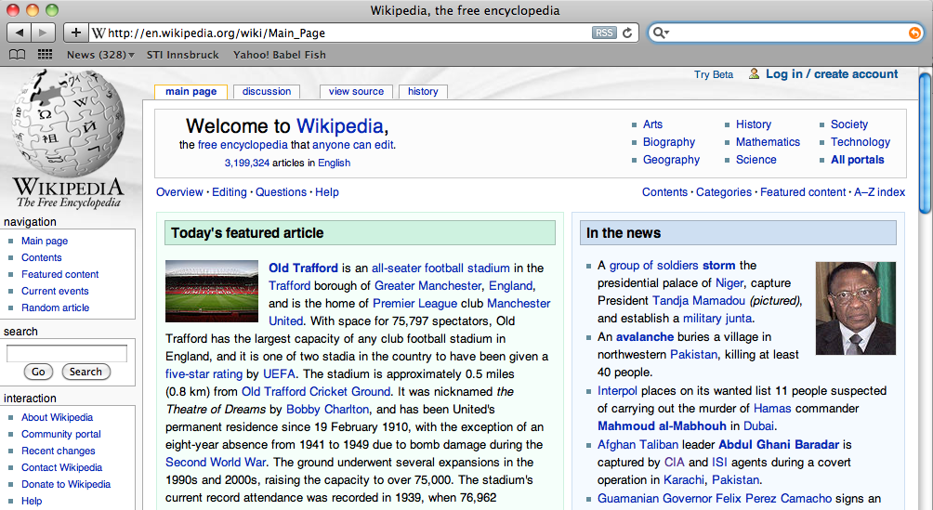
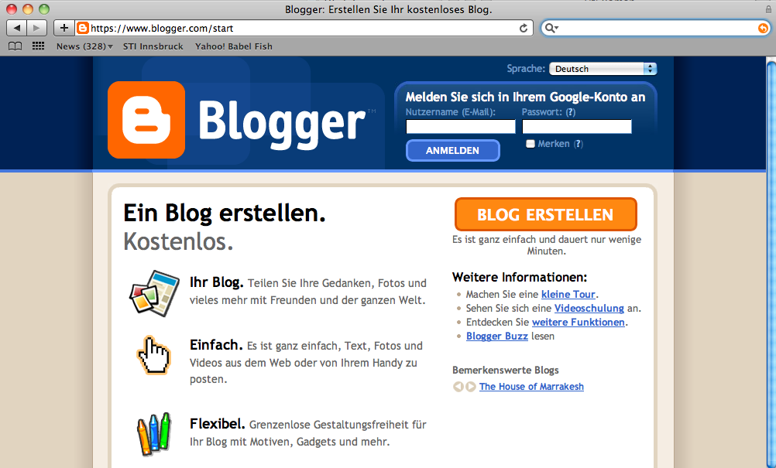
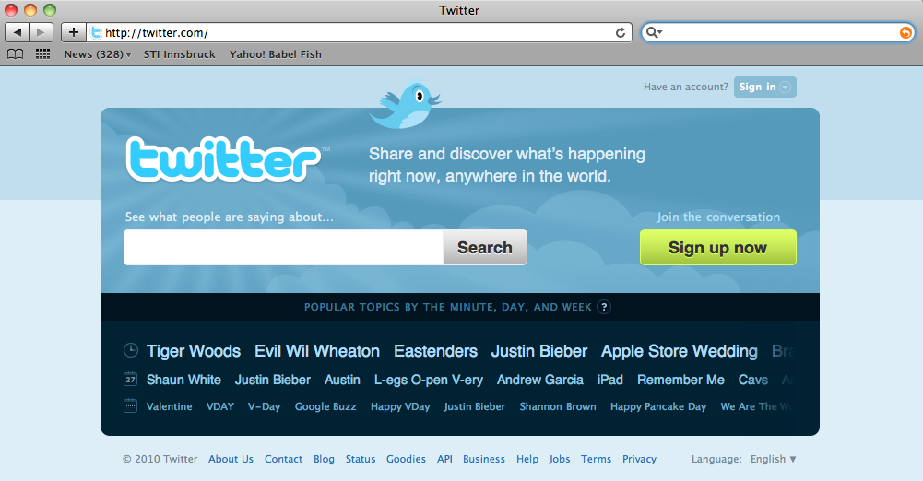
1. Blurring the distinction between content consumers and content providers
Wiki, Blogs, and Twiter turned the publication of text in mass phenomena, as flickr and youtube did for multimedia

Slide 14
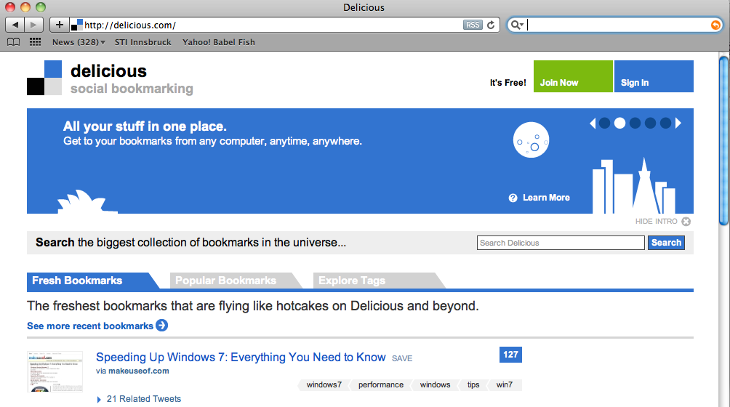
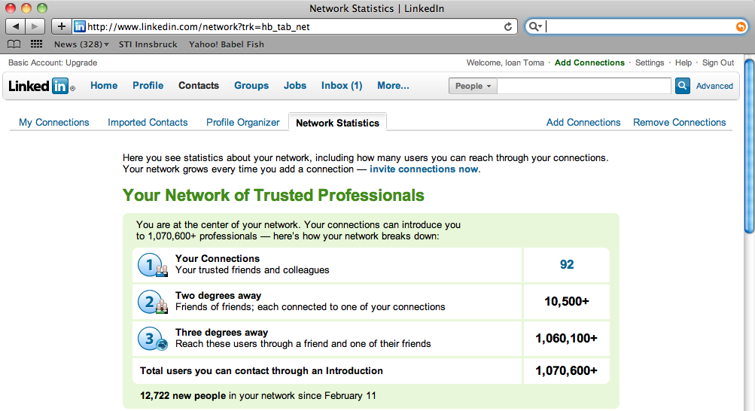
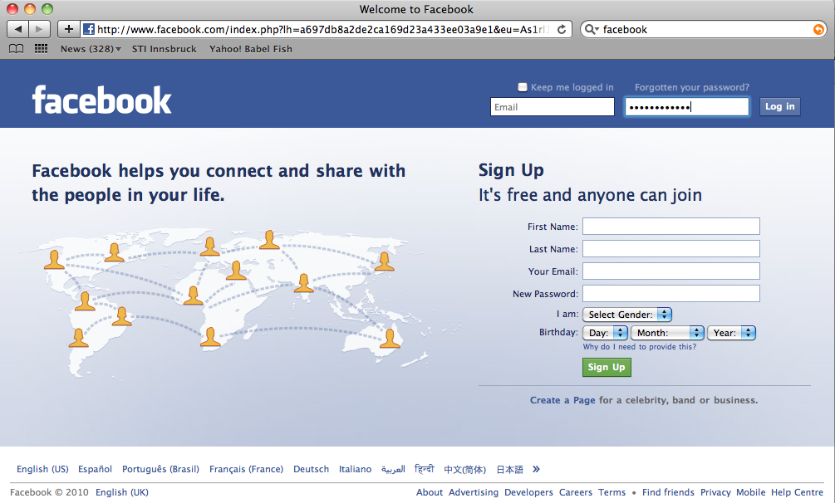
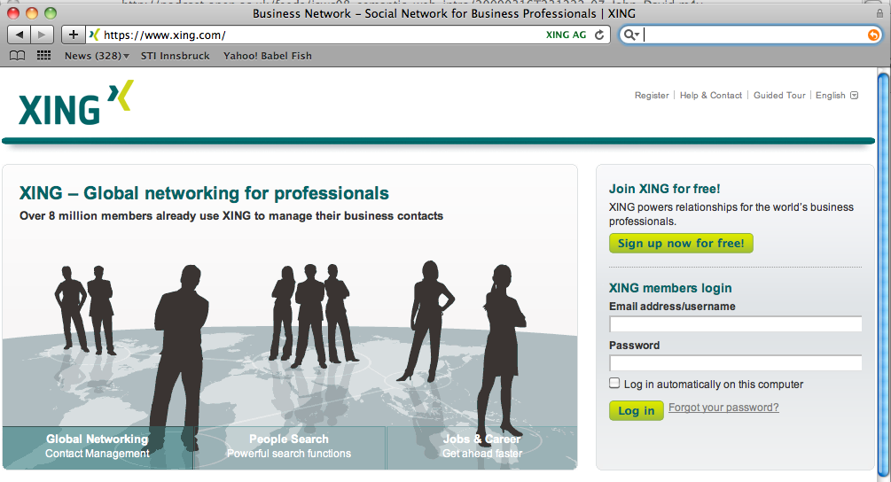
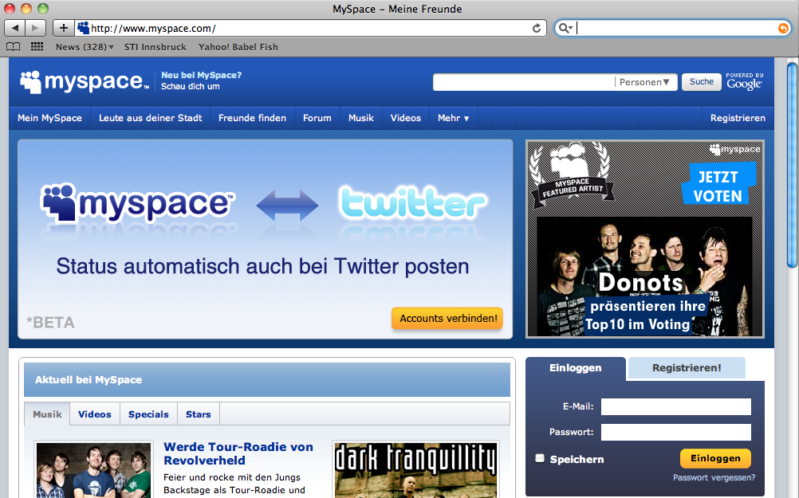
2. Moving from a media for individuals towards a media for communities
Social web sites such as del.icio.us, facebook, FOAF, linkedin, myspace and Xing allow communities of users to smoothly interweave their information and activities

Slide 15
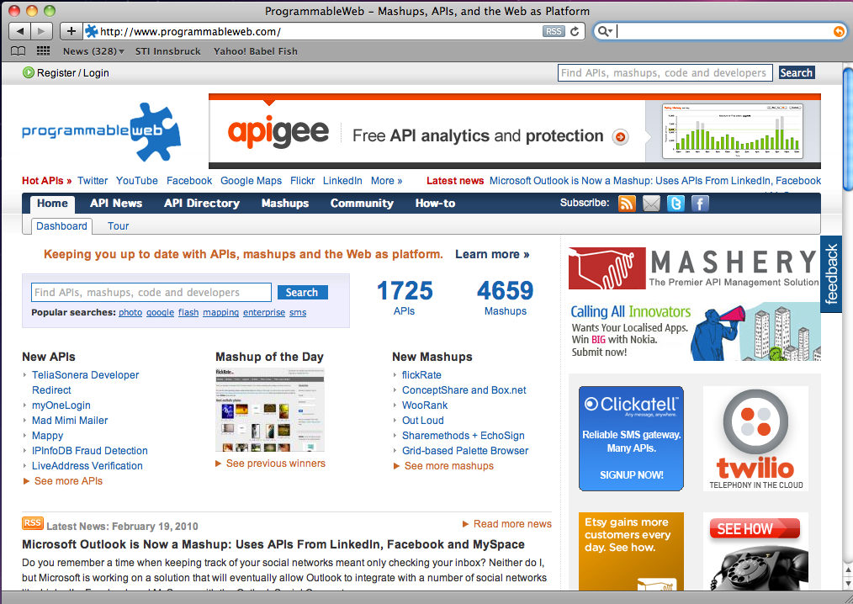
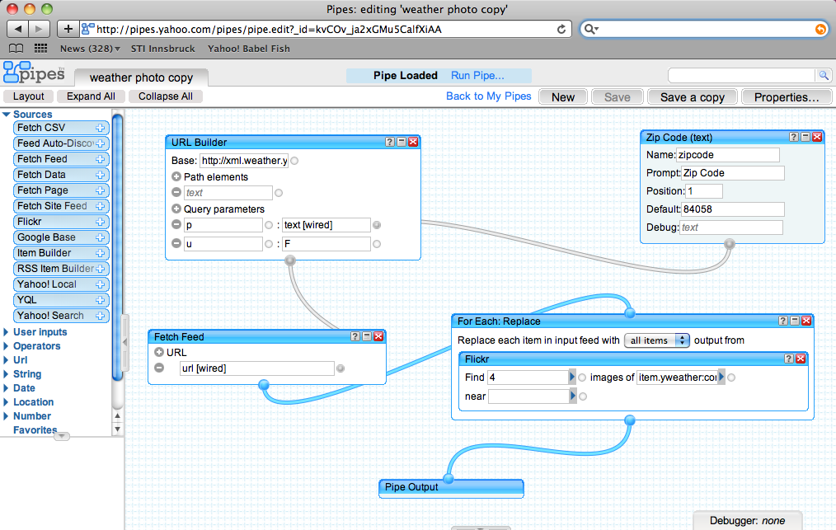
3. Blurring the distinction between service consumers and service providers
Mashups allow web users to easy integrate services in their web site that were implemented by third parties

Slide 16
Different Forms of Social Media
Social Bookmarking.
Allow users to save bookmarks to their favourite web resources (pages, audio, video, etc) and categorise them using tags.
Not dissimilar to bookmarking on a browser, but now it is the cloud so you can access them from anywhere.
You can share these with friends , colleagues etc.

Slide 17
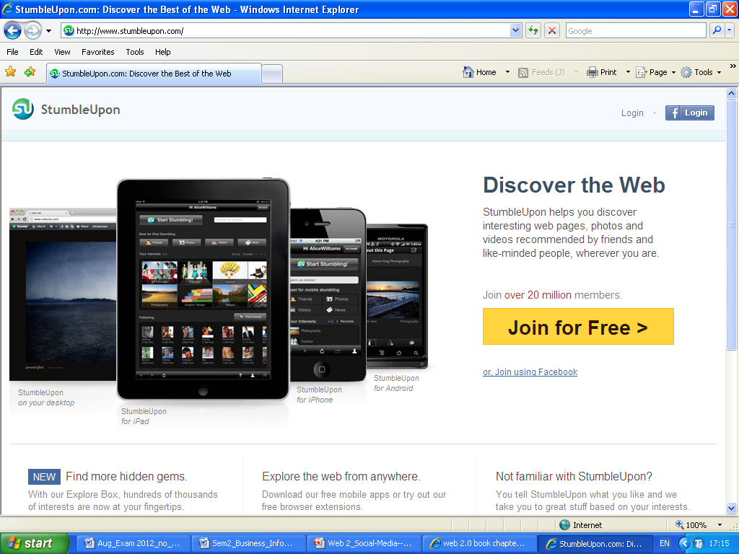
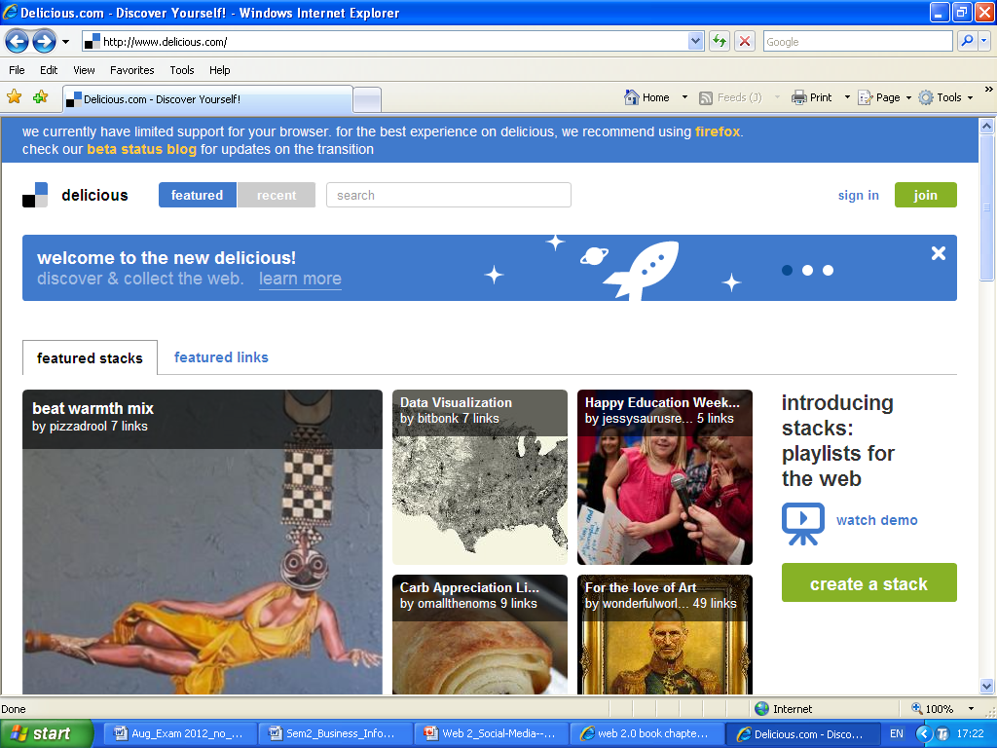
Different Forms of Social Media
Social Bookmarking.
Examples are stumbleupon.com and delicious.com

Slide 18
Different Forms of Social Media
Social Bookmarking.
What’s in it for marketers?
Amplify your exposure and traffic.
By creating compelling, useful content and making it easy for visitors to bookmark your pages (by providing ‘share this’ links or icons)
Increase your perceived relevancy and authority
The tags applied to your pages by people on social media sites can help search engines in finding your site more effectively.

Slide 19
Different Forms of Social Media
Social Media submission sites.
Similar to social bookmarking sites, only instead of saving personal bookmarks users submit articles, videos, podcasts, and other pieces of content they think the broader community would appreciate.
Viewers can vote, discuss, debate etc for items on the site.

Slide 20
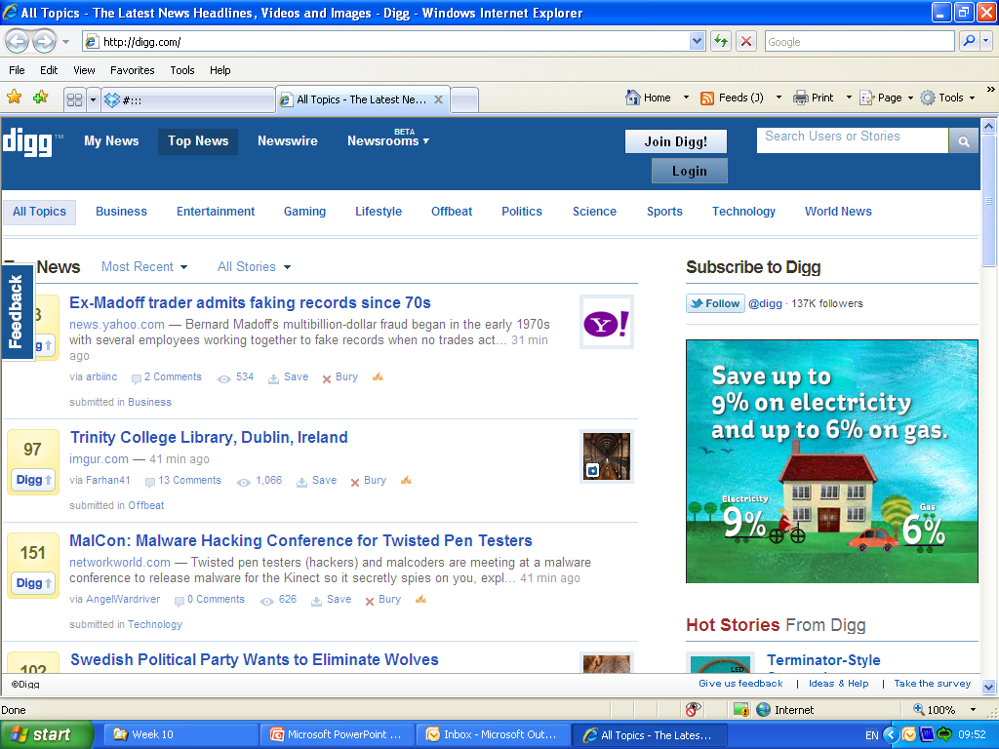
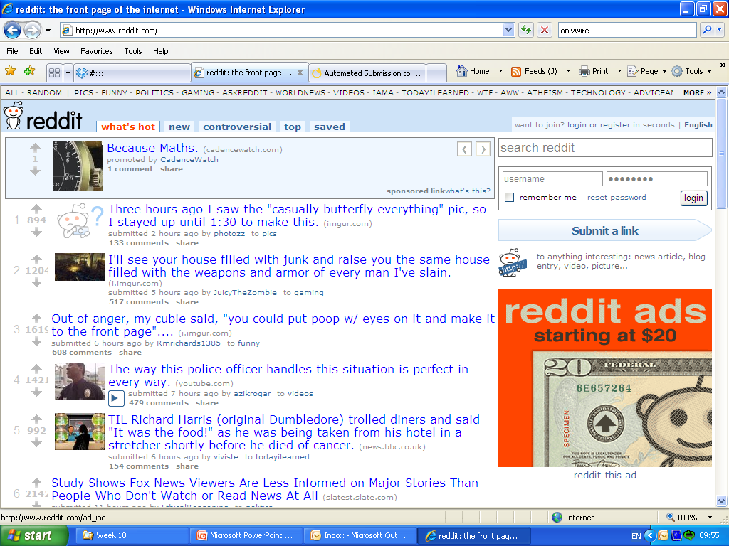
Different Forms of Social Media
Social Media submission sites.
Examples are Digg.com; Reddit.com

Slide 21
Different Forms of Social Media
Social Media submission sites.
What’s in it for marketers?
Find out what people are interested in
What type of content, in your area, people are interested in.
Amplify your exposure, traffic and online reputation.
Having articles and other content ranking highly can give you a huge boost in traffic
Raise profile and authority

Slide 22
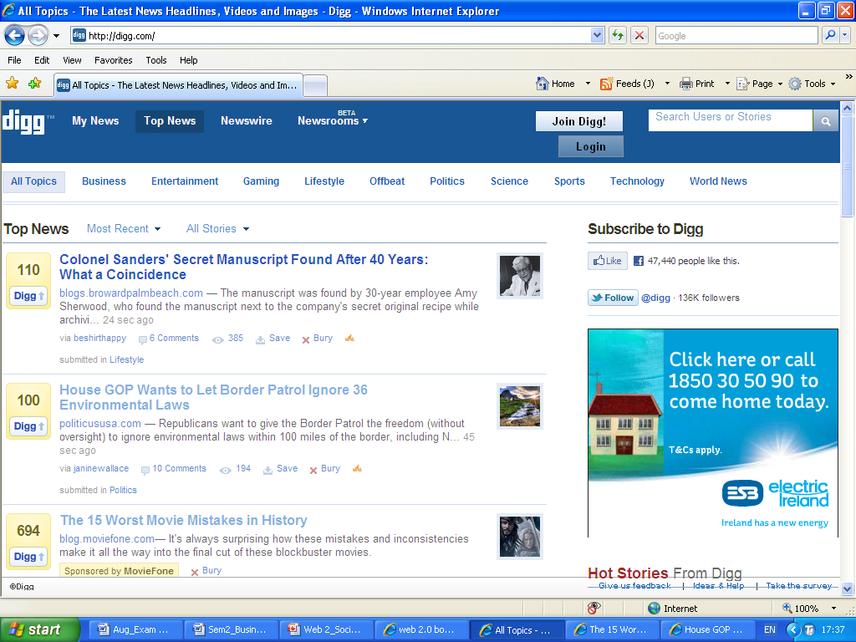
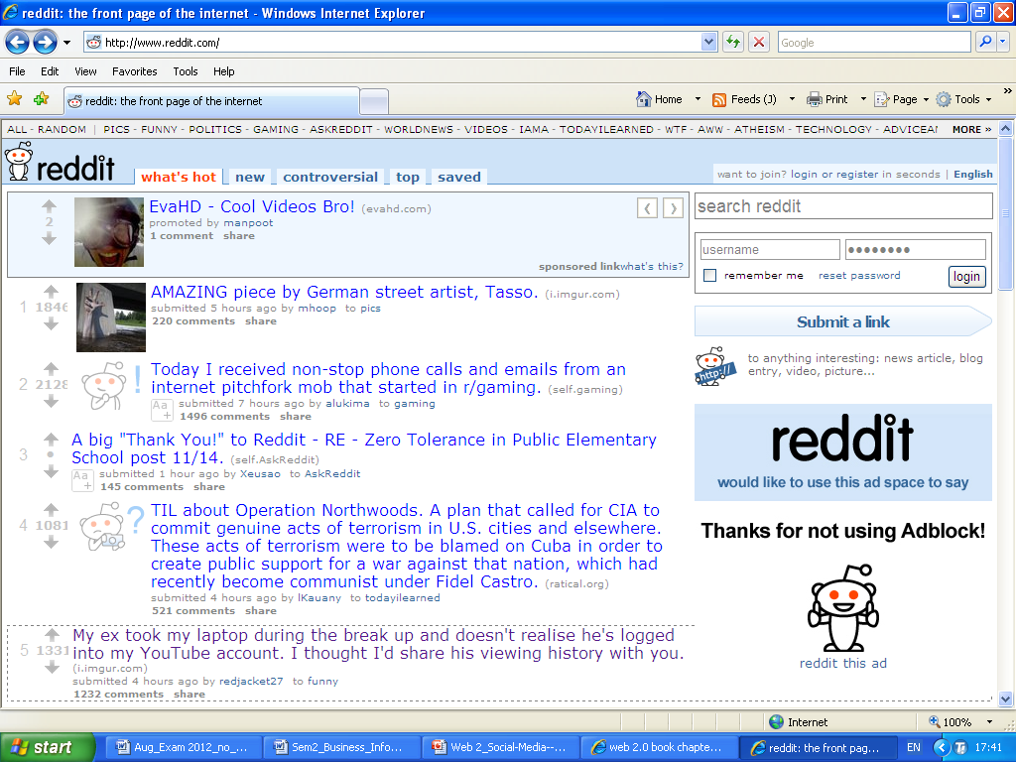
Different Forms of Social Media
Social Media submission sites.

Slide 23
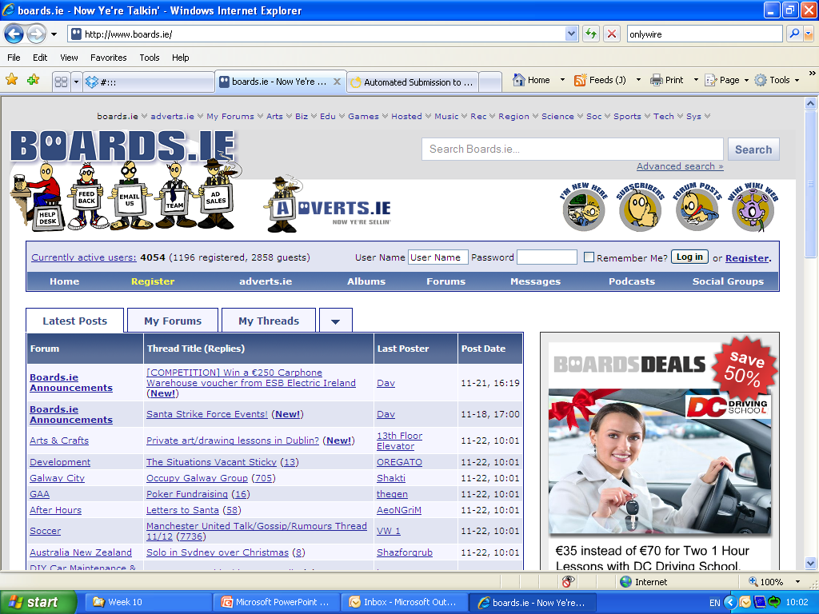
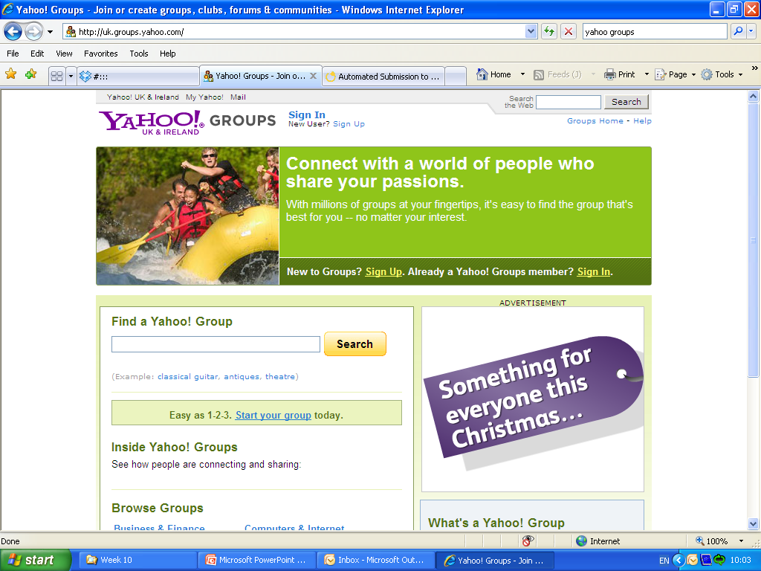
Different Forms of Social Media
Forums and Discussion sites.
Have been around since the early days of the internet.
Examples are boards.ie; Yahoo groups

Slide 24
Different Forms of Social Media
Forums and Discussion sites.
What’s in it for marketers?
Get closer to the customers
What your customer are saying
Raise your profile
Contribute to discussions, offer help and advice
Nip bad comments in the bud
Spot potentially negative comments and conversations, and be proactive in resolving them.

Slide 25
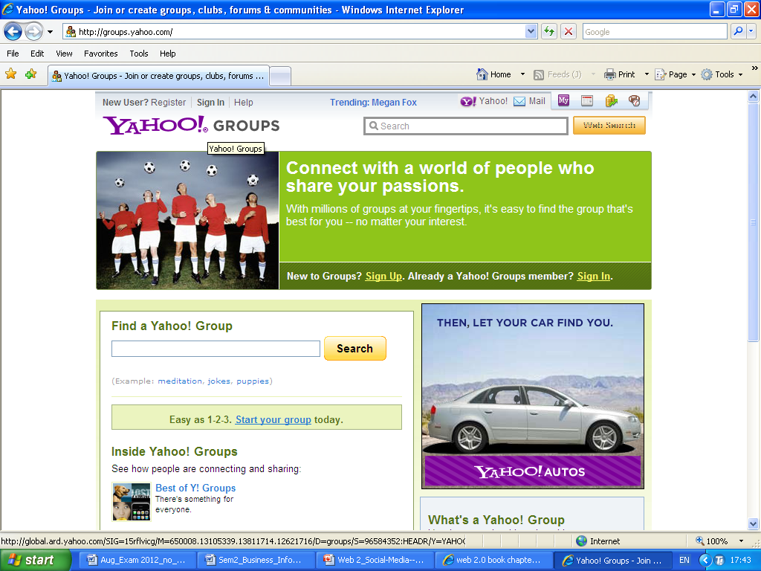
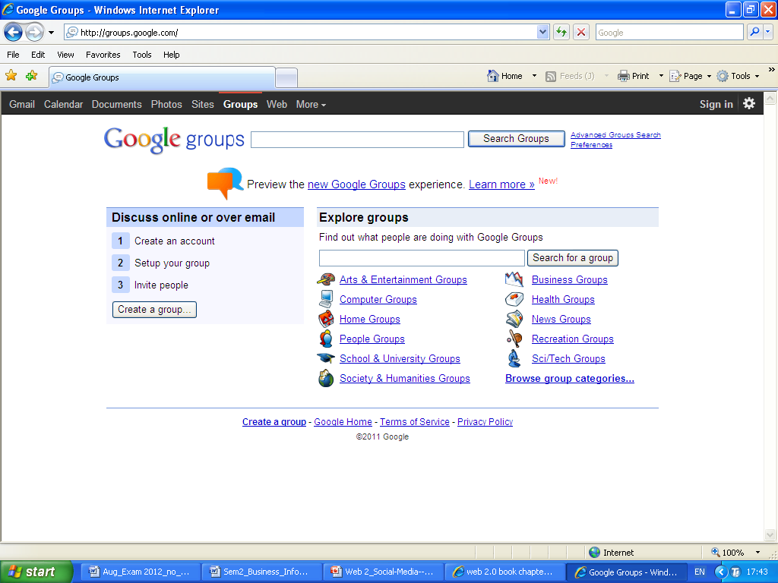
Different Forms of Social Media
Forums and Discussion sites.

Slide 26
Different Forms of Social Media
Media sharing sites.
Very Popular. Allow communities of members to upload, share, comment on and discuss their photographs, video, slides etc.
The sites typically allow you to make content publicly available or restrict access to the people you specify. You usually can embed the content to your Blog, or Website.

Slide 27
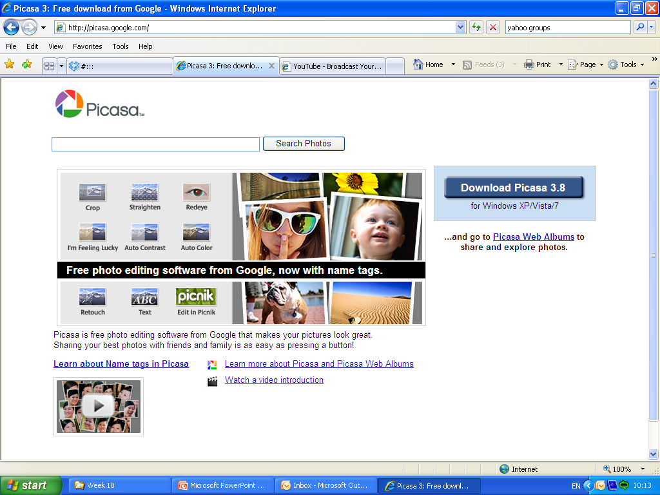
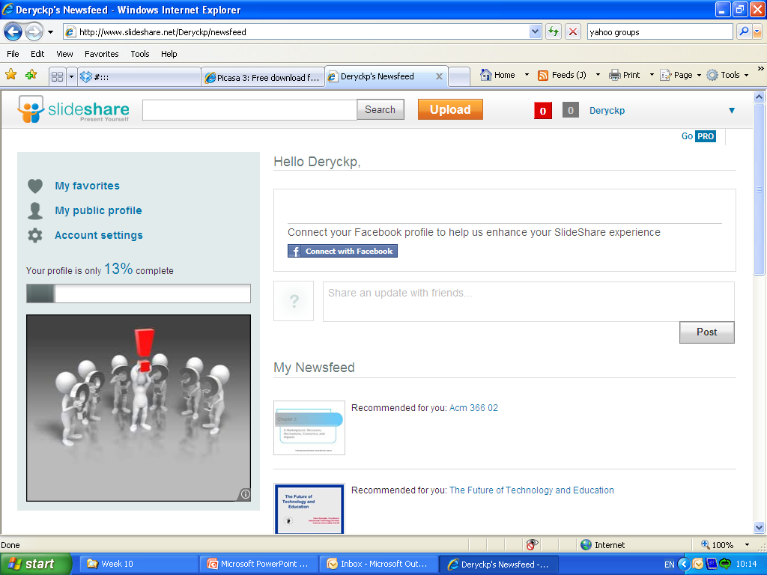
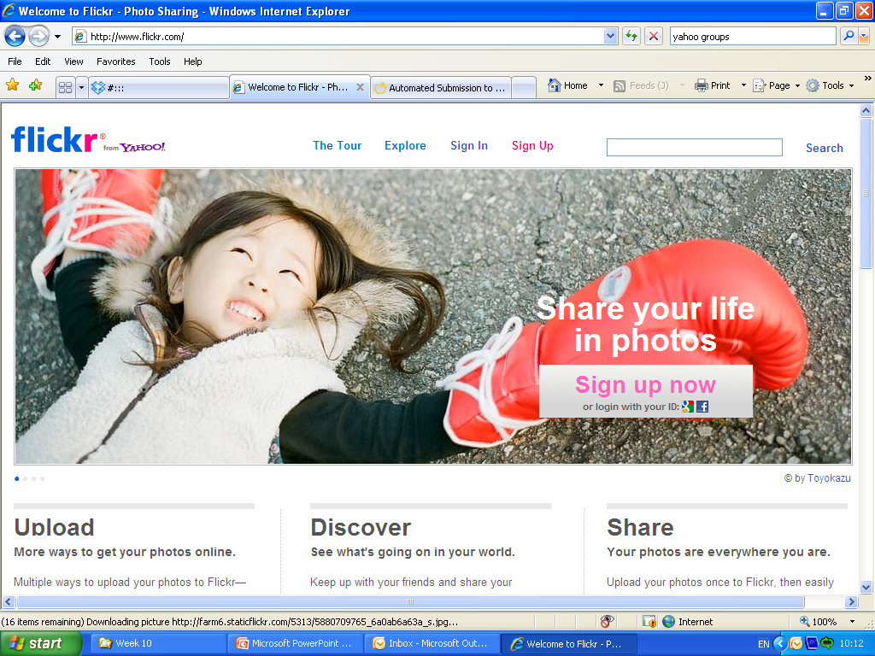
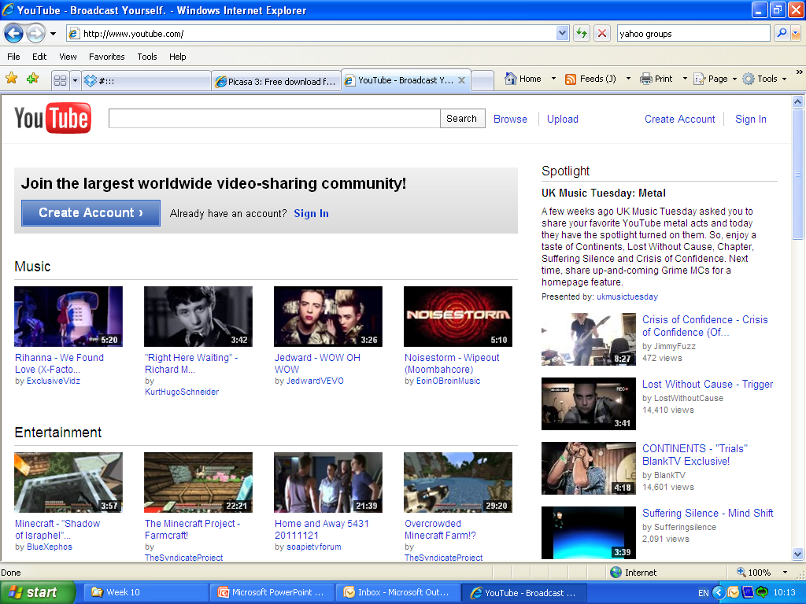
Different Forms of Social Media
Media sharing sites.
Examples
Flickr, Picassa, YouTube, Slideshare.

Slide 28
Different Forms of Social Media
Media sharing sites.
What’s in it for marketers?
Find out what your target market is watching
A ready made vehicle for content distribution
Ideal for rapid distribution of digital media
Can support other media campaigns

Slide 29
Different Forms of Social Media
Social Network sites.
These are the social media sites we think of, when we talk about social media. (facebook, Myspace etc.)
Social utilities that connect you with the people around you
Huge numbers use social media sites
Make the process of communicating with a large network of people easy and painless.

Slide 30
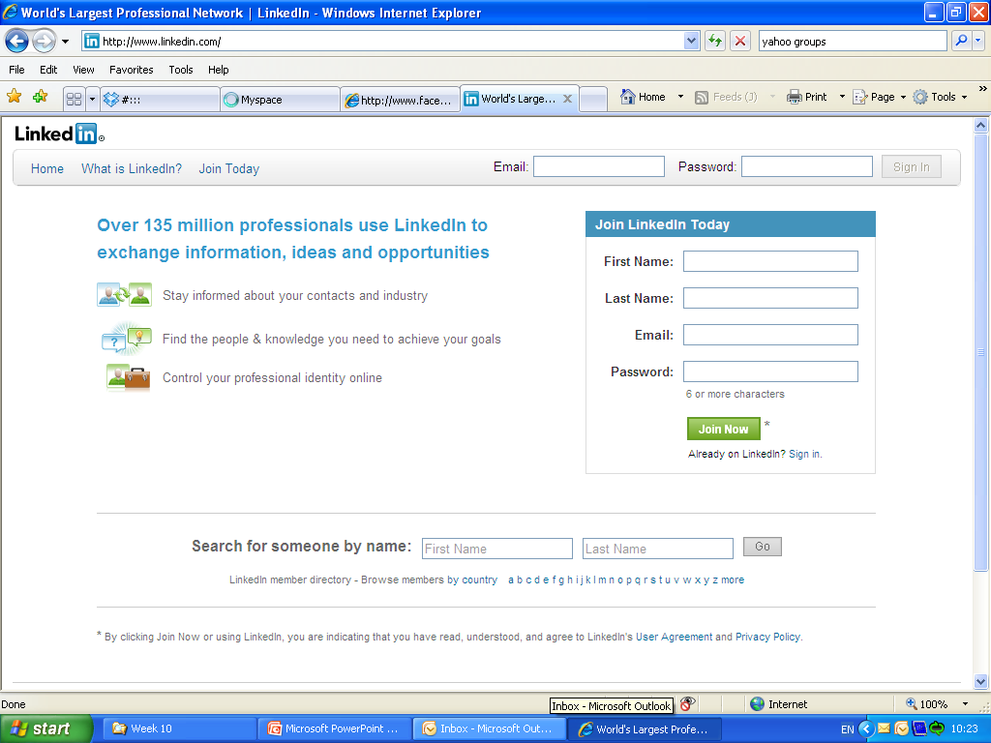
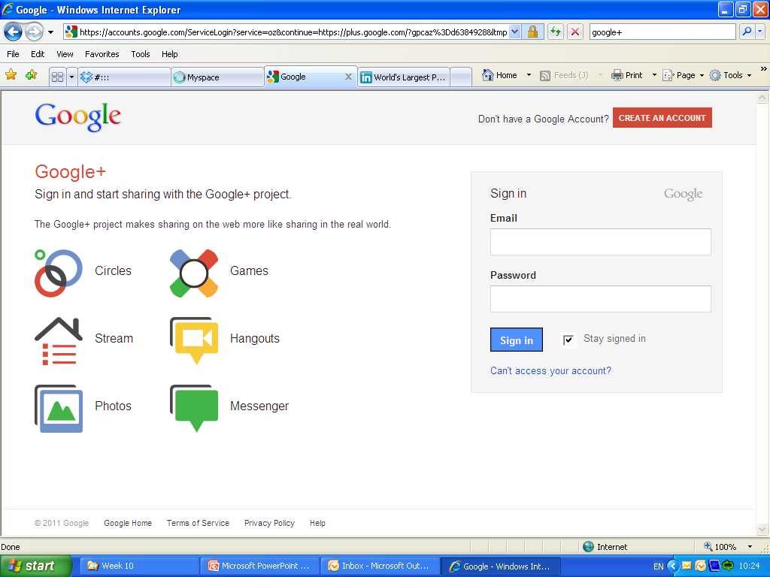
Different Forms of Social Media
Social Network sites.
Examples: Facebook, Myspace, Google+ , LinkedIn

Slide 31
Different Forms of Social Media
Social Network sites.
What’s in it for marketers?
Advertising
Offer flexible advertising options to target ads based on profile information
Improve your online exposure/reputation
Organisations can set up their own pages
Nurture brand advocates
Companies can reward people who are passionate about your products / brand

Slide 32
Different Forms of Social Media
Blogs
In the space of a very few years the widespread popularity and adoption of the blog (and acronym of weB LOG) as a medium of self-expression and communication have caused one of the most fundamental shifts in the history of modern media.
Suddenly, anyone can be a publisher.
Few if any barriers to entry

Slide 33
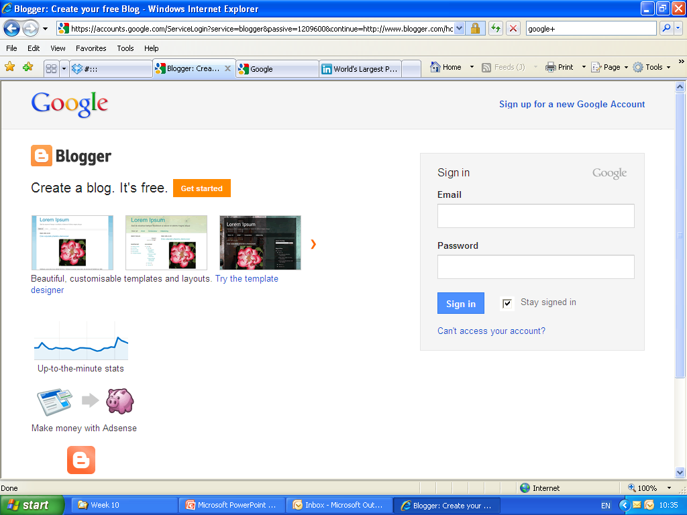
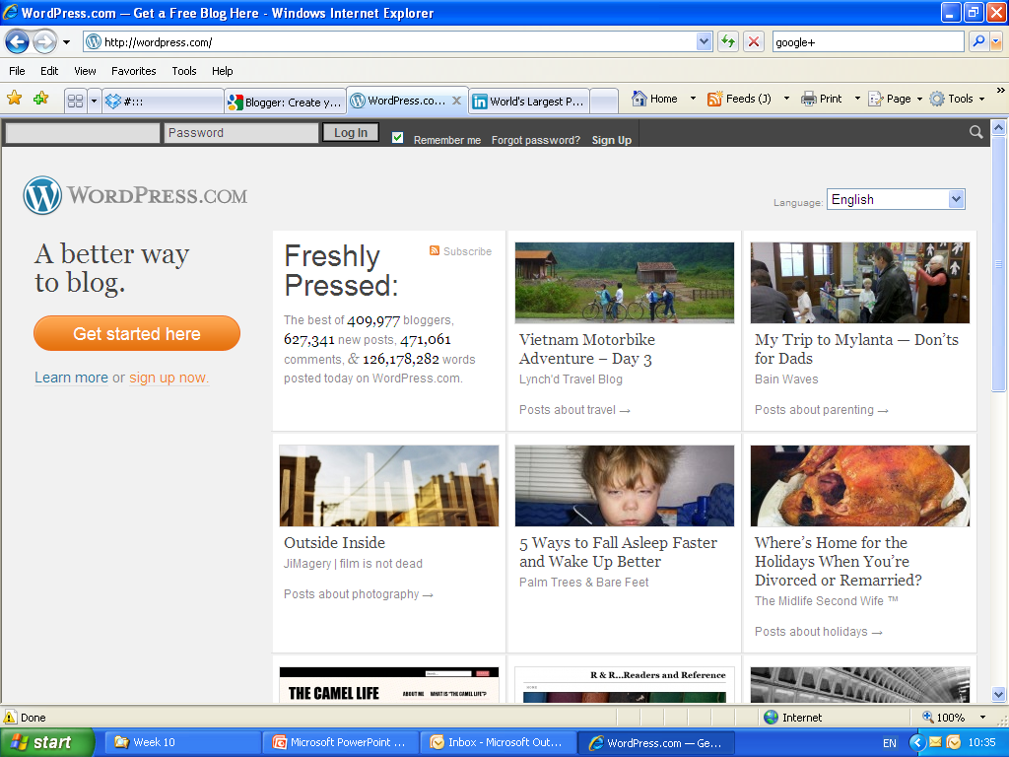
Different Forms of Social Media
Blogs
Examples
Blogger.com, WordPress.com

Slide 34
Different Forms of Social Media
Blogs
What’s in it for marketers?
Potentially massive exposure
If your press release picked up by prominent bloggers your will get online exposure, traffic and inbound links.
Consumer engagement
Companies can use their own company blogs to provide different information, improve consumer experience.

Slide 35
Different Forms of Social Media
Podcasts
Podcasts are a series of digital media files (audio or video) distributed over the internet.
They tend to be organised as chronological ‘shows’, with new episodes released at regular intervals.

Slide 36
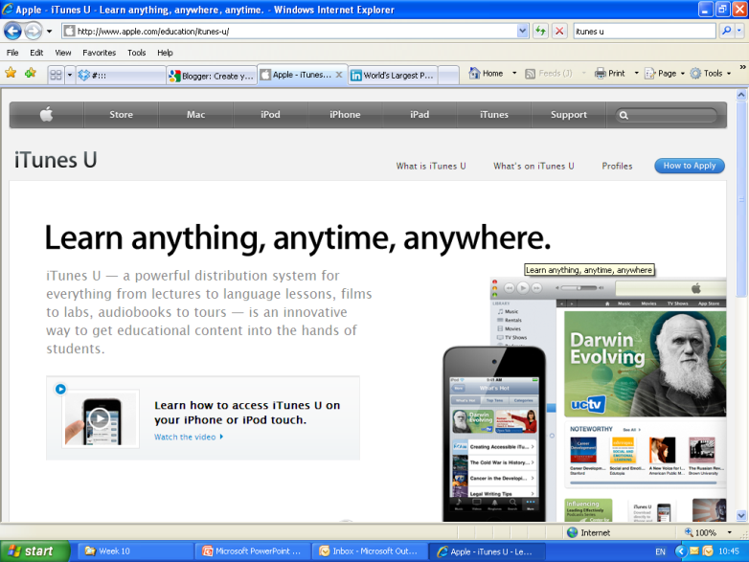
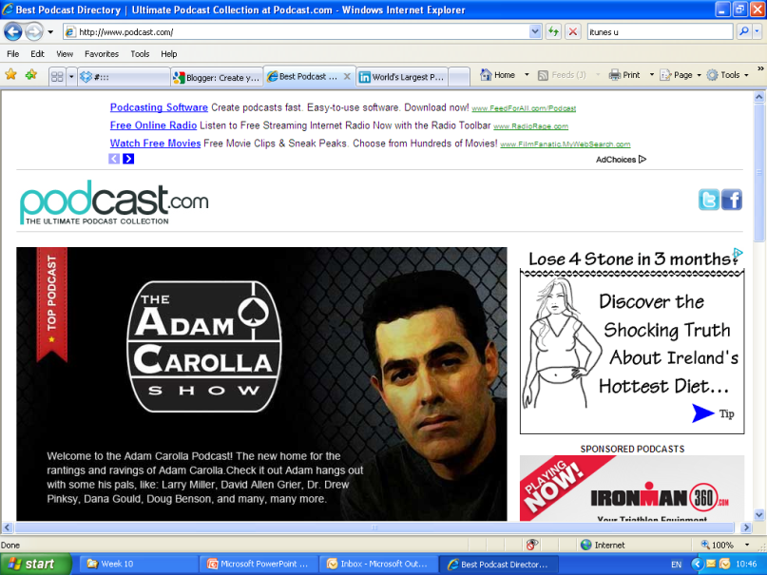
Different Forms of Social Media
Podcasts
What’s in it for marketers?
Do it yourself:
May add a valuable additional channel to reach your market.

Slide 37
Different Forms of Social Media
Micro-Blogging
Is a short-message broadcast service that let’s people keep their ‘friends’ up to date via short text posts.
Usually less than 160 characters.
The real value is not in the individual posts, but in the collective aggregation of these mini-posts into more than the sum of their parts.
Leads to understanding and a stronger connection.

Slide 38
Different Forms of Social Media
Micro-Blogging
What’s in it for marketers?
Understand the influencers
Communicate with your customers
Raise your online profile
Generate Traffic

Slide 39
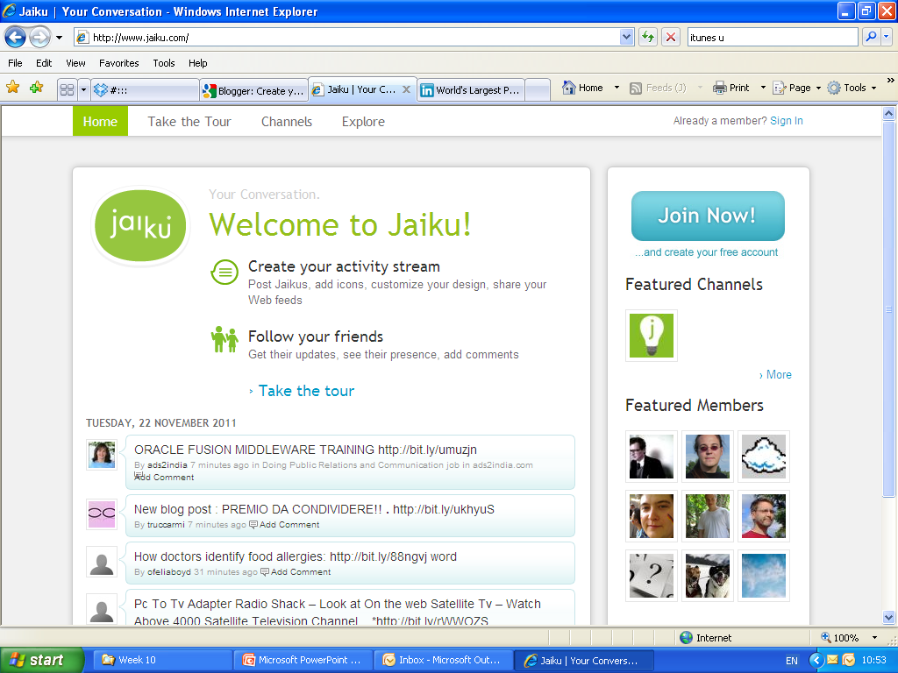
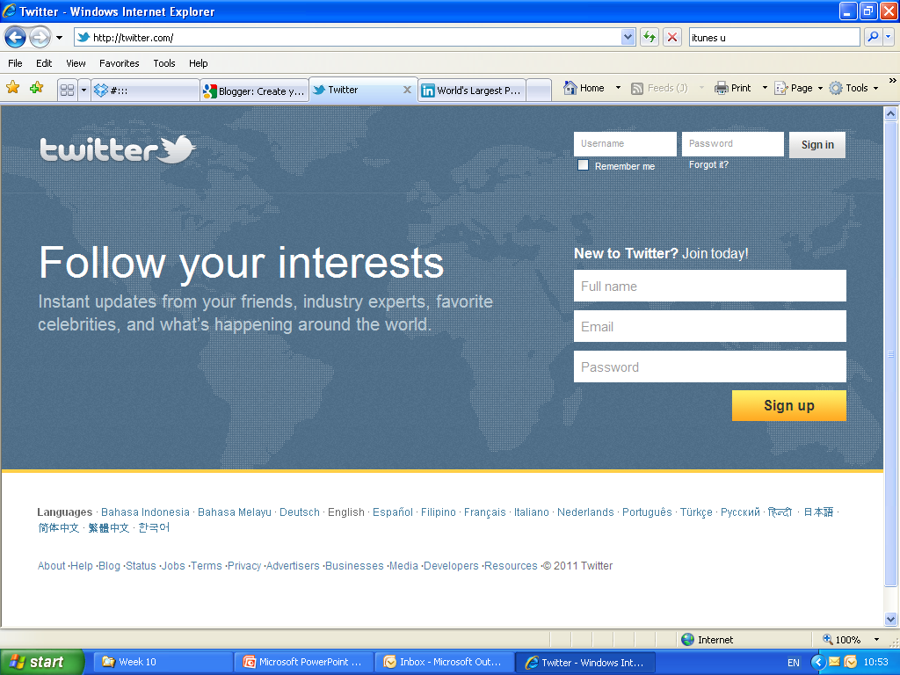
Different Forms of Social Media
Micro-Blogging
Examples:
Twitter, Jaiku

