Slide 1
Search Engines

Slide 2
What is a search engine?
Search engines use automated software programs
(spider, crawler, robot) to crawl the WWW by following
links. These software programs download web pages
into the search engine’s index (a database). Often
every word on a web page will be indexed.
Search Engine results are organized in a way that
is determined by a special algorithm to rank the
results so that the the “best”results listed first.

Slide 3
How does Google work?
Looks at how many sites link to a site (PageRank—Google’s algorithm)
Link Analysis - looks at the words people use to link to a site
Uses Web crawlers to index (and save) content
Details are a secret
The downside of popularity ranking? Reverse popularity: http://www.votefortheworst.com/

Slide 4
How do other search engines work?
Pretty much the same way…

Slide 5
How did search engines used to work(before Google) ?
From 1990-1998 (1st Generation of search tools):
Looked at title of web pages
Ranking was based on page content
Looked at number of times the search term appeared on the page
Looked at metatags

Slide 6
SEO (Search Engine Optimization)
Used by companies to get a higher result in search engines
White hat: Using legitimate techniques
Black hat: Using illegal techniques to trick the search engine, like paying sites to link to you.

Slide 7
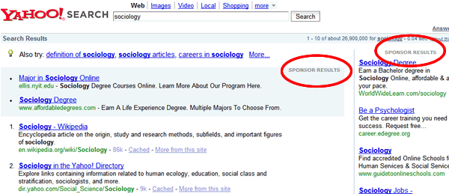
Paid results
Sometimes companies pay to have their results appear on a search results page.

Slide 8
Other types of search tools

Slide 9
Web Directories
Man-made
Organized by subject
Fewer results
See http://dir.yahoo.com/ or
http://www.dmoz.org/

Slide 10
Invisible (or Deep) Web
"Invisible Web" is the term used to describe all the information available on the World Wide Web that is not found by using general-purpose search engines.
via http://www.lagcc.cuny.edu/library/invisibleweb/definition.htm

Slide 11
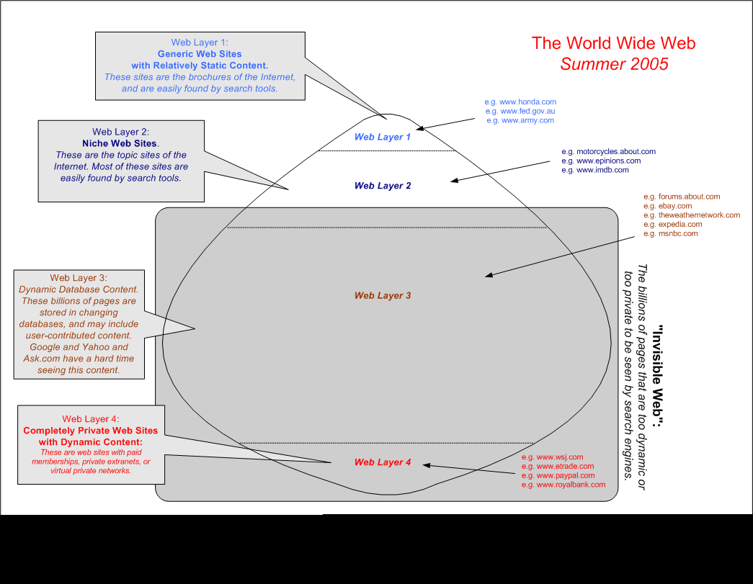
Notes:
http://netforbeginners.about.com/library/diagrams/n4layers.htm

Slide 12
Invisible Web Content
Hidden in databases
Dynamic Content
Password Protected
Proprietary Content
With more search advances happening
everyday, Invisible Web content is
becoming more and more accessible via
traditional search engines.

Slide 13
Why do you search the Invisible Web?
Find different content
Often find academic content – higher quality

Slide 14
How Google Works - Phrases
When you search for multiple keywords, Google first searches for all of your keywords as a phrase
So, if your keywords are disney fantasyland pirates, any pages on which those words appear as a phrase receive a score of X.
Image source: Google
Source: Google Hacks, p. 21

Slide 15
How Google Works - Adjacency
Google then measures the adjacency between your keywords and gives those pages a score of Y.
Image source: Google
Source: Google Hacks, p. 21

Slide 16
How Adjacency Works
A page that says
“My favorite Disney attraction, outside of Fantasyland, is Pirates of the Caribbean”
will receive a higher adjacency score than a page that says
“Walt Disney was a both a genius and a taskmaster. The team at WDI spent many sleepless nights designing Fantasyland. But nothing could compare to the amount of Imagineering work required to create Pirates of the Caribbean.”

Slide 17
How Google Works - Weights
Then, Google measures the number of times your keywords appear on the page (the keywords’ “weights”) and gives those pages a score of Z.
A page that has the word disney four times, fantasyland three times, and pirates seven times would receive a higher weights score than a page that only has those words once.
Source: Google Hacks, p. 21

Slide 18
Putting it All Together
Google takes
The phrase hits (the Xs),
The adjacency hits (the Ys),
The weights hits (the Zs), and
About 100 other secret variables
Throws out everything but the top 2,000
Multiplies each remaining page’s individual score by it’s “PageRank”
And, finally, displays the top 1,000 in order.

Slide 19
PageRank?
There is a premise in higher education that the importance of a research paper can be judged by the number of citations the paper has from other research papers.
Google simply applies this premise to the Web: the importance of a Web page can be judged by the number of hyperlinks pointing to it from other pages.
Or, to put it mathematically
Source: Google Hacks, p. 294

Slide 20
The PageRank Algorithm
Where
PR(A) is the PageRank of Page A
PR(T1) is the PageRank of page T1
C(T1) is the number of outgoing links from the page T1
d is a damping factor in the range of 0 < d < 1, usually set to 0.85
Source: Google Hacks, p. 295

Slide 21
In Summary
Google first searches for your keywords as a phrase and gives those hits a score of X.
Google then searches for keyword adjacency and gives those hits a score of Y.
Google then looks for keyword weights and gives those hits a score of Z.
Google combines the Xs, the Ys, the Zs, and a whole bunch of unknown variables, and then weeds out all but the top 2,000 scores.
Finally, Google takes the top 2,000 scores, multiplies each by their respective PageRank, and displays the top 1,000.

Slide 22
Google’s Boolean Default is AND
But there are ways to get around that.

Slide 23
Boolean Default is AND
If you search for more than one keyword at a time, Google will automatically search for pages that contain ALL of your keywords.
A search for disney fantasyland pirates is the same as searching for disney AND fantasyland AND pirates
Source: http://www.google.com/help/basics.html

Slide 24
Phrases
To search for phrases, just put your phrase in quotes.
For example, disney fantasyland “pirates of the caribbean”
This would show you all the pages in Google’s index that contain the word disney AND the word fantasyland AND the phrase pirates of the caribbean (without the quotes)
Source: http://www.google.com/help/refinesearch.html

Slide 25
Boolean OR
Sometimes the default AND gets in the way. That’s where OR comes in.
The Boolean operator OR is always in all caps and goes between keywords.
For example, an improvement over our earlier search would be disney fantasyland OR “pirates of the caribbean”
This would show you all the pages in Google’s index that contain the word disney AND the word fantasyland OR the phrase pirates of the caribbean (without the quotes)
Source: http://www.google.com/help/refinesearch.html

Slide 26
Three Ways to OR at Google
Just type OR between keywords
disney fantasyland OR “pirates of the caribbean”
Put your OR statement in parentheses
disney (fantasyland OR “pirates of the caribbean”)
Use the | (“pipe”) character in place of the word OR
disney (fantasyland | “pirates of the caribbean”)
All three methods yield the exact same results.
Source: Google Hacks, p. 3

Slide 27
Remember
Just remember, Google’s Boolean default is AND
Sometimes the default AND gets in the way. That’s where OR comes in.
Image source: http://www.phil-sears.com/

Slide 28
Capitalisation Does NOT Matter

Slide 29
Google is not case sensitive.
So, the following searches all yield exactly the same results:
disney fantasyland pirates
Disney Fantasyland Pirates
DISNEY FANTASYLAND PIRATES
DiSnEy FaNtAsYlAnD pIrAtEs
Source: http://www.google.com/help/basics.html

Slide 30
Google Has a Hard Limit of 10 Keywords
Source: Google Hacks, p. 19

Slide 31
Google’s 10 Word Limit
Google won’t accept more than 10 keywords at a time.
Any keyword past 10 is simply ignored.
How can you get around this limit? Well, first you need to remember that …
Source: Google Hacks, p. 19

Slide 32
Google Ignores a BUNCH of Common Words
Words to avoid

Slide 33
Stop Words
To enhance the speed and relevancy of your Web search, Google routinely and automatically ignores common words and characters known as “stop words.”
Source: http://www.google.com/press/guide/reviewguide_7.html

Slide 34
Stop _ _ Name _ Love
There are the 28 stop words (could be more)
a, about, an, and, are, as, at, be, by, from, how, i, in, is, it, of, on, or, that, the, this, to, we, what, when, where, which, with
You can force Google to search for a stop word by putting a + in front of it (for example pirates +of +the caribbean)
Source: 10/23/02 post by Bill Todd to news:google.public.support.general

Slide 35
Dealing with the 10 Word Limit
Omit the stop words in your search terms and you’ll probably never run into the 10 word limit.
Another way around the limit is to use wildcards.
Image source: http://www.alloyd.com/

Slide 36
Google DOES Support Wildcard Searches … Sort Of.

Slide 37
Wildcards
Wildcards are characters, usually asterisks (*), that represent other characters.
For example, some search engines support a technique called “stemming”
With stemming, you search for something like pirate* and the search engine shows you all the pages in its database that contain variants of the word pirate – pirates, pirated, etc.

Slide 38
Google and Wildcards
Google doesn’t support stemming.
Rather, Google offers full-word wildcards.
For example, if you search Google for it’s +a * world, Google shows you all of the pages in its database that contain the phrase “it’s a small world” … and “it’s a nano world” … and “it’s a Linux world” … and so on.
Source: Google Hacks, p. 37

Slide 39
it’s +a * world
The + before a is required because it is a stop word and would otherwise be ignored.
Most of the hits are phrases because that’s what Google looks for first.
Oh, and I defy you to get that song out of your head!
Image source: http://themeparksource.com/

Slide 40
Wildcards and the Word Limit
Remember when I said that one way to get around the 10 word limit was to use wildcards?
Google doesn’t count wildcards toward the limit.
For example, Google thinks that though * mountains divide * * oceans * wide it's * small world after all is exactly 10 words long.
Source: Google Hacks, p. 19

Slide 41
The Order of Your Keywords Matters
A me life for pirate’s?

Slide 42
How Google Works
When you conduct a search at Google, it searches for
Phrases, then
Adjacency, then
Weights.
Because Google searches for phrases first, the order of your keywords matters.
Image source: Google
Source: Google Hacks, p. 20-22

Slide 43
For Example
A search for disney fantasyland pirates yields the same number of hits as a search for fantasyland disney pirates, but the order of those hits – especially the first 10 – is noticeably different.

Slide 44
Part Two: In Summary
Google’s Boolean default is AND.
Capitalization does not matter.
Google has a hard limit of 10 keywords.
Google ignores a BUNCH of common words.
Google does support wildcard searches … sort of.
The order of your keywords matters.

Slide 45
Part Three: Advanced Search Operators
Beyond plusses, minuses, ANDs, ORs, quotes, and *s

Slide 46
How Google Finds New Pages
Google has special programs called spiders (a.k.a. “Google bots”) that constantly search the Internet looking for new or updated Web pages.
When a spider finds a new or updated page, it reads that entire page, reports back to Google, and then visits all of the other pages to which that new page links.
Image source: http://www.disobey.com/

Slide 47
When the spider reports back to Google, it doesn’t just tell Google the new or updated page’s URL.
The spider also sends Google a complete copy of the entire Web page – HTML, text, images, etc.
Google then adds that page and all of its content to Google’s cache.

Slide 48
So What?
When you search Google, you’re actually searching Google’s cache of Web pages.
And because of this, you can search for more than text or phrases in the body of a Web page.
Google has some secret, advanced search operators that let you search specific parts of Web pages or specific types of information.
Source: Google Hacks, p. 5

Slide 49
Advanced Operators
Query modifiers
daterange:
filetype:
inanchor:
intext:
intitle:
inurl:
site:
Alternative query types
cache:
link:
related:
info:
Other information needs
phonebook:
stocks:

Slide 50
Query Modifiers
Stuff you can add to the end your regular searches

Slide 51
daterange:
daterange: limits your search to a particular date or range of dates that a page was indexed by Google.
daterange: only works with Julian dates, so you’ll need to find a Julian date converter online.
The Julian date must be an integer (no decimals.)
Source: Google Hacks, p. 6

Slide 52
daterange:start-stop
pirates daterange:2452401-2452766

Slide 53
filetype:
filetype: restricts your results to files ending in ".doc" (or .xls, .ppt. etc.), and shows you only files created with the corresponding program.
There can be no space between filetype: and the file extension
The “dot” in the file extension – .doc – is optional.
Source: http://www.google.com/help/faq_filetypes.html

Slide 54
Google’s Official Filetypes
Adobe Portable Document Format (pdf)
Adobe PostScript (ps)
Lotus 1-2-3 (wk1, wk2, wk3, wk4, wk5, wki, wks, wku)
Lotus WordPro (lwp)
MacWrite (mw)
Microsoft Excel (xls)
Microsoft PowerPoint (ppt)
Microsoft Word (doc)
Microsoft Works (wks, wps, wdb)
Microsoft Write (wri)
Rich Text Format (rtf)
Text (ans, txt)
Source: http://www.google.com/help/faq_filetypes.html

Slide 55
filetype:extension
pirates filetype:pdf
pirates -filetype:pdf

Slide 56
inanchor:
inanchor: restricts the results to text in a page’s link anchors.
There can be no space between inanchor: and the following word.
You can also search for phrases. Just put your phrase in quotes.
Source: http://www.google.com/help/operators.html

Slide 57
Link Anchor Text?
…
<body>
<p>Pirates of the Caribbean opened March 18, 1967.</p>
<p>Please <a href=“guestbook.html”>sign our guestbook</a></p>
</body>
…

Slide 58
inanchor:terms
inanchor:guestbook
pirates -inanchor:”walt disney”

Slide 59
intext:
intext: ignores link text, URLs, and titles, and only searches body text.
intext: helps you find query words that are too common in URLs and links.
There can be no space between intext: and the following word.
You can also search for phrases. Just put your phrase in quotes.
Source: Google Hacks, p. 5

Slide 60
intext:terms
intext:disney
pirates -intext:”disney.com”

Slide 61
intitle:
intitle: restricts the results to documents containing a particular word in its title.
There can be no space between intitle: and the following word.
You can also search for phrases. Just put your phrase in quotes.
Source: http://www.google.com/help/operators.html

Slide 62
Title?
<!DOCTYPE HTML PUBLIC "-//W3C//DTD HTML 4.01 Transitional//EN">
<html> <head>
<title>
Pirates of the Caribbean
</title>
</head>
<body> ...

Slide 63
intitle:terms
intitle:pirates
pirates -intitle:”walt disney”

Slide 64
A Quick Question
What would happen if I searched for intitle:walt disney (without the quotes)?
Google would look for every page with the world walt in its title AND the word disney somewhere in its body.
Remember, the quotes are kind of important if you want to search for phrases using intitle:

Slide 65
inurl:
inurl: restricts the results to documents containing a particular word in its URL.
There can be no space between inurl: and the following word.
Source: http://www.google.com/help/operators.html

Slide 66
URL?
A URL is a uniform resource locator, a string that uses a standard syntax to identify an access protocol, location, and identifier for a file or other Internet resource.
http://www.disney.com/
http://www.google.com/
ftp://wuarchive.wustl.edu/
news:google.public.support.general
Source: http://search400.techtarget.com/newsItem/0,289139,sid3_gci850,00.html

Slide 67
inurl:term
inurl:disney
pirates –inurl:disney

Slide 68
site:
site: restricts the results to those websites in a domain.
There can be no space between site: and the domain.
Source: http://www.google.com/help/operators.html

Slide 69
site:domain
pirates site:disney.com

Slide 70
Using site:
You use site: in conjunction with another search term or phrase. pirates site:disney.com
You can also use site: to exclude sites. pirates –site:disney.com
You can use site: to exclude or include entire domains (and, like with filetype, the dot is optional). pirates –site:com pirates site:edu

Slide 71
Alternative Query Types
Stuff you can use if you want to search without using any keywords

Slide 72
cache:
cache: shows the version of a web page that Google has in its cache.
There can be no space between cache: and the URL.
You can use cache: in conjunction with a keyword or phrase, but few do.
Source: http://www.google.com/help/operators.html

Slide 73
cache:URL
cache:disney.com

Slide 74
link:
link: restricts the results to those web pages that have links to the specified URL.
There can be no space between link: and the URL.
Source: http://www.google.com/help/operators.html

Slide 75
link:URL
link:disney.com

Slide 76
related:
related: lists web pages that are "similar" to a specified web page.
There can be no space between related: and the URL.
Source: http://www.google.com/help/operators.html

Slide 77
related:URL
related:disney.com

Slide 78
info:
info: presents some information that Google has about a particular web page.
There can be no space between related: and the URL.
Source: http://www.google.com/help/operators.html

Slide 79
info:URL
info:disney.com

Slide 80
Other Information Needs
Did you know that Google can look up phone numbers and stock quotes?

Slide 81
phonebook:
There are actually three different Google phonebook operators.
phonebook: searches the entire Google phonebook.
rphonebook: searches residential listings only.
bphonebook: searches business listings only.
Source: http://www.google.com/help/operators.html

Slide 82
How to Use the Phonebook
first name (or first initial), last name, city (state is optional)
first name (or first initial), last name, state
first name (or first initial), last name, area code
first name (or first initial), last name, zip code
phone number, including area code
last name, city, state
last name, zip code

Slide 83
phonebook:Data
phonebook:disneyland ca
phonebook:(714) 956-6425

Slide 84
stocks:
If you begin a query with stocks: Google will treat the rest of the query terms as stock ticker symbols, and will link to a Yahoo finance page showing stock information for those symbols.
Go crazy with the spaces – Google ignores them!
Source: http://www.google.com/help/operators.html

Slide 85
stocks:Symbol1 Symbol2 …
stocks: msft
stocks: aapl intc msft macr

