Slide 1
Week 4
Classwork Assignment

Slide 2
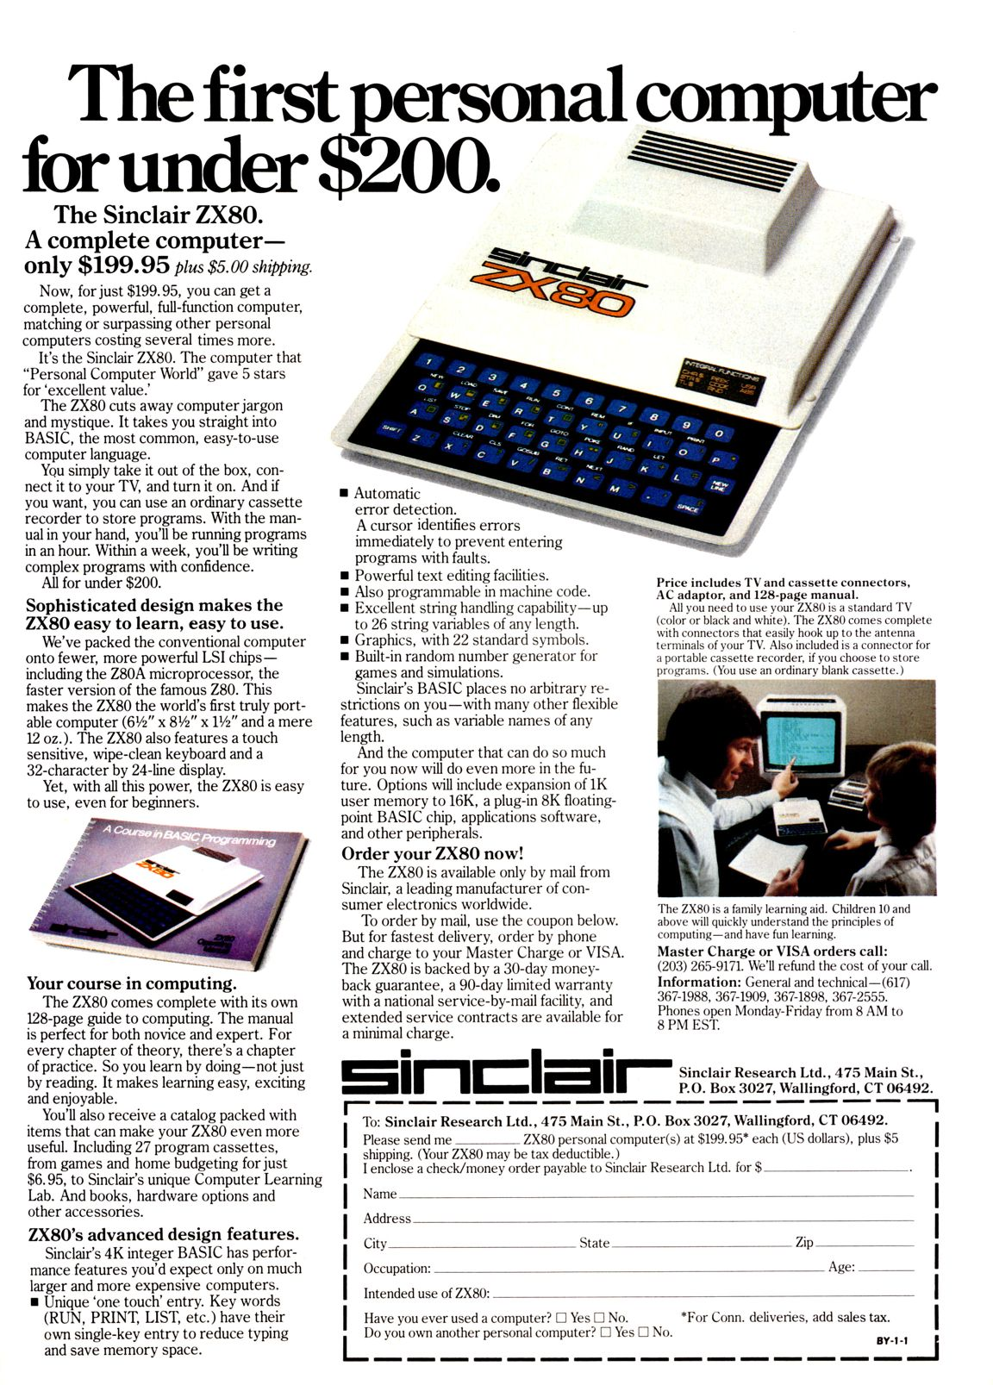
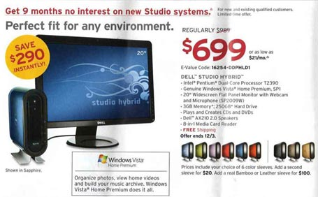
1981 to Now

Slide 3
Look at Specifications for TSR80 Original IBM pc and Apple Macbook air
http://www.computercloset.org/TRS80Model1.htm
http://www.computercloset.org/IBMPC.htm
http://www.apple.com/uk/macbookair/specs.html
What capacity the Ram or Memory of Each?
What type and capacity of external storage do each have?
What capacity is the external storage?

Slide 4
Write answers on word document
Upload to week 4 on Moodle

